Slide 1
How to Develop and Use Rubrics
Modified from a presentation given by Mary J. Allen

Slide 2
Rubrics can be used to classify student essays, research reports, projects, performances, works of art, oral presentations, portfolios, and group activities. They are powerful tools that can both give feedback to students as well as collect data for assessment.

Slide 3
Rubrics are used to classify materials that vary along a continuum, and the use of rubrics can reduce the subjectivity of grading and assessment.

Slide 4
There are two major types of scoring rubrics:
Holistic scoring, which produces one global, holistic score. This is the type of rubric that we use for the GWE scoring and for the English 350 readings.
Analytic rubrics, which produce separate, holistic scoring of specific characteristics of student work. These can be very useful in extracting data on student learning outcomes.

Slide 5
The following are 4-point and six-point holistic rubrics for critical thinking.

Slide 6
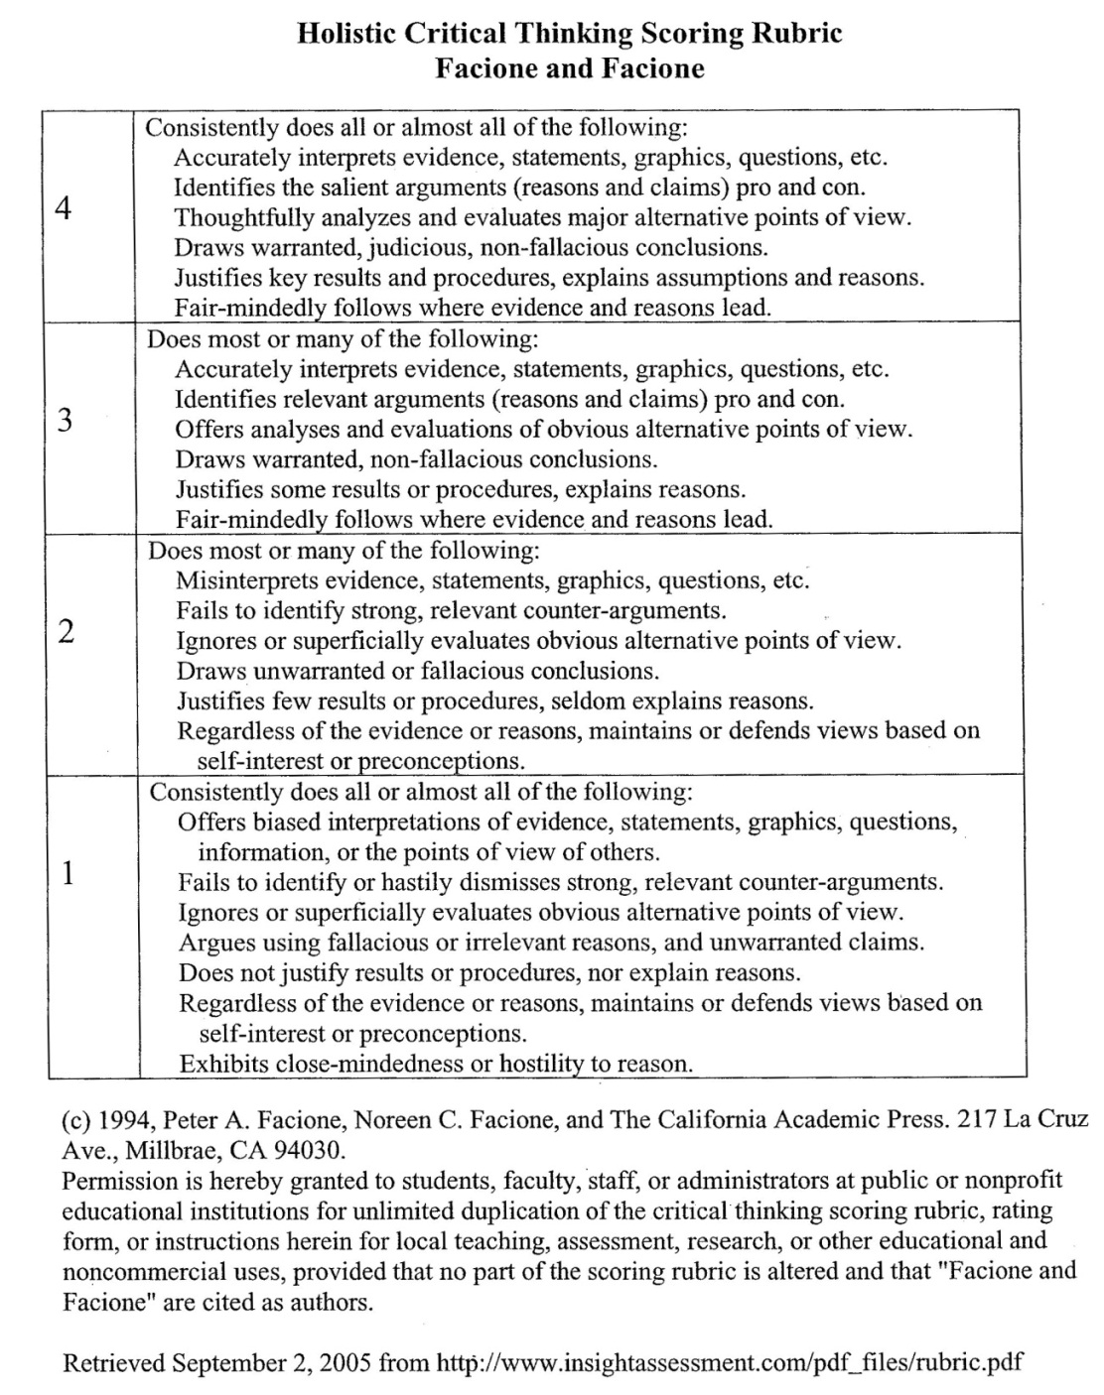
Holistic Critical Thinking Scoring Rubric Facione and Facione

Slide 7
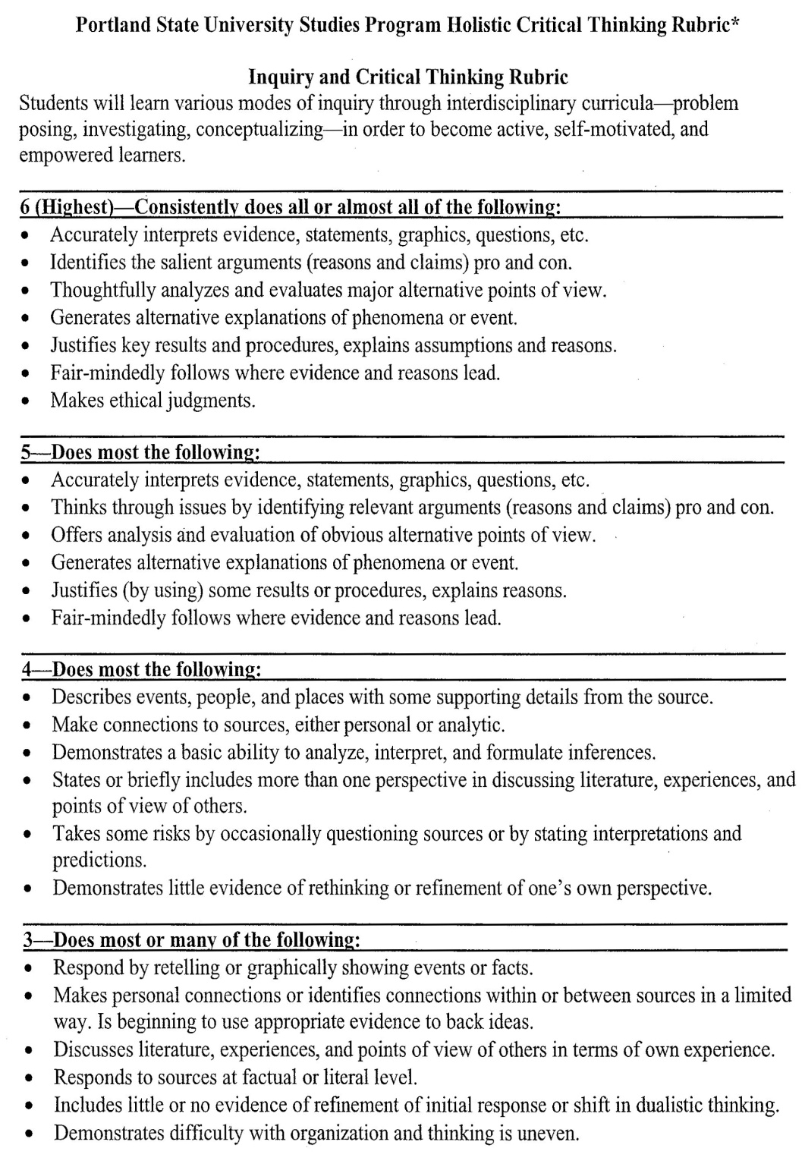
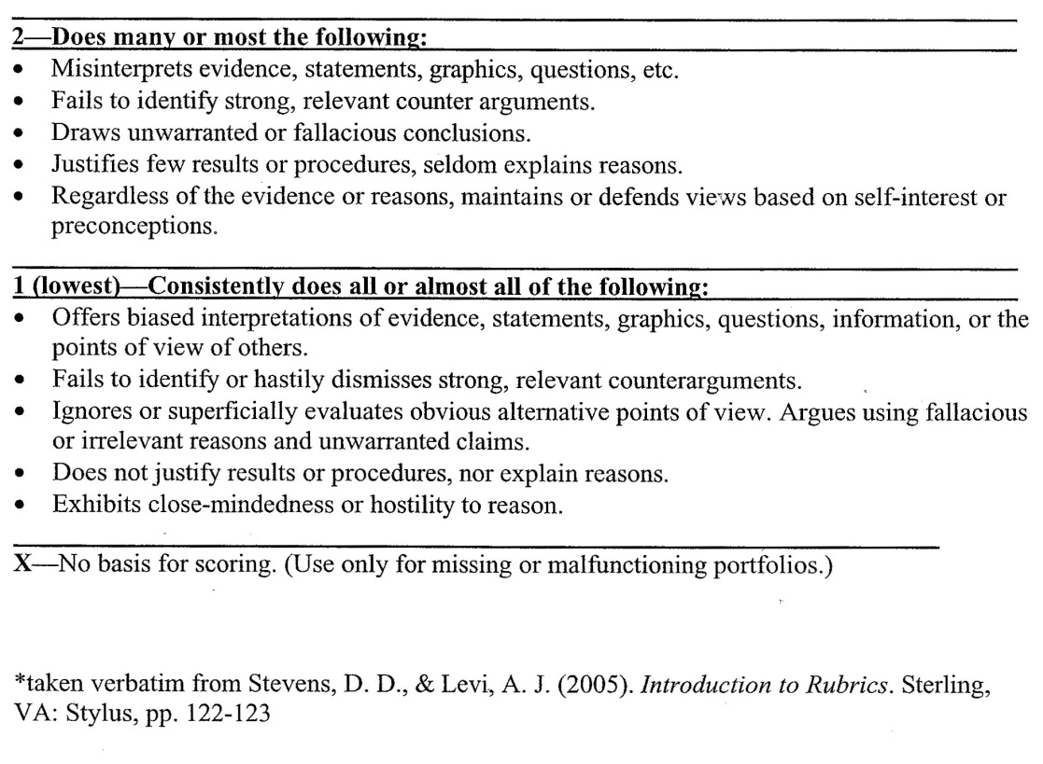
Portland State University Studies Program Holistic Critical Thinking Rubric

Slide 8
GWE Rubric CSUDH; Holistic scoring
6 Superior A 6 essay demonstrates superior writing, but may have minor flaws. A typical essay in this category:
Addresses the topic clearly and responds effectively to all aspects of the task. Demonstrates a thorough critical understanding of the prompt in developing an insightful response. Explores the issues thoughtfully and in depth. Is coherently organized and developed, with ideas supported by apt reasons and well-chosen examples. Has an effective, fluent style marked by syntactic variety and a clear command of language. Is generally free from errors in grammar, usage, and mechanics.
5 Strong A 5 essay demonstrates clearly competent writing. It may have some errors, but they are not serious enough to distract or confuse the reader. A typical essay in this category:
Clearly addresses the topic, but may respond to some aspects of the task more effectively than others. Demonstrates a sound critical understanding of the prompt in developing a well-reasoned response. Shows some depth and complexity of thought. Is well-organized and developed, with ideas supported by appropriate reasons and examples. Displays some syntactic variety and facility in the use of language. May have a few errors in grammar, usage, and mechanics.
4 Adequate A 4 essay demonstrates adequate writing. It may have some errors that distract the reader, but they do not significantly obscure meaning. A typical essay in this category:
Addresses the topic, but may slight some aspects of the task. Demonstrates a generally accurate understanding of the prompt in developing a sensible response. May treat the topic simplistically or repetitively. Is adequately organized and developed, generally supporting ideas with reasons and examples. Demonstrates adequate use of syntax and language. May have some errors, but generally demonstrates control of grammar, usage, and mechanics.
3 Sub-Marginal A 3 essay demonstrates developing writing competence, but is flawed in some significant way(s). A typical essay in this category reveals one or more of the following weaknesses:
Distorts or neglects aspects of the task. Demonstrates some understanding of the prompt, but may misconstrue parts of it or make limited use of it in developing a weak response. Lacks focus, or demonstrates confused or simplistic thinking. Is poorly organized and developed, presenting generalizations without adequate and appropriate support or presenting details without generalizations. Has limited control of syntax and vocabulary. Has an accumulation of errors in grammar, usage, and mechanics that sometimes interfere with meaning.
2 Inadequate A 2 essay demonstrates seriously flawed writing. An essay in this category reveals one or more of the following weaknesses:
Indicates confusion about the topic or neglects important aspects of the task. Demonstrates very poor understanding of the main points of the prompt, does not use the prompt appropriately in developing a response, or may not use the prompt at all. Lacks focus and coherence, and often fails to communicate its ideas. Has very weak organization and development, providing simplistic generalizations without support. Has inadequate control of syntax and vocabulary. Is marred by numerous errors in grammar, usage, and mechanics that frequently interfere with meaning.
1 Incompetent A 1 essay demonstrates fundamental deficiencies in writing skills. A typical essay in this category reveals one or more of the following weaknesses:
Suggests an inability to comprehend the question or to respond meaningfully to the topic. Demonstrates little or no ability to understand the prompt or to use it in developing a response. Is unfocused, illogical, or incoherent. Is disorganized and undeveloped, providing little or no relevant support. Lacks basic control of syntax and vocabulary. Has serious and persistent errors in grammar, usage, and mechanics that severely interfere with meaning.

Slide 9
The following three rubrics are examples of analytic rubrics, which break down the assessment into the specific tasks that students are expected to master.

Slide 10
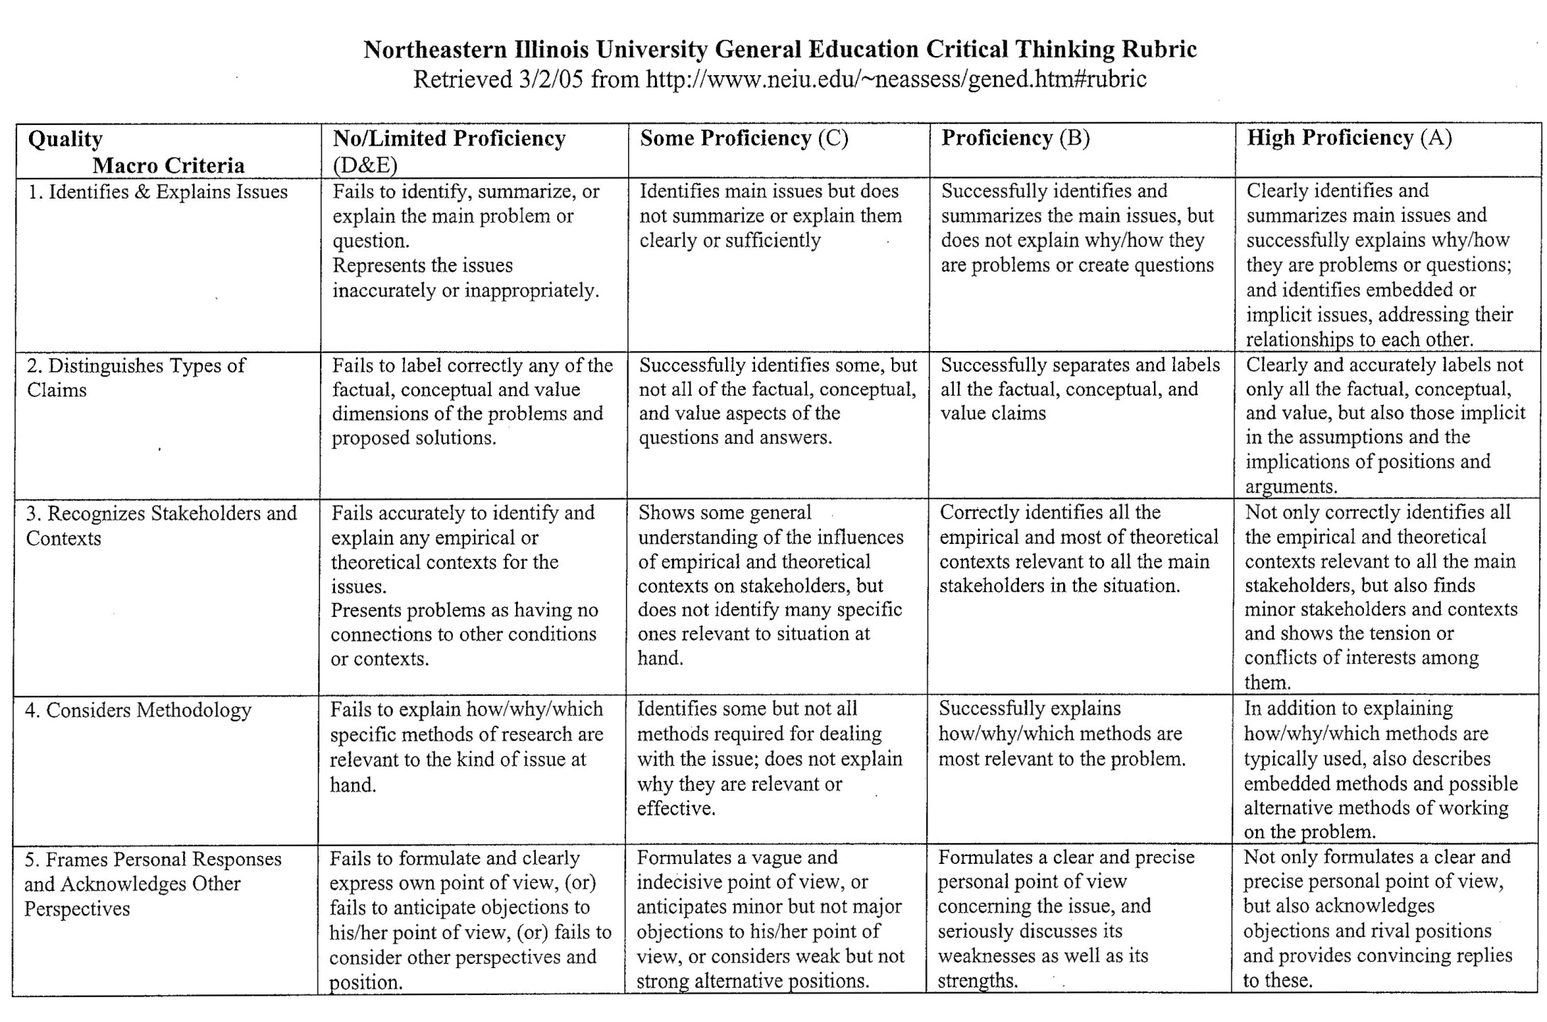
Northeastern Illinois University General Education Critical Thinking Rubric

Slide 11
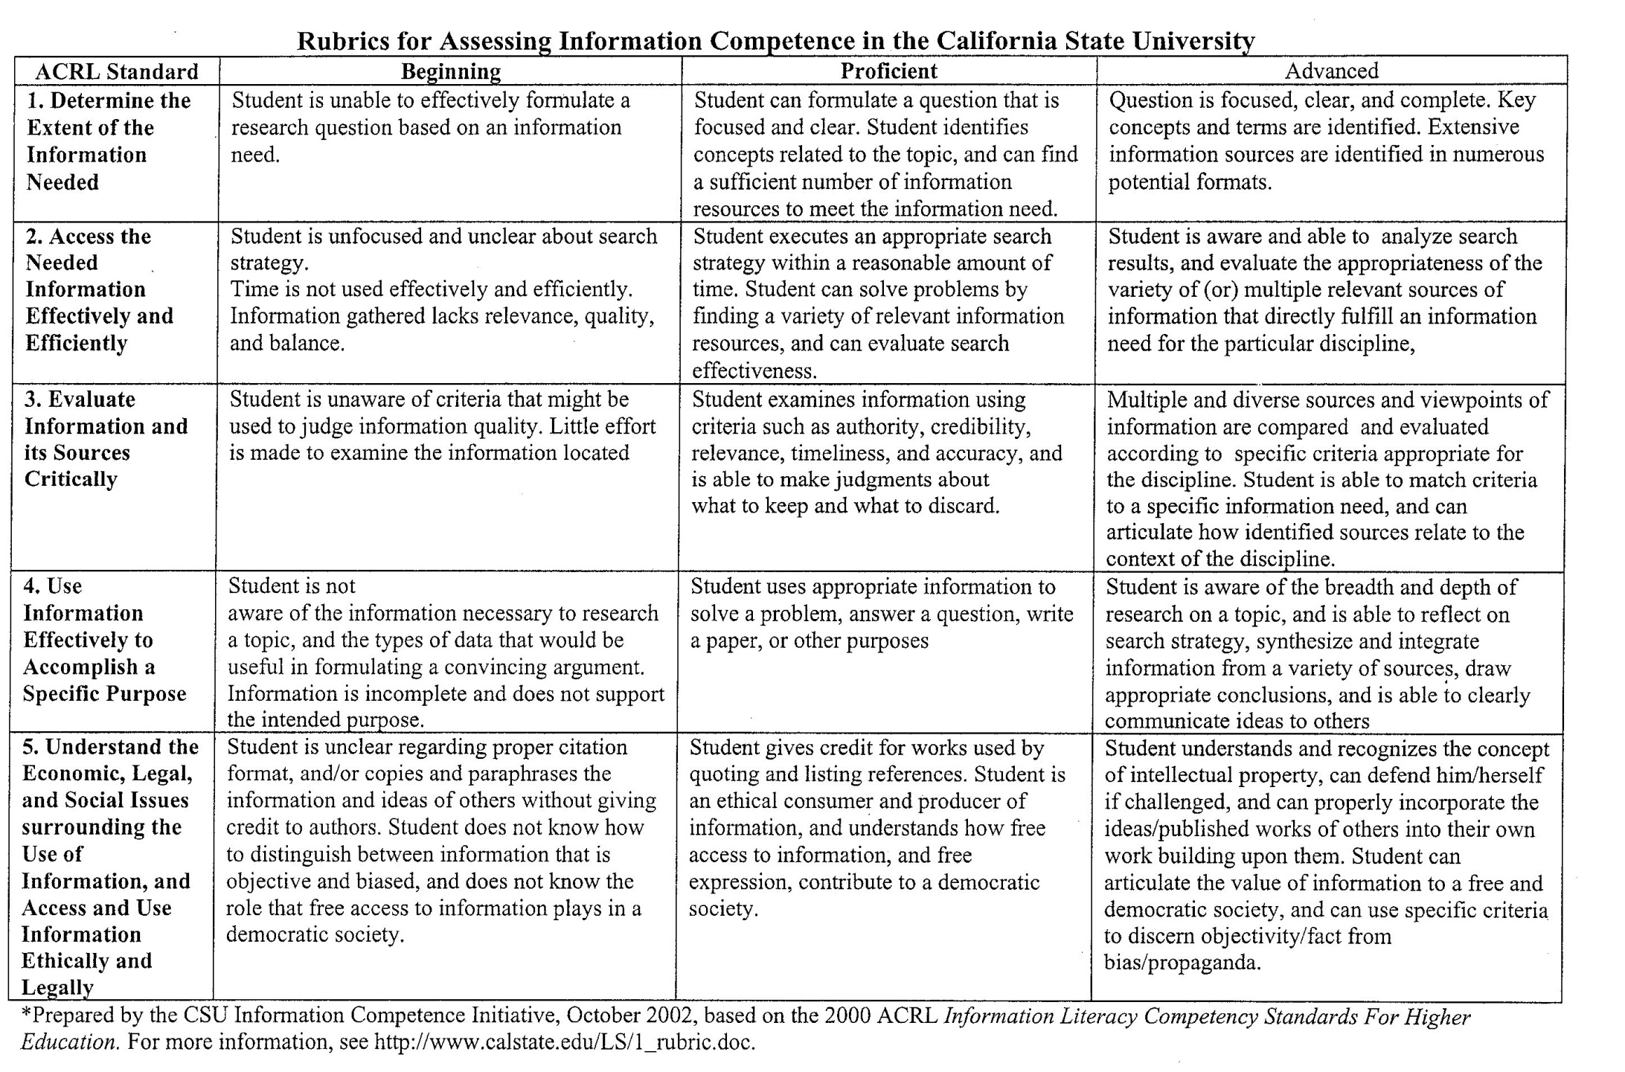
Rubrics for Assessing Information Competence in the California State University

Slide 12
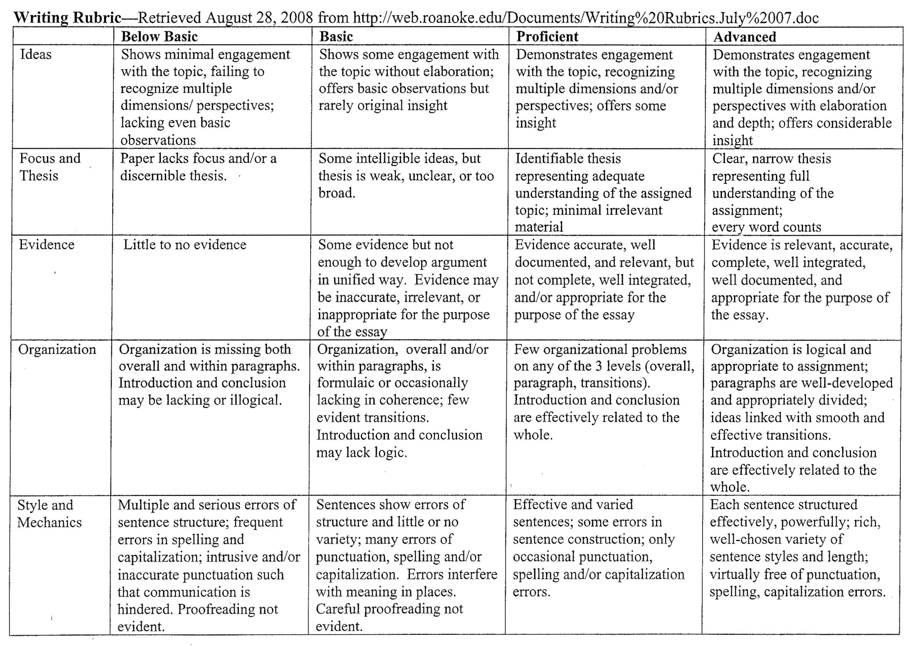
Writing Rubric

Slide 13
Rubrics have many strengths:
Complex materials can be examined efficiently.
Developing a rubric helps to precisely define faculty expectations.
Well-trained reviewers apply the same criteria and standards.
Rubrics are criterion-referenced rather than norm-referenced. Thus, the work can be assessed as to whether or not it met certain criteria rather than how it compares to other pieces of work.
Ratings can be done by students to assess their own work, or they can be done by others – peers, faculty, fieldwork supervisors, etc.

Slide 14
Rubrics can be useful for grading as well as assessment.
The following is an example of the same rubric that can be used in different ways to grade, and at the same time gather evidence needed for program assessment. This particular rubric is assessing oral presentation skills.

Slide 15
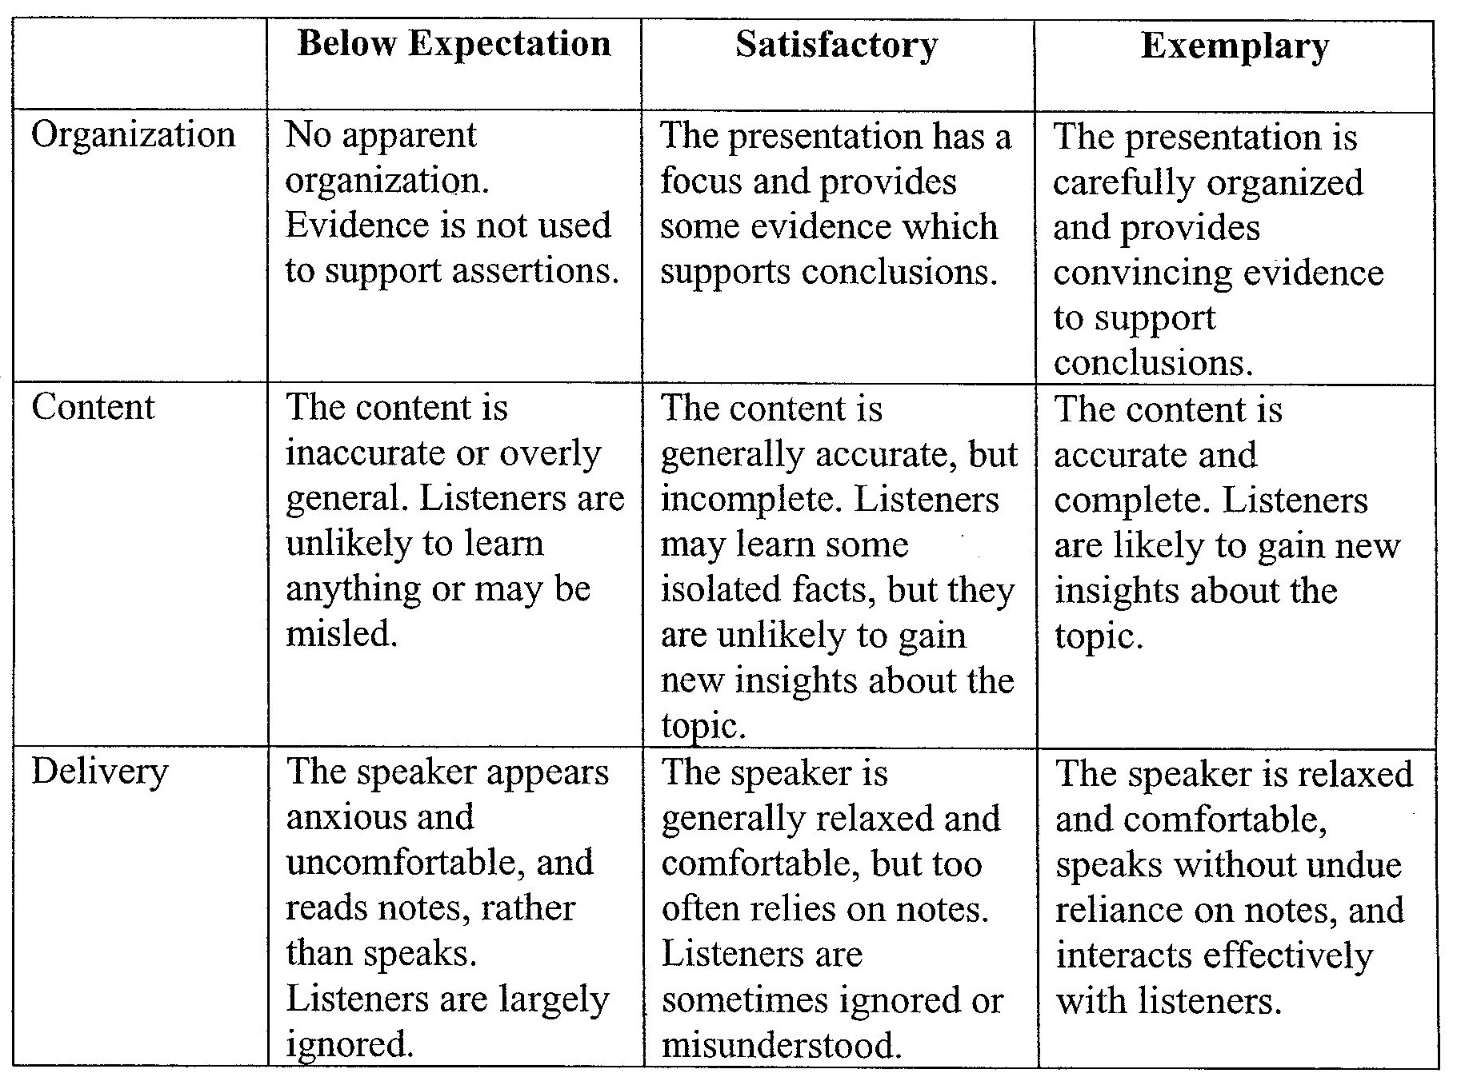
Rubric example

Slide 16
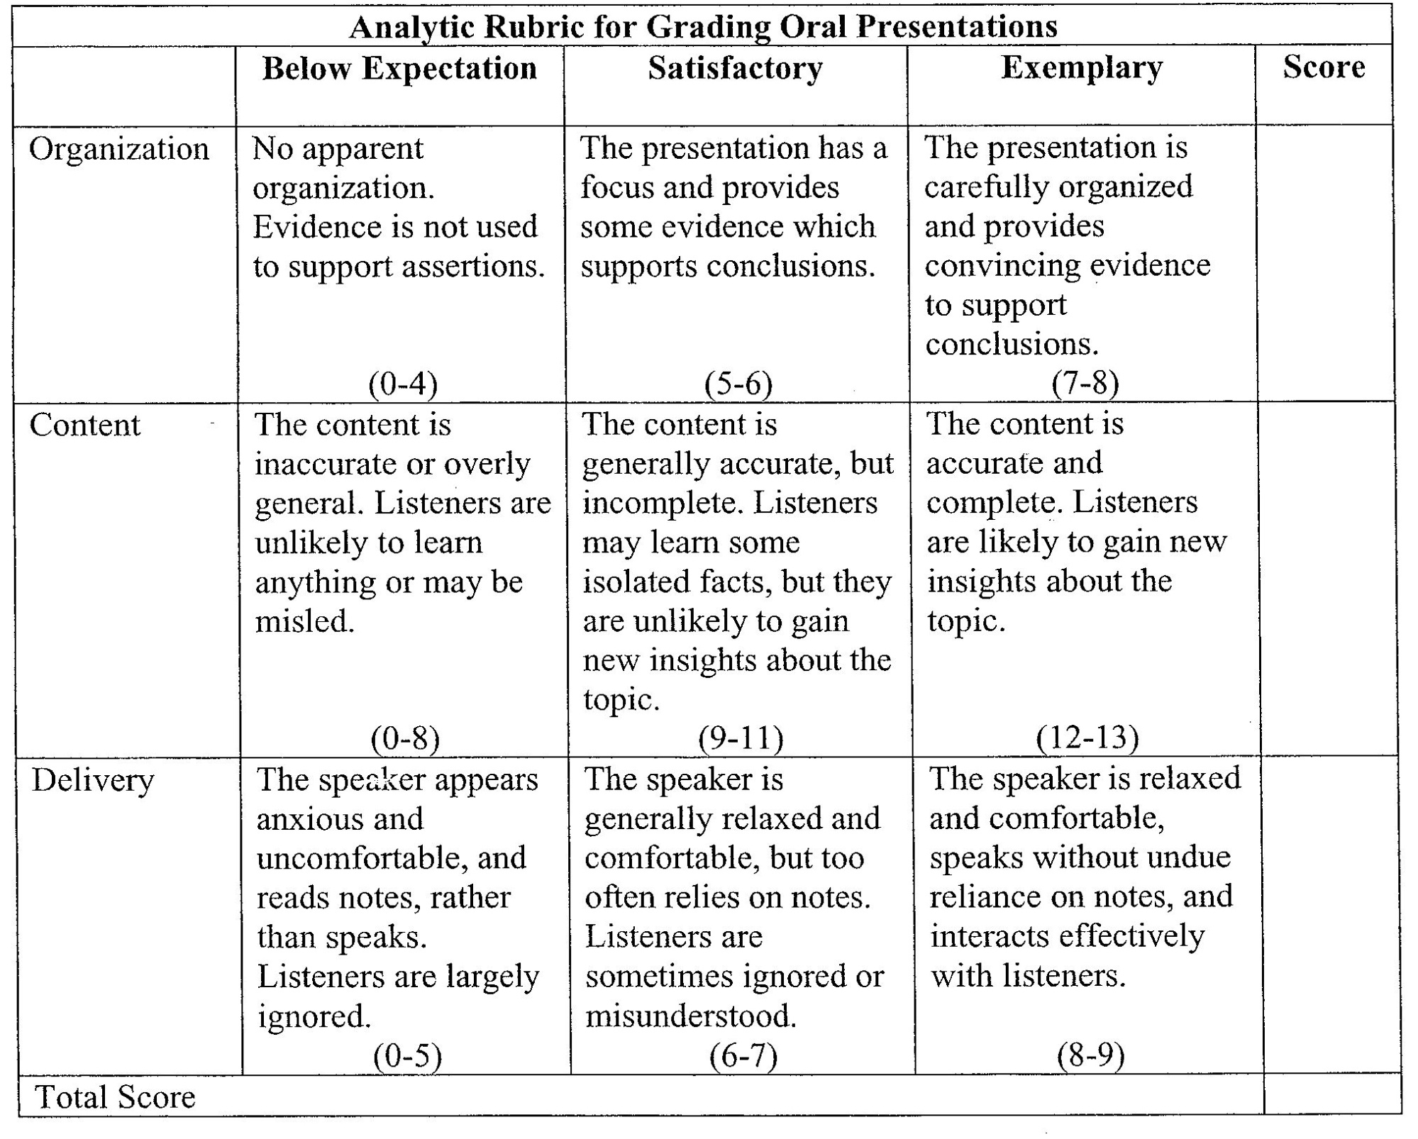
Analytic Rubric for Grading Oral Presentations

Slide 17
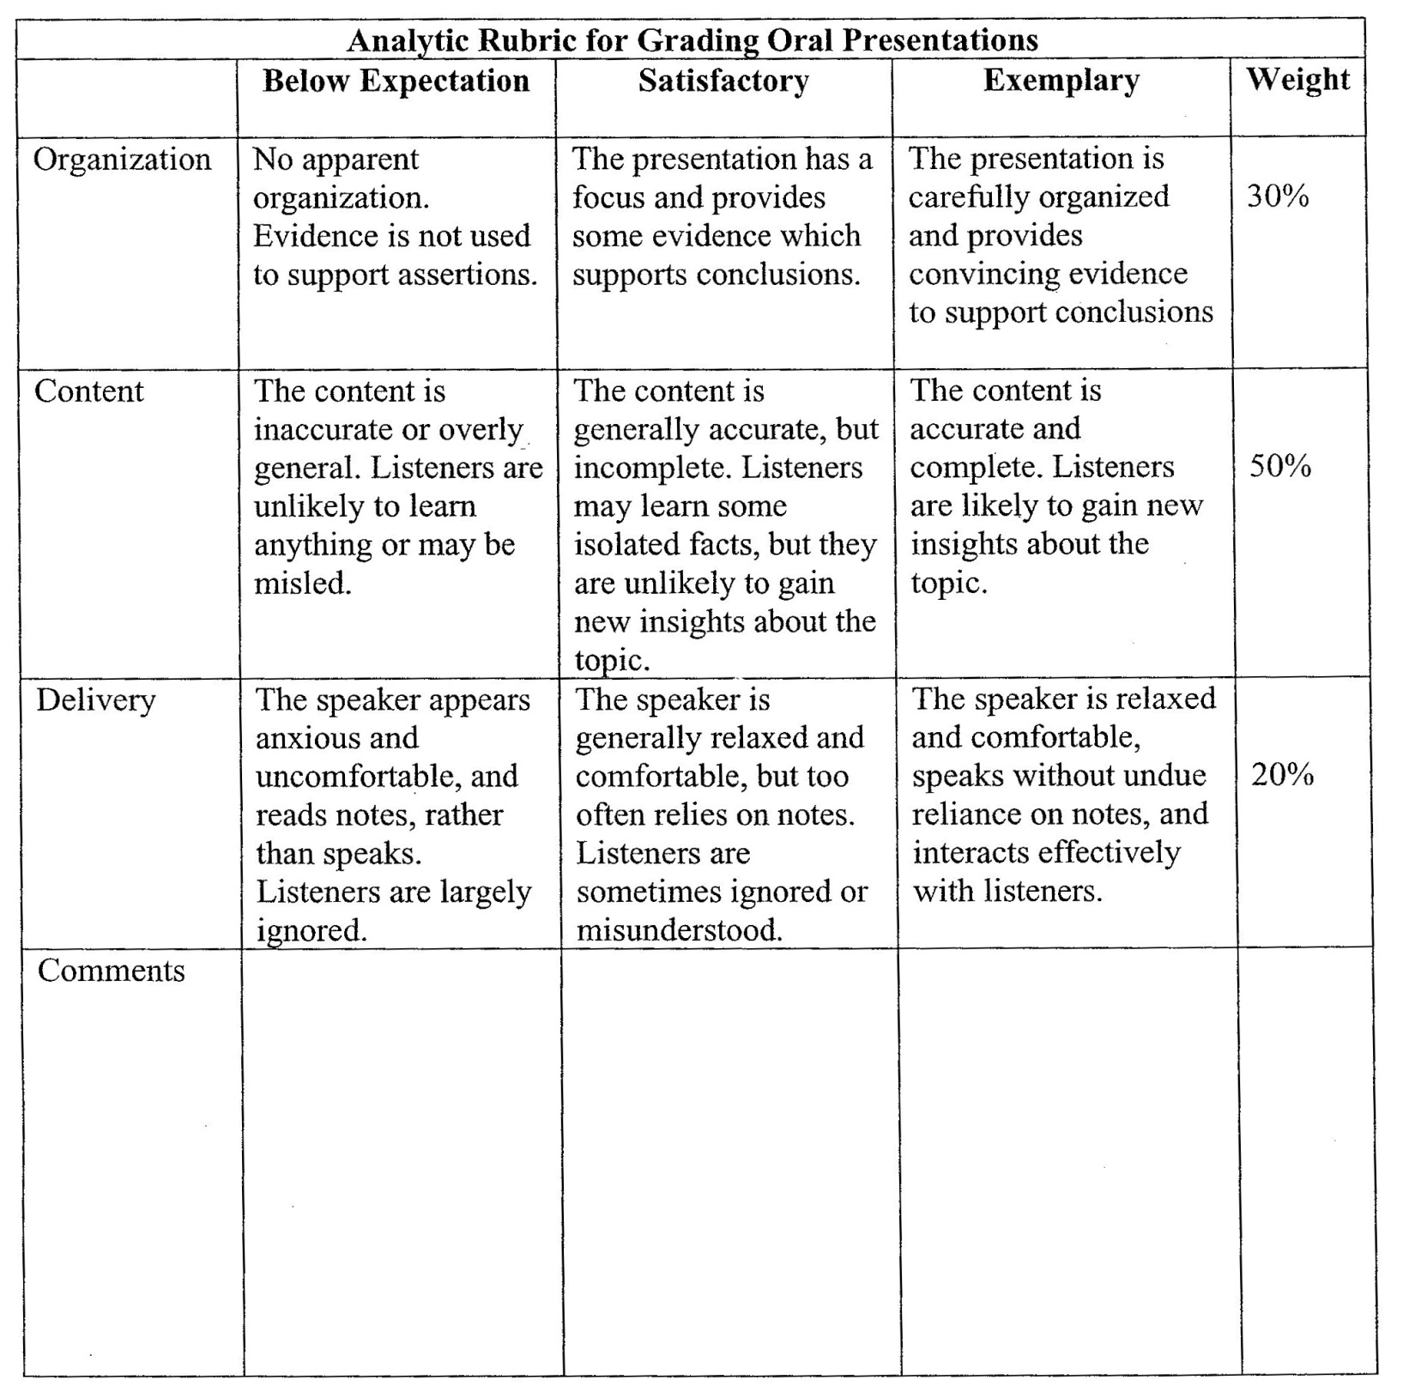
Analytic Rubric for Grading Oral Presentations Example

Slide 18
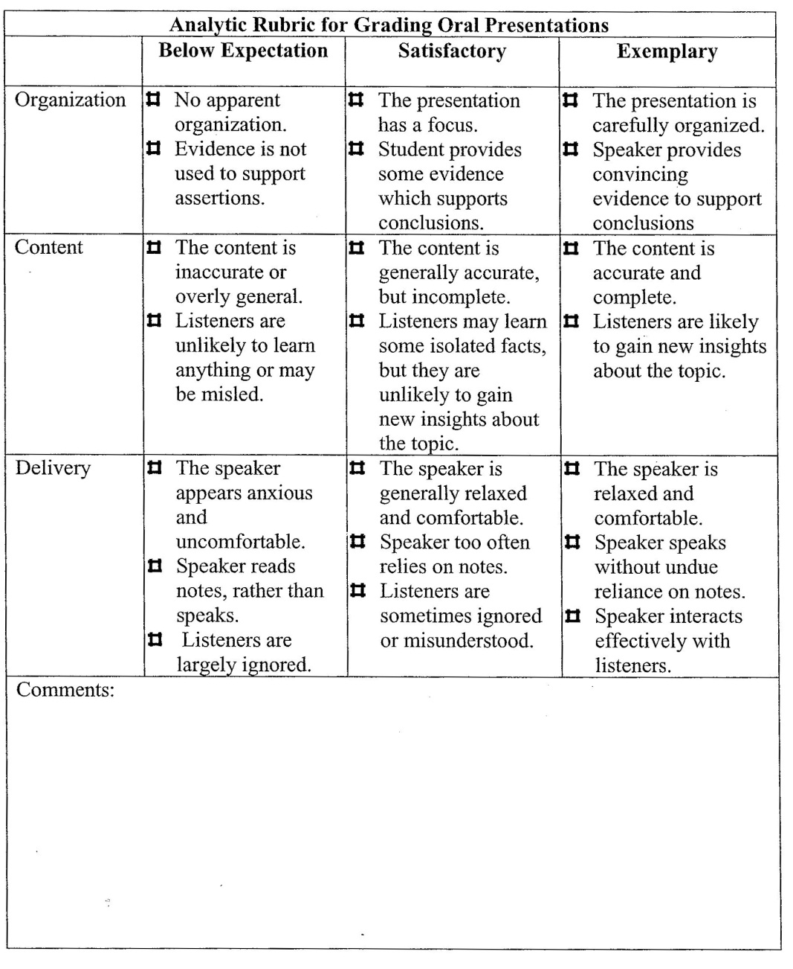
In this version of the rubric, the faculty checks off aspects of the presentation, and then grades the entire performance holistically.

Slide 19
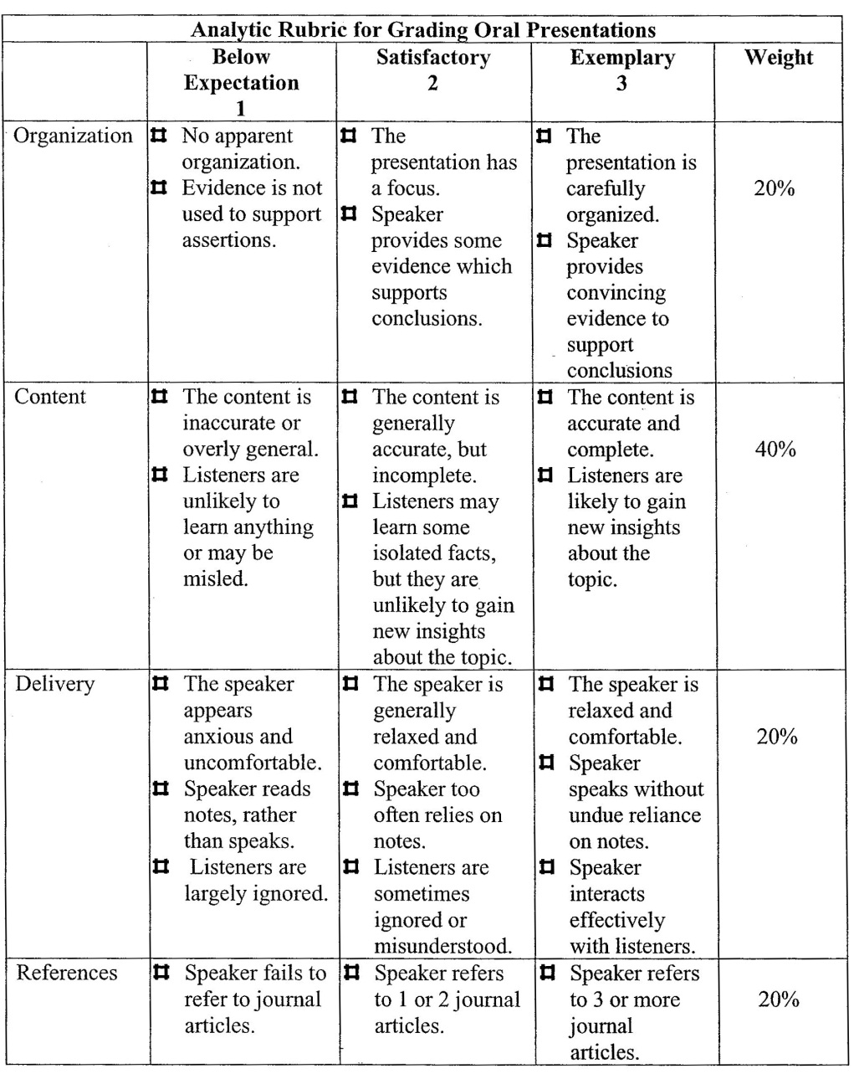
The rubric can be amended to include other information, and can combine features used for grading.

Slide 20
Assessment Vs. Grading Concerns
Grading rubrics may include criteria that are not related to the learning outcome being assessed. These criteria are used for grading, but ignored for assessment.
Grading requires more precision than assessment.
If multiple faculty will use the rubric for grading or assessment, they should be calibrated to get inter-reader reliability.

Slide 21
Rubrics can:
Speed up grading
Provide routine feedback for students.
Clarify expectations to students.
Reduce student grade complaints.
Improve the reliability and validity of assessment and grades.
Make grading and assessment more efficient and effective by focusing the faculty member on the important dimensions.
Help faculty create better assignments that ensure that students display what you want them to demonstrate.

Slide 22
Suggestions for use of rubrics in classes.
Hand out the grading rubric with the assignment so students will know your expectations.
Use a rubric for grading student work, and return the rubric with the grading on it.
Develop a rubric with your students for an assignment or a group project.
Have students apply the rubric to other products before they do their own assignment.
Have students exchange draft papers and give peer feedback using the rubric; then give a few days before the final draft is turned in.
Have students self-assess their products, and compare their assessment with that of the faculty.

Slide 23
Typical Four-Point Rubric Levels
Below Expectations. Student’s demonstrated level of understanding clearly does not meet our expectations. Major components may be missing, inaccurate, or irrelevant to the task.
Needs Improvement. Student needs to demonstrate a deeper understanding to meet our expectations, but does show some understanding; student may not fully develop ideas or may use concepts incorrectly.
Meets Expectations. Student meets our expectations, performs at a level acceptable for graduation, demonstrates good understanding, etc.
Exceeds Expectations. Student exceeds our expectations, performs at a sophisticated level, identifies subtle nuances, develops fresh insights, integrates ideas in creative ways, etc.

Slide 24
Rubric Category Labels
Unacceptable, Marginal, Acceptable, Exemplary
Below Expectations, Developing, Meets Expectations, Exceeds Expectations
Novice, Apprentice, Proficient, Expert
Below Basic, Basic, Proficient, Advanced

Slide 25
Create a Rubric
Adapt an already-existing rubric
Analytic method
Expert systems model

Slide 26
Steps for Creating a Rubric: Analytic Method
1. Identify what you are assessing, e.g., critical thinking.
2. Identify the characteristics of what you are assessing, e.g., appropriate use of evidence, recognition of logical fallacies.
3. Describe the best work you could expect using these characteristics. This describes the top category.
4. Describe the worst acceptable product using these characteristics. This describes the lowest acceptable category.
5. Describe an unacceptable product. This describes the lowest category.
6. Develop descriptions of intermediate-level products and assign them to intermediate categories. You might decide to develop a scale with five levels (e.g., unacceptable, marginal, acceptable, competent, outstanding), three levels (e.g., novice, competent, exemplary), or any other set that is meaningful.
7. Ask colleagues who were not involved in the rubric’s development to apply it to some products or behaviors and revise as needed to eliminate ambiguities.

Slide 27
Steps for Creating a Rubric: Expert Systems Method
1. Have experts sort sample documents into piles with category labels.
2. Determine the characteristics that discriminate between adjacent piles.
3. Use these characteristics to describe each category.
4. Ask colleagues who were not involved in the rubric’s development to apply it to some products or behaviors and revise as needed to eliminate ambiguities.

Slide 28
There are different ways to use rubrics when reading document
One reader/document
Two independent readers/document, perhaps with a third reader to resolve discrepancies.
Paired readers

Slide 29
Before hosting an assessment party
Develop and pilot test the rubric
Select examples of weak, medium, and strong student work
Develop a system for recording scores.

Slide 30
Using the rubrics, you can gather data on the percent of students achieving at each level for each outcome assessed.

Slide 31
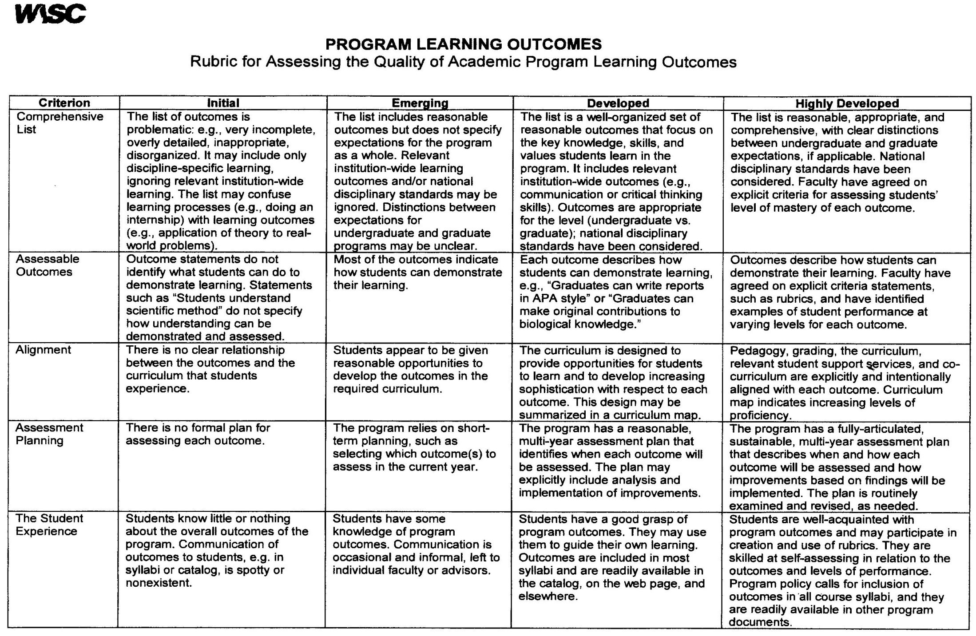
WASC uses a rubric to assess our outcomes.

Slide 32
For links to online rubrics, go to http://www.calstate.edu/itl/resources/assessment/scoring-rubrics-examples.shtml

