Slide 1
Student Learning Outcomes at CSUDH

Slide 2
Outcomes assessment can tell us if our students are really learning what we think they should be able to do.

Slide 3
Student Learning Outcomes:
Are the cognitive knowledge, behavioral skills and/or affective values you expect your students to achieve.
Must be stated in measurable terms.
Are faculty-generated.

Slide 4
SLO Examples (our ILOs)
Think critically and creatively and apply qualitative and quantitative reasoning to address complex challenges and everyday problems locally and globally. (Critical Thinking)
Communicate clearly and collaborate effectively in a range of social, academic, and professional contexts, both orally and in writing. (Communication)
Locate, evaluate, and effectively use information in pursuit of discovery as preparation for continuous lifelong learning. (Information Literacy)
Demonstrate expertise in a specialized discipline of study and the ability to integrate its ideas, methods, theory and practice. (Disciplinary Proficiency)
Develop knowledge of diversity and multicultural competencies and ways to use that knowledge to promote equity and justice at local and global levels. (Engaged Citizenry)

Slide 5
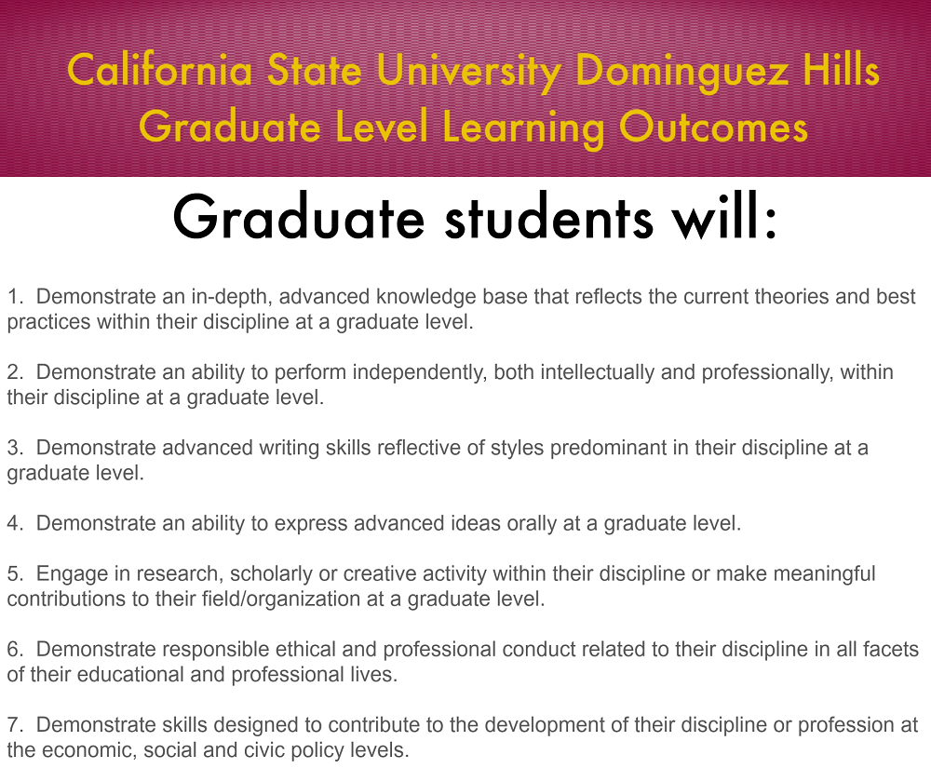
Graduate Level Learning Outcomes

Slide 6
How to get started
The first step in the process is for the departmental faculty to meet and decide on the outcomes. There usually should be between 5-10 of these.
For accredited programs, many of the outcomes will already be specified.
Produce a curriculum map to see how these are covered in the curriculum.

Slide 7
I = concept introduced; R = concept reinforced; F = final assessment

Slide 8
The program-level outcomes should link with both the Institutional Learning Outcomes and with course-level outcomes.

Slide 9
Not every outcome need link to the ILOs, but every program should have at least a few connections.

Slide 10
Course-level outcomes
These should be stated in the Student Learning Outcomes.
The link between the Program-level outcomes and the Course-level outcomes can be put into a table.

Slide 11
The program should also choose its assessment tools.

Slide 12
Indirect assessments
Surveys of students, graduates, and employers
Exit interviews
Focus groups

Slide 13
Direct assessments
Scoring Rubrics: can be used to holistically score any product or performance such as essays, portfolios, recitals, oral exams, research reports, etc
Capstone Courses
Case Studies
Embedded Questions to Assignments
Standardized Achievement Tests
Locally developed exams with objective questions
Locally developed essay questions
Reflective Essays
Collective Portfolios

Slide 14
Although both indirect and direct measures can be used to assess student learning, direct measures yield better, more reliable data.

Slide 15
The program needs also to decide what level of achievement of each of the outcomes is acceptable.

Slide 16
Criteria for Success
Set criteria for each PLO
“Basic”
  % students to achieve minimum requirements
“Intermediate”
  % students to achieve above average level
“Advanced”
  % students to achieve expert level

Slide 17
Then start assessing!
Create a schedule for assessing the outcomes.
Collect the data and analyze it.
See if the students have achieved the preset goals.
If they have, then continue assessing on a regular schedule to make sure they keep making the goals.

Slide 18
If the students are not achieving the goals:
The program should meet to decide on a course of action to correct the problem.
If curricular changes are required, these should be initiated and completed.

Slide 19
Closing the Loop
Did the changes improve outcomes?
If not, work out a solution.
If successful, continue regular assessment.

Slide 20
For links to rubrics, syllabus construction, and forms: http://www.csudh.edu/academic-affairs/student-learning/resources/index

Slide 21
USLOAC members are available for one-on-one help
Email lcarrier@csudh.edu

Slide 22
CSUDH Strategic Framework
Mission
We provide education, scholarship and service that are, by design, accessible and transformative. We welcome students who seek academic achievement, personal fulfillment, and preparation for the work of today and tomorrow.
Vision
By 2015, we are known as a gathering place where:
Diversity in all its forms is explored, understood, and transformed into knowledge and practice that benefit the world.
Our use of technology allows us to transcend our boundaries as we reach out to students, both locally and globally.
Sustainable environmental, social, and economic practices are a way of life.
Our educational partnerships ensure pathways and support for local students to aspire to and complete a college degree.
We are engaged in serving the dynamic needs of the surrounding communities.
Student life is meaningful and vibrant.
Our accomplishments and those of our alumni are recognized nationally and internationally.
As a result, our students graduate with an exemplary academic education and a genuine commitment to justice and social responsibility.
Core Values
Collaboration among all segments of the campus community
Continuous Learning that improves teaching, scholarship, and service
Rigorous Standards of excellence in all our practices.
Proactive Partnerships with our communities
Respect for diversity in all forms
Responsiveness to the needs of students and society
Notes:
22

