Slide 1
Academic Affairs Hiring Plan 2018-19
April 18, 2018
Presentation to the Academic Senate
California State University, Dominquez Hills

Slide 2
Flow Process for Faculty Recruitment Appointments

Slide 3
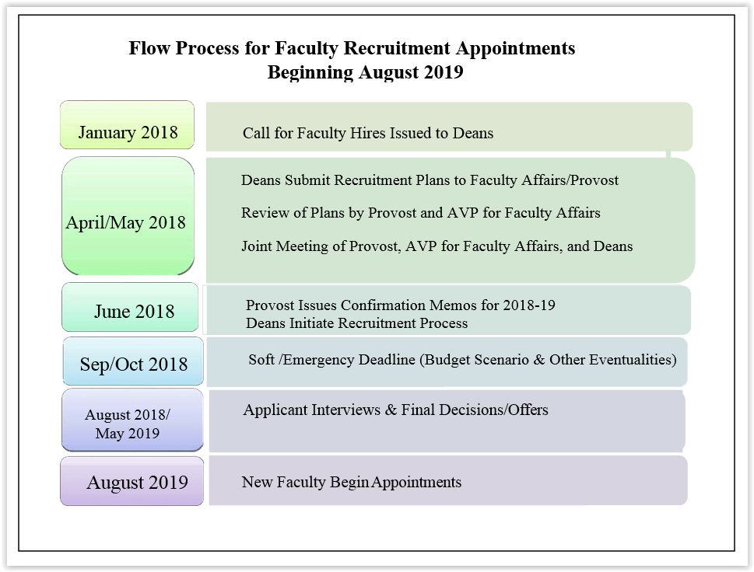

Slide 4
Overarching University Parameters

Slide 5
CRITERIA FOR APPROVING NEW TENURE- TRACK FACULTY POSITIONS
Quantitative Criteria that should be considered:
High temporary/permanent faculty ratios (calculated both as FTEF and percent of SCUs and courses taught) as compared to colleges/departments within campus peer institutions.
Department/Program SFR over the last three years.
Number of majors per permanent faculty headcount (if above 38:1, what steps has the department taken to address the issue?).
Number of degrees, certificates and credentials conferred over the past three years.

Slide 6
CRITERIA FOR APPROVING NEW TENURE- TRACK FACULTY POSITIONS
Quantitative Criteria that should be considered:
Retention and graduation rates of cohorts for the past three years (six- and four-year graduation rates for freshmen and transfer students; three-year rates for master’s students).
Faculty distribution by rank and demographics.
Number of department faculty entering and ending FERP, as well as resignations, retirements, and non-retentions in the past year.
Number of recent permanent faculty hires (last three years) in the department.
Trustee policy on the number of permanent faculty with terminal degrees needed for graduate programs (at least five per proposed program).

Slide 7
CRITERIA FOR APPROVING NEW TENURE- TRACK FACULTY POSITIONS
Qualitative Criteria that should be considered:
The extent to which the hire will support the College/Divisional Strategic Plan that is integral to the University Strategic Plan and Mission.
The steps that the department has taken to streamline its curriculum, reducing the reliance on part time faculty consistent with accreditation and/or ACR 73, and increasing the efficient use of faculty resources.
Program review/accreditation recommendations.
Ability to garner external (non-state) resources and/or form regional partnerships consistent with the College/Divisional Strategic Plan that is integral to the University Strategic Plan and Mission.

Slide 8
CRITERIA FOR APPROVING NEW TENURE- TRACK FACULTY POSITIONS
Qualitative Criteria that should be considered:
Response to new or changing curricular/programmatic need, new markets, and environments consistent with the College/Divisional Strategic Plan that is integral to the University Strategic Plan and Mission
Ability to strengthen permanent faculty capacity to carry out Department/College/ Division/University goals and objectives, strengthen program quality, and strengthen program and Department/College/Division/University reputation.

Slide 9
CRITERIA FOR APPROVING NEW TENURE- TRACK FACULTY POSITIONS
Other Considerations:
Availability of facilities (office/lab/specialized) and provision of proper staff support.
Availability of required start-up funds.

Slide 10
Process & Timeline

Slide 11
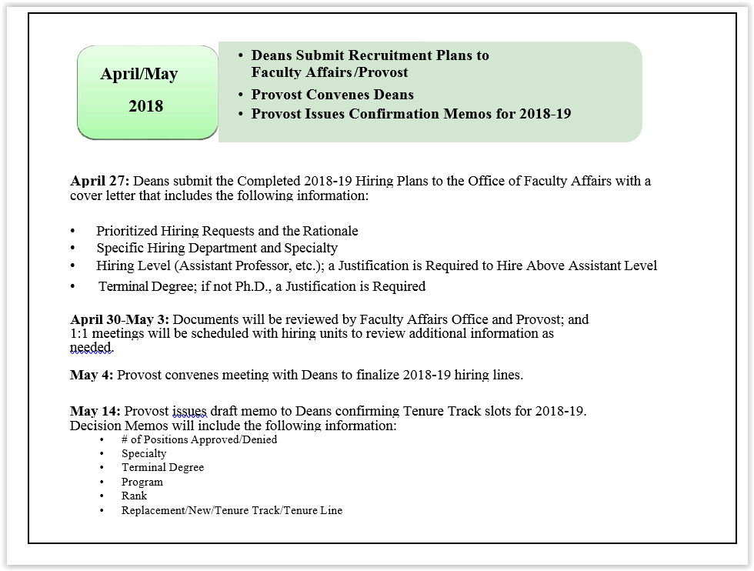

Slide 12
Hiring Practices by College/Library

Slide 13
College/Library Hiring Practices
(Short Overview of How Each Colleges
Determine Departmental Hiring)
CAH –
Tenure Density
Program Goals
Strategic Opportunities
“Triage” (Do no Harm)
CBAPP –
Accreditation Requirements
Tenure Density
FTES/FTEF Ratio
Chairs Council Discussions
Retirement/FERP
Academic Plan

Slide 14
College/Library Hiring Practices
CNBS –
Majors/TT
FTES/TT
Tenure Density
Accreditation Need
NBS Council Feedback
COE –
FTES by TT Density
Tenure Density
Program Creation in the College
Feedback from Cabinet
SFR by department/program

Slide 15
College/Library Hiring Practices
CHHSN –
Programmatic Accreditation
Tenure Density
College Chairs Inputs
New Programs
Library –
New degree programs/majors needing library academic support
Library Strategic Plan
Emerging functional areas to meet curricular/research support needs of faculty and staff

Slide 16
The Recruitment Process

Slide 17
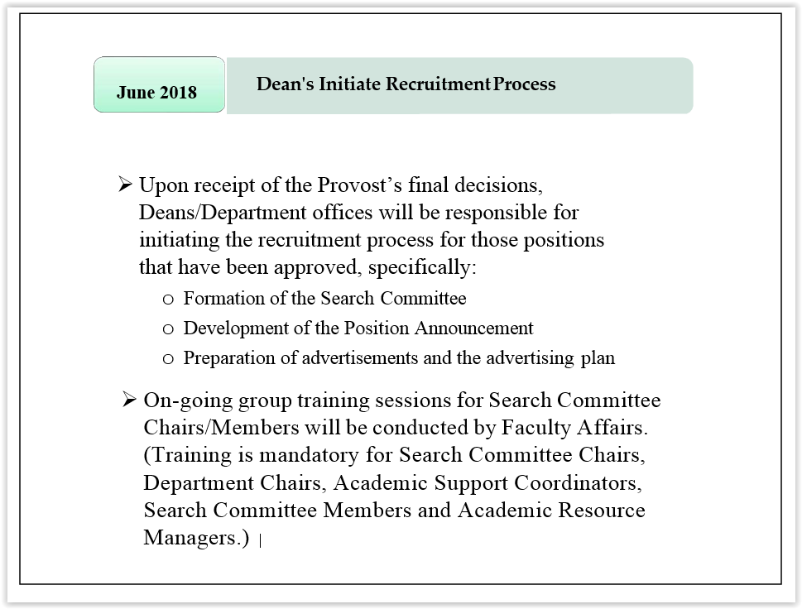

Slide 18
Process for Off-Cycle Requests

Slide 19
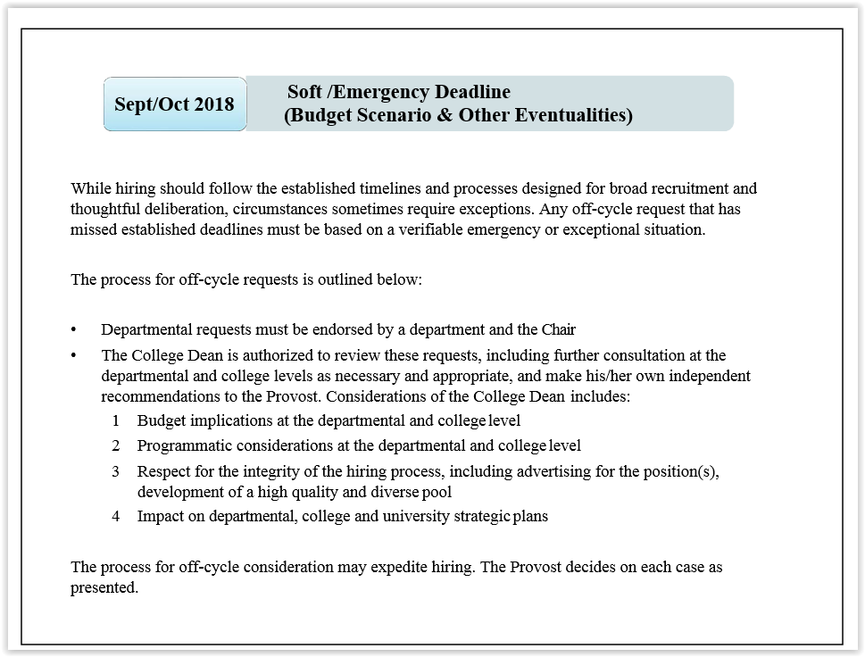

Slide 20
Applicant Interviews & Final Decisions/Offers

Slide 21
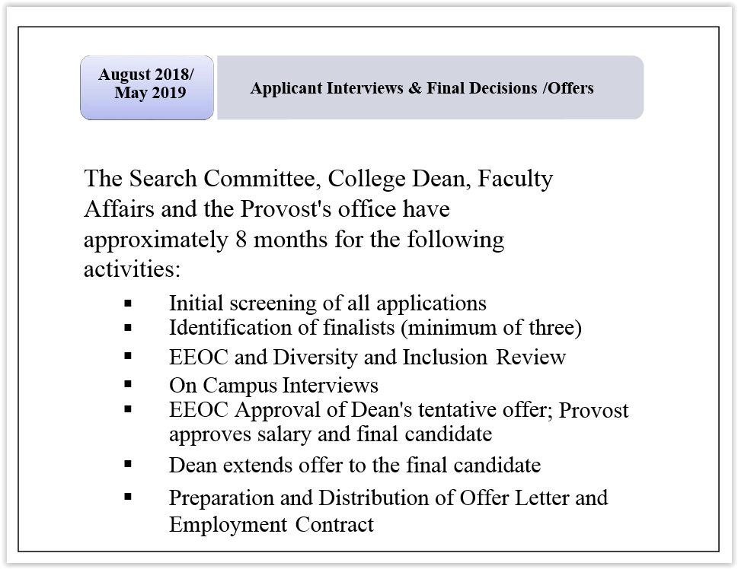

Slide 22
New Faculty Begin Appointments

Slide 23
