Slide 1
Faculty recruitment Plan 2019-20
Michael E. Spagna| Provost & VP for Academic Affairs | April 24, 2019

Slide 2
Faculty recruitment plan 2019-20
Academic Affairs Manual
Code Number: AA 2017-03
Status: Active
Effective Date: August 31, 2017
Subject: Guidelines & Rationale for Tenure-Track Lines
Overview
This policy intends to facilitate the achievement of Goal #1, Objective A, Strategy #1 in the 2014-2020 University Strategic Plan to:
“Conduct a comprehensive faculty flow data analysis of tenured and tenure-track faculty in order to develop a campus multi-year plan of faculty hiring.”

Slide 3
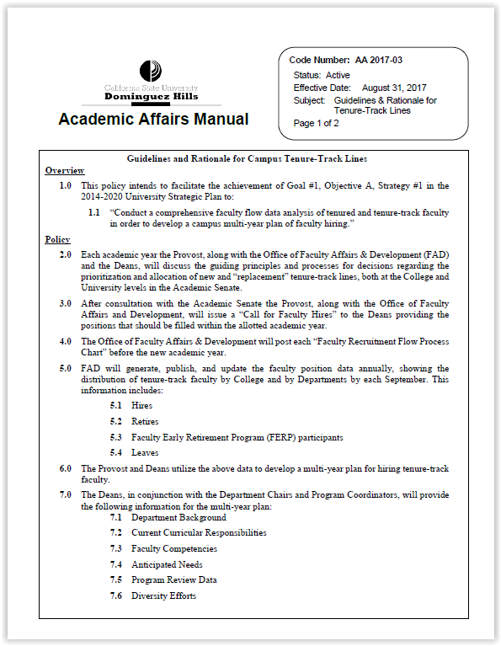
Faculty recruitment plan 2019-20
Academic Affairs Manual
Code Number: AA 2017-03
Status: Active
Effective Date: August 31, 2017
Subject: Guidelines & Rationale for Tenure-Track Lines
Policy Item 9.0
Each year, before the end of the spring semester, the Provost will provide, in a report to the Academic Senate, a rationale for the allocation of new and “replacement” tenure-track lines for the upcoming academic year.

Slide 4
Fall 2018 | Full-Time Equivalents (FTE) |  |  |  | Ratios
 | Students | Lecturers | Tenure-Track | All Faculty (Lect+TT) | Student to Ten-Track Faculty | Student to All Faculty | Tenure Density (TT/All Fac)
CA&H | 3644.7 | 96.3 | 58.9 | 155.1 | 61.9 | 23.5 | 38%
CNBS | 4232.4 | 87.2 | 71.3 | 158.5 | 59.4 | 26.7 | 45%
CHHSN | 2030.5 | 63.8 | 40.4 | 104.2 | 50.3 | 19.5 | 39%
CBAPP | 1865.6 | 34.6 | 46.0 | 80.6 | 40.6 | 23.1 | 57%
COE | 983.2 | 33.0 | 26.0 | 59.0 | 37.8 | 16.7 | 44%
TOTALS | 12756.4 | 314.9 | 242.5 | 557.4 | 52.6 | 22.9 | 44%

Slide 5
Faculty FTE by College
2018 Census

Slide 6
Snapshot for First-Time Full-Time Freshmen Cohort 2012: Graduation Rates

Slide 7
Snapshot for Community College Transfer Cohort 2012: Graduation Rates

Slide 8
rationale for the allocation of new and replacement lines
SUBTITLE GOES HERE
Program Goals
“Triage” (Do No Harm)
Strategic Plan
Department Climate and Likelihood of Success
College of Arts & Humanities

Slide 9
rationale for the allocation of new and replacement lines
SUBTITLE GOES HERE
Accreditation Requirements
Academic Plan
Chairs Council Discussions
College of Business Administration and Public Policy

Slide 10
rationale for the allocation of new and replacement lines
SUBTITLE GOES HERE
Number of Majors by Department
New Programs
Chair Feedback
College of Education

Slide 11
rationale for the allocation of new and replacement lines
SUBTITLE GOES HERE
Programmatic Accreditation & Review
Responsiveness to New Markets
College Chairs Inputs
Availability of Startup Funds
Availability of Facilities
Faculty Distribution
Number of Majors per Faculty Headcount
College of Natural and Behavioral Sciences

Slide 12
rationale for the allocation of new and replacement lines
SUBTITLE GOES HERE
Programmatic Accreditation & Review
Dept. Tenure Density (those at 10% have priority)
College Chairs Inputs
New Programs
Departmental Leadership Pipeline
College of Health, Human Services and Nursing

Slide 13
rationale for the allocation of new and replacement lines
SUBTITLE GOES HERE
Overall Number of Campus Faculty Lines
Library’s Strategic Plan
Core/New Functional Academic Support Areas
Library Faculty Feedback
University
Library

Slide 14
Allocation to Colleges and Departments
SUBTITLE GOES HERE
FTES Growth | Accreditation | Dept. Leadership | Attrition | Tenure Density | Major-to-Faculty Ratio | Strategic | Faculty Line Allocated?
✓ | ✓ |  |  | ✓ |  |  | ✓
✓ |  |  |  | ✓ | ✓ |  | ✓
 |  |  | ✓ |  |  |  | x
✓ |  | ✓ |  |  |  | ✓ | ✓

Slide 15
Faculty Scenarios by College for Hiring 2020-21
 | Proposed 2019-20 Tenured and Tenure-track Recruitments
 | Rollover Projected | Replace Projected | New Projected | Total
CA&H | 1 | 2 | 4 | 7
CBAPP | 1 | 0 | 2 | 3
CHHSN | 1 | 2 | 5 | 8
CNBS | 1 | 4 | 4 | 9
COE | 0 | 2 | 1 | 3
Library | 0 | 0 | 1 | 1
Total Searches = 31

Slide 16
Funding for Tenure-Track Faculty Hiring
SUBTITLE GOES HERE
Base Commitments
Annual Salary
One-Time
Commitments
Assigned Time
Total Funding Commitments
Benefits
Startup Funding
Relocation
Monitoring of fund source (GI 2025 vs. other)
$3,956,200
+
$1,131,500
=
$5,087,700

Slide 17
Tenure-Track Faculty Hiring Planning Timeline
SUBTITLE GOES HERE
Expected Final Allocation of Faculty Lines:
Summer 2019
Fall
2020
Fall
2018
Spring
2019
Fall
2019
Spring
2020
Spring
2021
— Now —
Preliminary Allocations
for Fall 2019-20 Recruitments
Expected Faculty Hires

