Slide 1
Institutional review board
(IRB)
Judith Aguirre
Research compliance Officer
Office of graduate studies and research

Slide 2
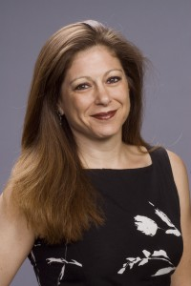




CSUDH IRB team
IRB Chair – Dr. Susan Einbinder
Institutional Official – Dean of Graduate Studies and Research
Dr. Sheree Schrager
Judy Aguirre – IRB Analyst
IRB Board Members – 9 members, 1 alternate member
Denise Aguiluz – Student Assistant

Slide 3
Why Do Human Research Subjects Need Protection?
History of human research
  At times, the rights and welfare of subjects was not respected
All institutions conducting human research are required to have an oversight body to oversee human subject research.
The IRB is more than the IRB board. It is a comprehensive human subject protection program at CSUDH with all CSUDH IRB team members playing various roles with the overriding goal being the protection of human subjects.

Slide 4
Historical context for the need and development of irbs
The Nazi Experiments – Nuremburg code 1947
Tuskegee Syphilis Study
  National Commission for the Protection of Human Subjects 1974
  Belmont Report 1978
  Common Rule (Federal Regulations) 1994

Slide 5
Federal regulations
“COMMON RULE”
A federal policy regarding Human Subjects Protection that applies to 17 Federal agencies and offices.
Applies to agencies that have signed an agreement to uphold the Common Rule
Outlines the requirements for assuring compliance by researchers and their institutions
Carves out protections for vulnerable populations. (Subparts B-D).
  Children
  Prisoners
  Pregnant Women, Fetuses, and Neonates

Slide 6
How do I know if a study needs IRB approval?
Meets federal definition of “research” Systematic investigation designed to develop or contribute to generalizable knowledge
Meets definition of “human subject(s)” The investigator will gather data about living individuals through intervention or interaction OR The investigator will gather data about living individuals that is private and identifiable.

Slide 7
HOW DO I BEGIN THE IRB PROCESS
Go to the IRB Home Page and follow the instructions to complete your application.
https://www.csudh.edu/gsr/research/research-compliance/irb/
Submit IRB Submission to irb@csudh.edu.

Slide 8
REQUIRED human subjects TRAINING FOR IRB submissions
Completion of human subject training
  CSUDH uses the CITI training platform
Training must be renewed every 3 years
There are social-behavioral, education and biomedical courses depending on the type of research being performed.

Slide 9
CRITERIA FOR APPROVAL
Risks are Minimized
Risks are Reasonable in Relation to Benefits
Selection of Subjects is Equitable
Informed Consent will be Sought for Each Prospective Subject
Research Plan Adequately Protects the Privacy of Subjects and Maintains Confidentiality
  Dropbox
When some or all of the subjects are likely to be vulnerable to coercion or undue influence, additional safeguards need to be included in the protocol to protect the rights and welfare of these subjects.

Slide 10
The irb has the authority to:
Approve the study
Require modifications prior to approval
Table
Disapprove all research activities including proposed changes in previously approved human subject research

Slide 11
Who Submits the Proposal?
All individuals associated with CSUDH (faculty, staff, students) must submit a protocol if it meets the definition of human research.
List the faculty mentor as the Principal Investigator and the students as the Co-Investigator
Students should submit a proposal under the supervision of a faculty member.

Slide 12
Irb Review categories of Research
All research projects are categorized into one of three categories for the IRB review process. Each category is different in the level of scrutiny and review process. The IRB is responsible for making the final decision of which a category a research project falls under.
Full
Expedited
Exempt

Slide 13

Full Review category
For higher risk studies
Requires a fully convened IRB committee review
  Check IRB Calendar posted on the IRB Homepage

Slide 14

Expedited review category
Moderate risk protocols that meet specific federal criteria qualify for an expedited review (45 CFR 46.110)
  Expedited Categories
The IRB Chair or designated primary reviewers review the IRB Submission
Reviews occur throughout the month as IRB Submissions are received

Slide 15
Exempt from IRB review
Involve low risk to human subjects.
The IRB Analyst conducts these reviews
Reviews occur throughout the month as IRB Submissions are received

Slide 16
consent form elements
Statement that the study involves research
Research is described
Description of Risks
Description of Benefits
Disclosure of Alternatives
Confidentiality
If more than minimal risk, compensation and/or medical treatment
Participation is voluntary
Whom To Contact

Slide 17
Form B (Proposal)
Recruitment Methods:
Describe how you will identify and recruit subjects. Submit a copy of the flyer or advertisement if you will be advertising for subjects. (If subjects will be identified through private records, the holder of the records must make the initial contact with the subject.) Include a statement about how the recruitment will ensure voluntary participation and not single out or embarrass individuals who choose not to participate.
Important to be specific as to how you will recruit subjects.
For example, if you state “snowball recruitment”, describe where the snowball starts and how the recruitment will expand.
Simply stating “snowball recruitment” is not sufficient.
Secure permission to recruit from physical or virtual sites.

Slide 18
Examples
Secure Permission to Conduct Research from research sites.
Includes Virtual research sites.
Letter from Principal
Letter from Clinic Director
Screenshot from Social Media Moderator

Slide 19
Form B (Proposal)
Identify Risks:
Consider potential or known physical, psychological, social, and economic or legal risks that might be associated with participation in the research. These might be direct risks, or the result of a subject’s name accidentally being linked to his/her responses. Discuss whether the risks are minimal (no greater than normal daily risks) or significant.
Psychological and social risks should be identified.
Participation in research may result in undesired changes in thought processes and emotion (e.g. episodes of depression, feelings of stress, guilt, and loss of self-esteem)
Stress and feelings of guilt or embarrassment may arise simply from thinking or talking about one's own behavior or attitudes on sensitive topics such as drug use, sexual preferences, selfishness, and violence. These feelings may be aroused when the subject is being interviewed or filling out a questionnaire.

Slide 20
Form B (Proposal)
Management of Risks:
Describe precautions, safeguards, or other steps incorporated into the research activity to reduce or limit the severity or likelihood of harm. These might include extra precautions in storing data or coding personal identifiers.
For psychological risks, consider providing community resources or allowing participant to stop the study at any time without penalty
Consider how you will safeguard data and separate personal identifiers from data

Slide 21
Cayuse human ethics
COMING SOON!
The Cayuse Human Ethics platform is an online human subject research application management system used to electronically prepare, submit, and route research studies for IRB approval.
All information is stored in the cloud and can be accessed securely from any location, making it simple for researchers/investigators to upload, edit, and submit human subjects research studies.
Users receive electronic notifications whenever an action is required on their part, allowing the study to proceed smoothly through each step of the review process from study creation to final approval.

Slide 22
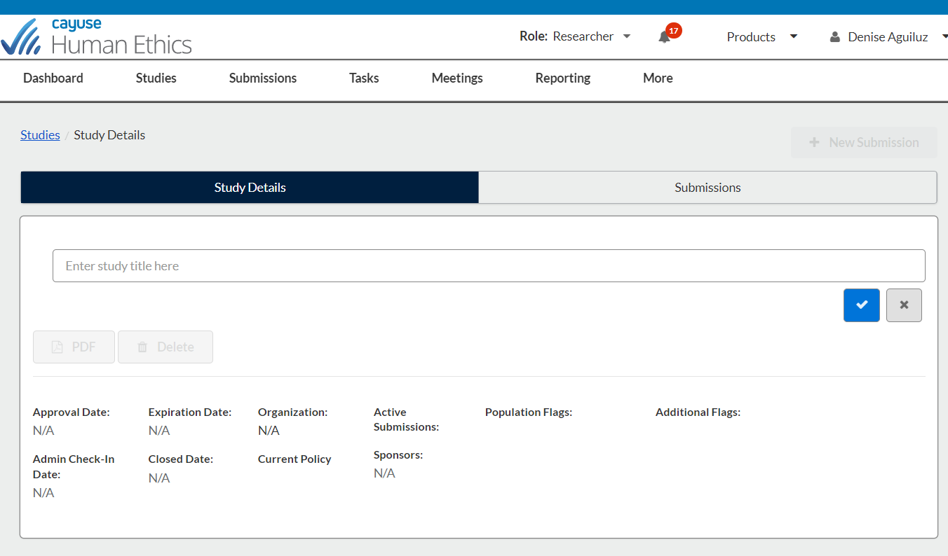

Slide 23

Resources
CSUDH IRB Homepage
https://www.csudh.edu/gsr/research/research-compliance/irb/
-CSUDH IRB Templates
-Online CITI Human Subject Training information
Office for Human Research Protections (OHRP)
https://www.hhs.gov/ohrp/index.html

Slide 24
Questions?
https://www.csudh.edu/gsr/research/research-compliance/irb/

