Slide 1
Outreach Training Program
www.OSHACardPortal.com

Slide 2
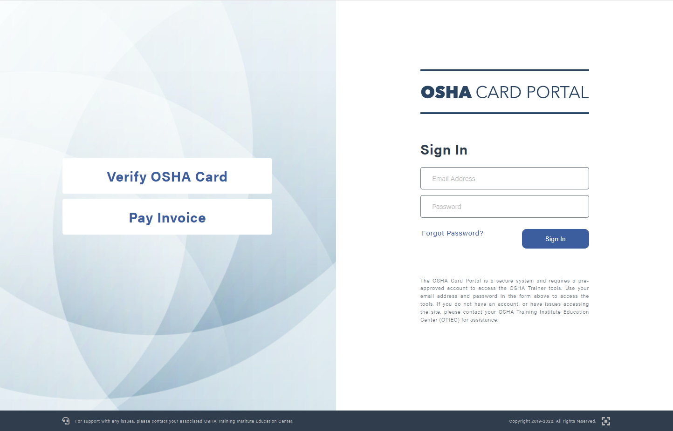
www.oshacardportal.com
Available Features:
Anyone can access the OSHA Card Portal; however, only
pre-registered Outreach trainers will be able to log in
Without a log in you can:
  Verify an OSHA Card
  Pay an Invoice

Slide 3
Verifying an osha card

Slide 4
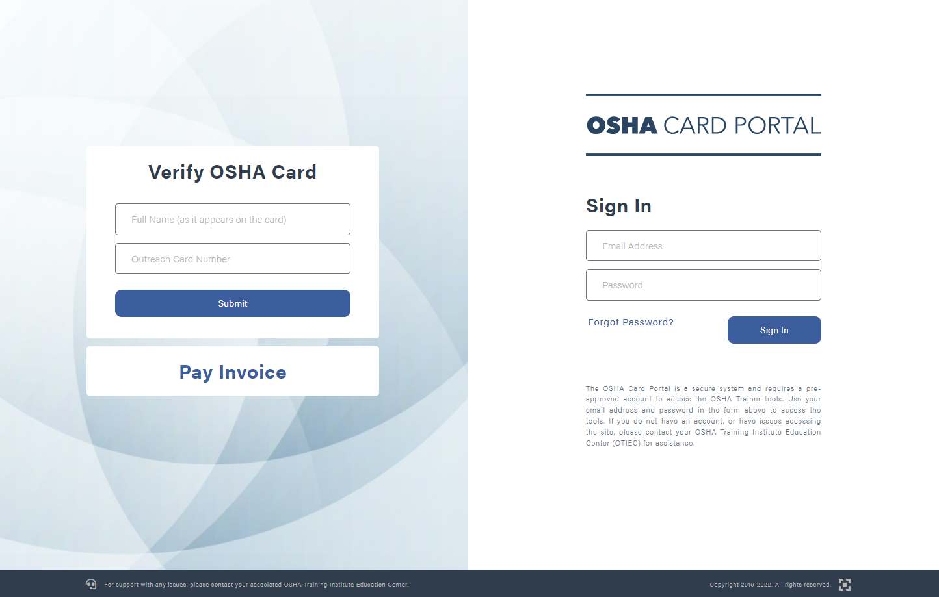
Verifying an OSHA Card
How to Verify
an OSHA Card:
Enter in the Full Name as it appears on the card; be sure to include any suffix, middle name, and punctuation
Enter in the Outreach Card number, including the dash
Click the Submit button

Slide 5
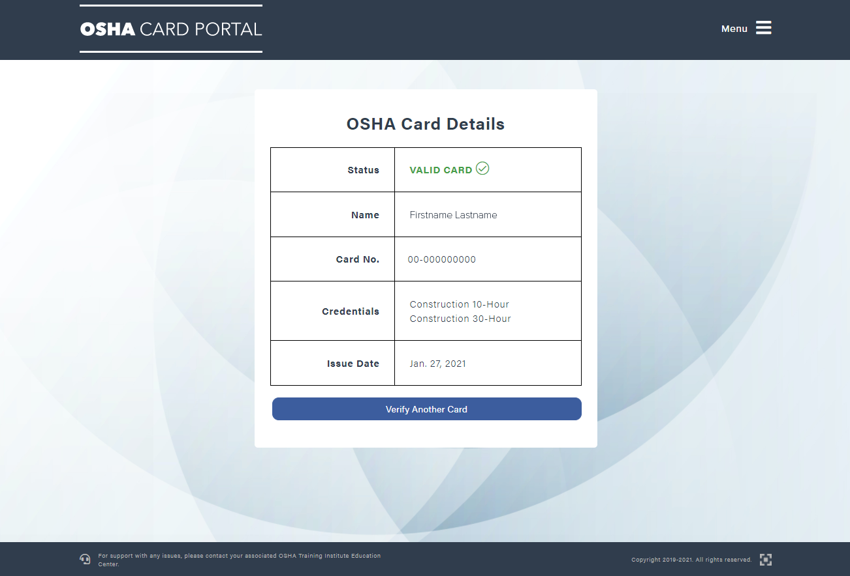
Verifying an OSHA Card
How to Verify
an OSHA Card:
The portal will either provide Valid Card or Not Valid once submitted
If you receive a Not Valid response and believe it is a valid card, click Verify Another Card
Once you’re back to the verification page, re-enter the information from the card
Be sure to double check the spelling of the name, including punctuation, and resubmit

Slide 6
Paying an invoice
Without a log in

Slide 7
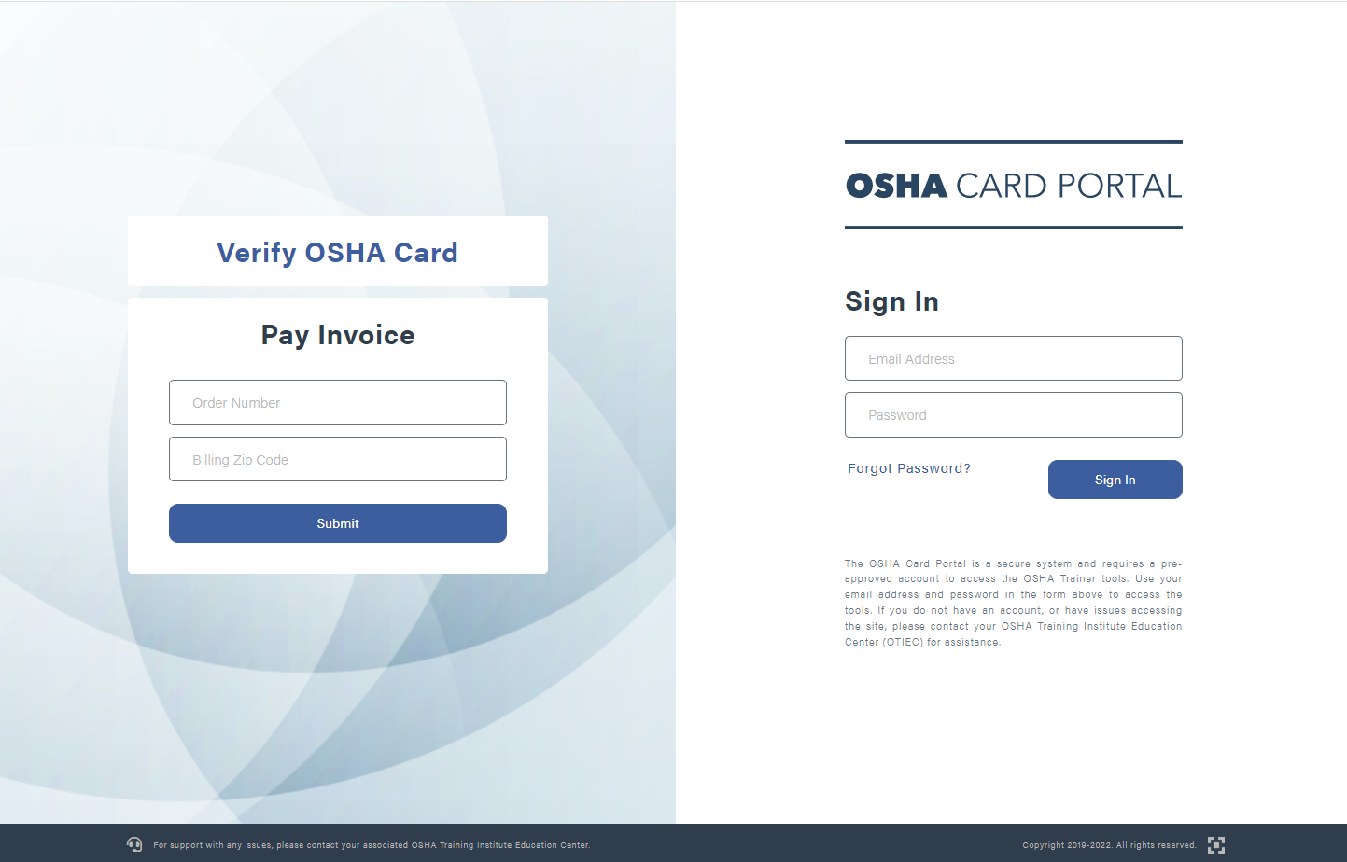
Paying an Invoice
Without a Log In:
This feature is designed to be used by a third-party who submits payment for an order placed by an Outreach trainer
  This is including, but not limited to, accounting departments, military, and educational institutions
Enter in the Order Number. This is found on the Invoice provided by the Outreach trainer
Enter in the Billing Zip Code. This is found on the Invoice provided by the Outreach trainer
Once the information is entered into the corresponding box, click Submit

Slide 8
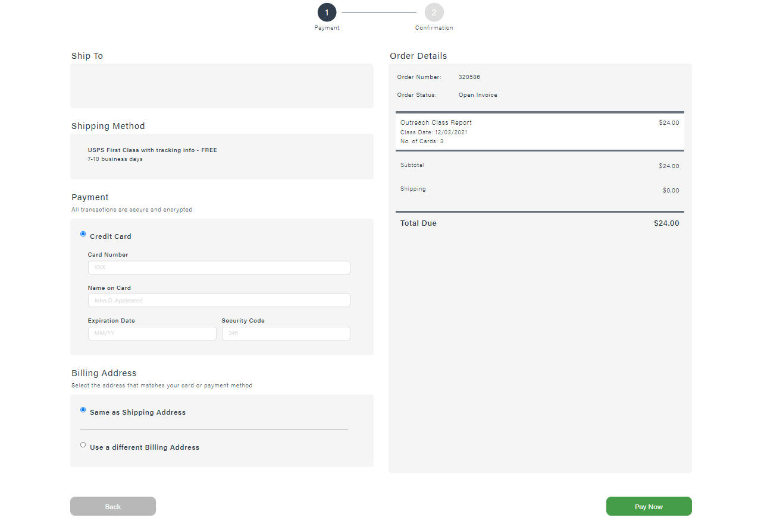
Paying an Invoice
Submitting Payment:
After clicking Submit, you will be able to review the details of the order and complete payment with a credit card
Only credit card payments may be submitted on the portal. Instructions for submitting a payment with a check are available on every invoice
The Shipping Address and Shipping Method cannot be adjusted once the order has been submitted for invoicing
If the billing address is incorrect, they can select Use a different Billing Address and make the necessary adjustments
Once complete, click Pay Now
Trainer Name
123 Main St, City, St 00000

Slide 9
Setting up your account

Slide 10
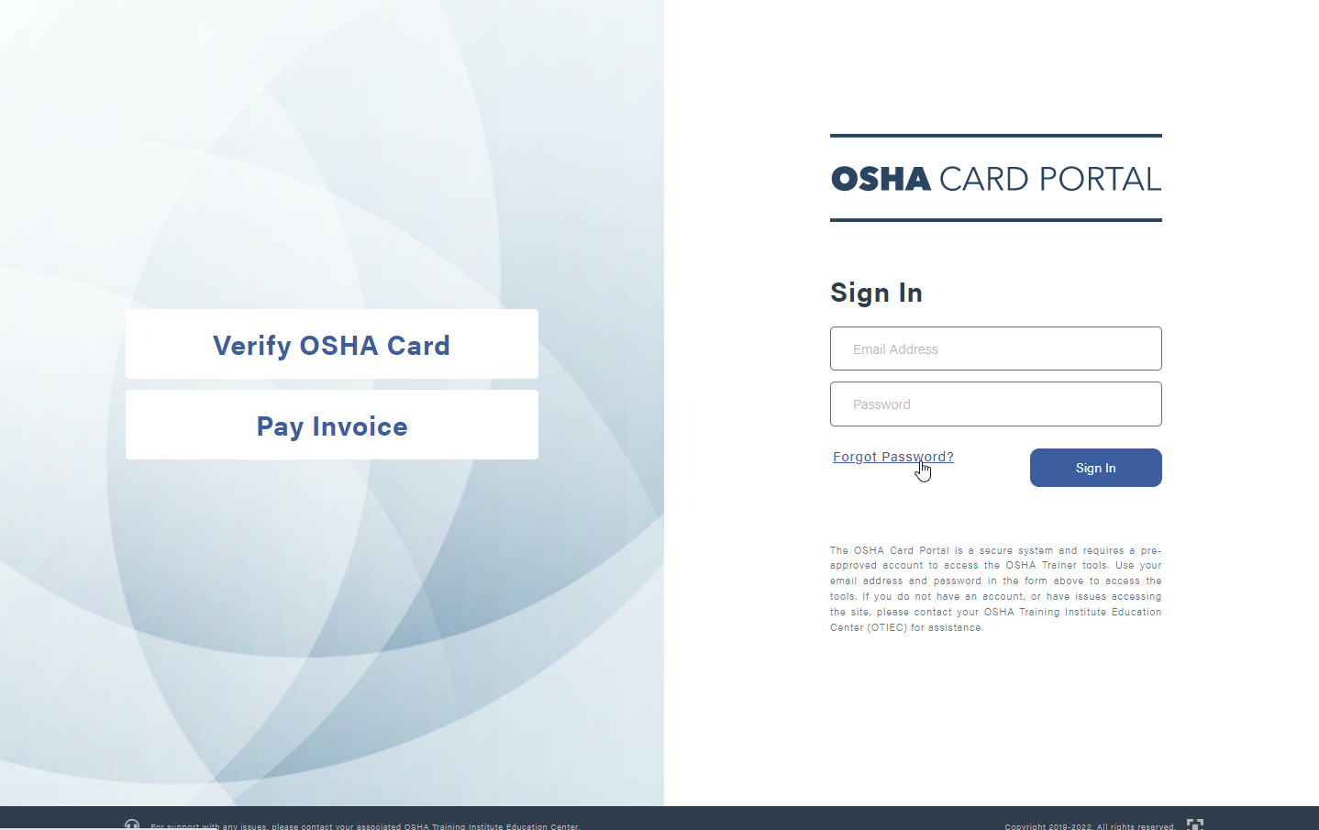
Setting up your account
First Time Logging In?
Once a new account has been created, you will receive a New Account Created email from the portal to the address that was provided
  Only 1 email address per user
  An email address cannot be shared with another user
  You do not need your trainer ID to log in
Go to www.OSHACardPortal.com
Click on Forgot Password?

Slide 11
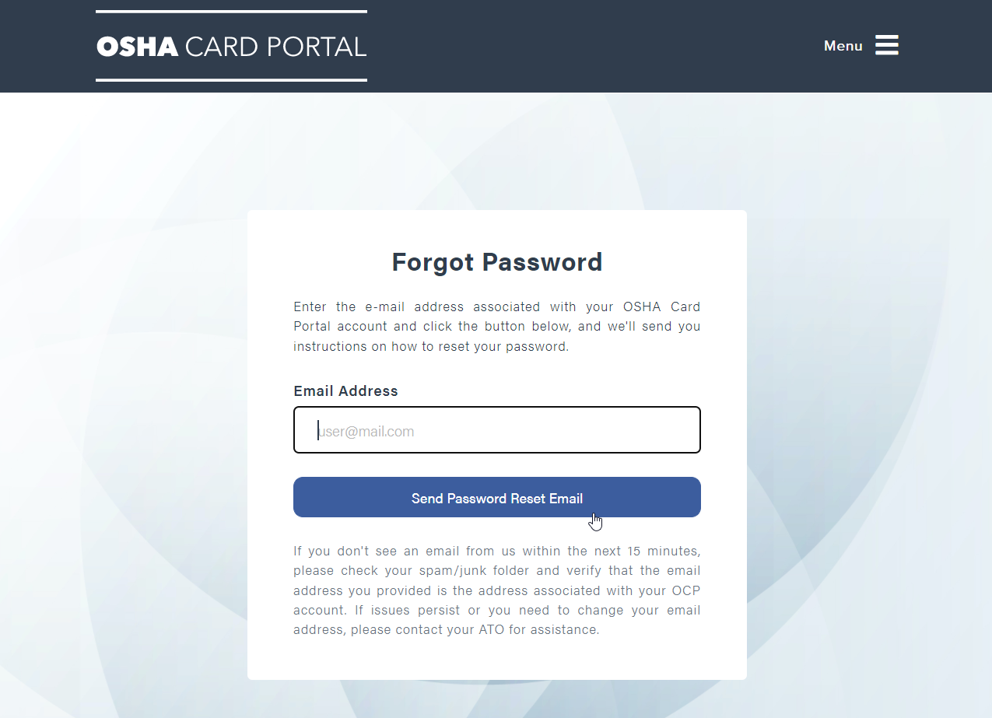
Setting up your account
Sending a Password Reset Email:
Input your User Email
Click Send Password Reset Email
An email with the reset password link will be sent to your email address
Click on the link, it will prompt you to create a password

Slide 12
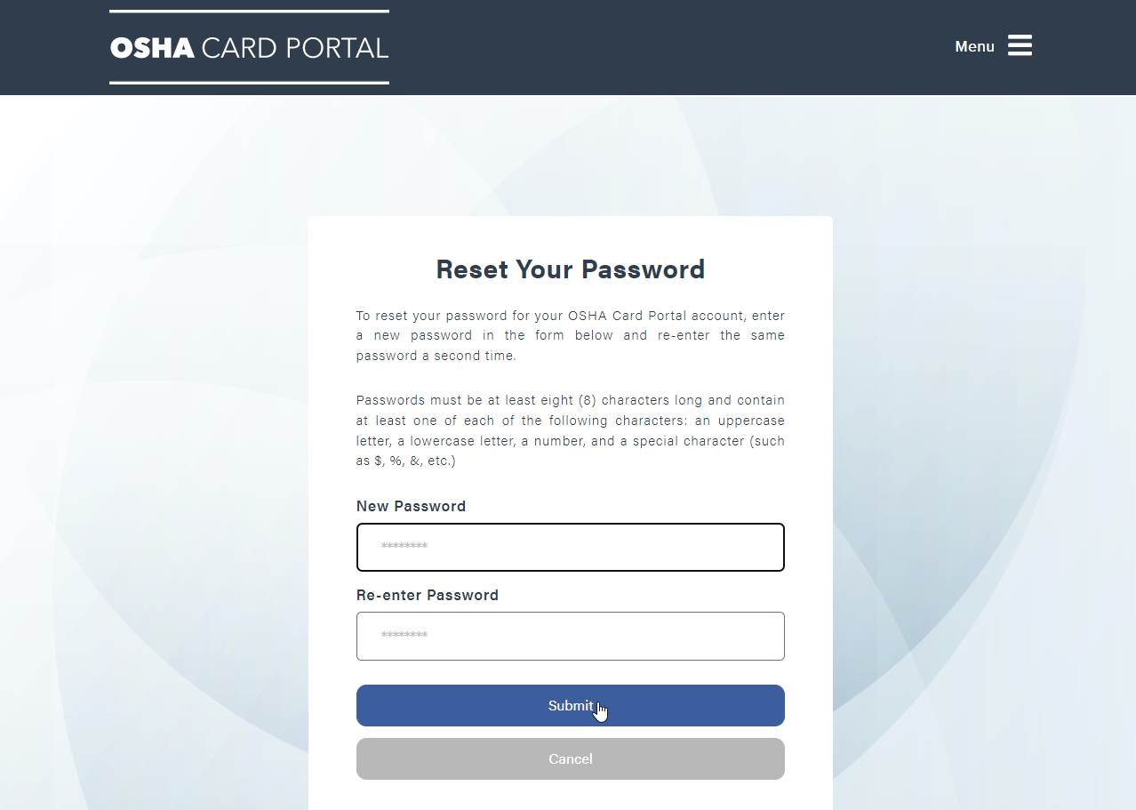
Setting up your account
Important Notes:
Passwords must be at least eight (8) characters long and contain one of each of the following characters:
  An uppercase letter
  A lowercase letter
  A number
  A special character
  (such as $, %, &, etc.)
Click Submit after entering your new password in both boxes
After your password is created you can go back to the OSHA Card Portal webpage and log in

Slide 13
Once you’re logged in

Slide 14
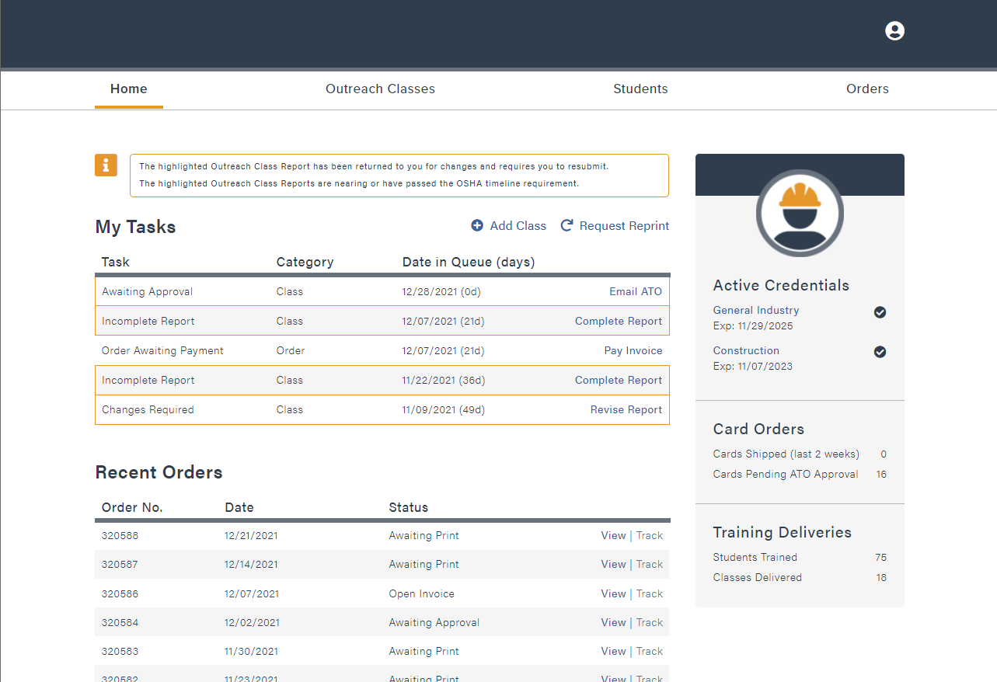
Once you’re logged in
Getting to know your Home Screen:
CSUDH
Hi, Katty
There are four main tabs: Home, Outreach Classes, Students, & Orders
In the gray box to the right, you’ll find your Active Credentials, Card Orders, and Training Deliveries
  Active Credentials: A quick view of your current active credentials and their expiration dates
  Card Orders: A quick view of cards that have shipped in the last 2 weeks and cards that are Pending ATO Approval
  Training Deliveries: A quick view of how many students you’ve taught & how many classes you’ve instructed

Slide 15
Once you’re logged in
Getting to know your Home Screen:
CSUDH
Hi, Katty
In the space to the left you’ll find Add Class, Request Reprint, My Tasks, and Recent Orders
Add Class: Clicking here will start the reporting process for a recently completed class
Request Reprint: This will take you to the Students tab where you can order a replacement Student Completion Card
My Tasks: Reports listed in this category need attention before they’re approved
Recent Orders: A list of your most recent orders and their status

Slide 16
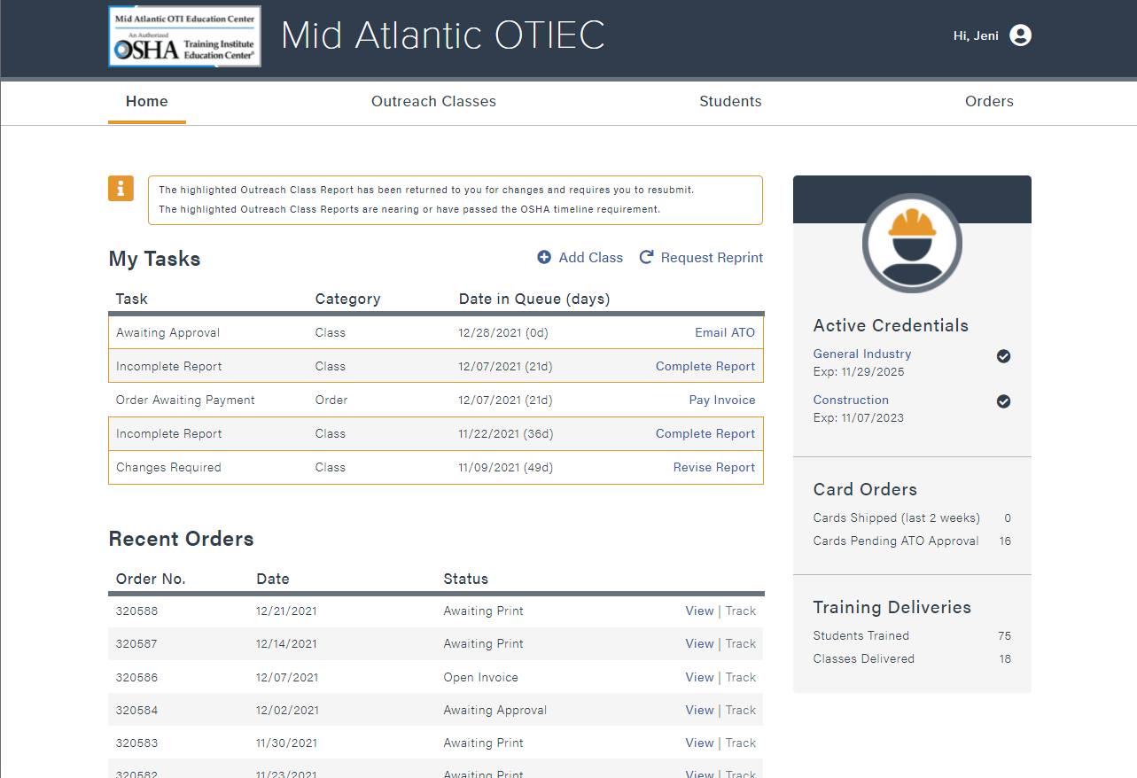
Once you’re logged in
What are My Tasks?
Reports listed in this category need attention before they’re approved
Awaiting Approval: Report has been submitted and is waiting for the ATO to review the report
Incomplete Report: Report was started but was not finished.
Click Complete Report to add
any missing information and submit the report
Order Awaiting Payment: Report was submitted for invoicing, and the invoice is waiting on payment
Changes Required: Report was completed, submitted, paid for, and reviewed by the ATO. Click Revise Report and make any necessary adjustments and resubmit
Classes outlined in yellow have additional information that needs to be addressed

Slide 17
Submitting a class report

Slide 18
Submitting a class report
Adding a Class:
CSUDH
Hi, Katty
Locate and click the Add Class button found above the My Tasks section

Slide 19
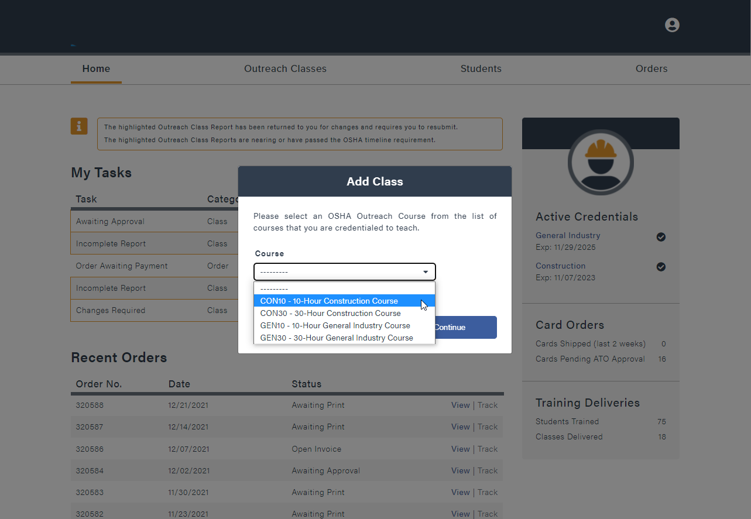
Submitting a class report
Adding a Class:
CSUDH
Hi, Katty
Select from the drop-down list of OSHA Outreach Courses
Only courses you’re authorized to instruct will be listed
Once you hit Continue the report will be started

Slide 20
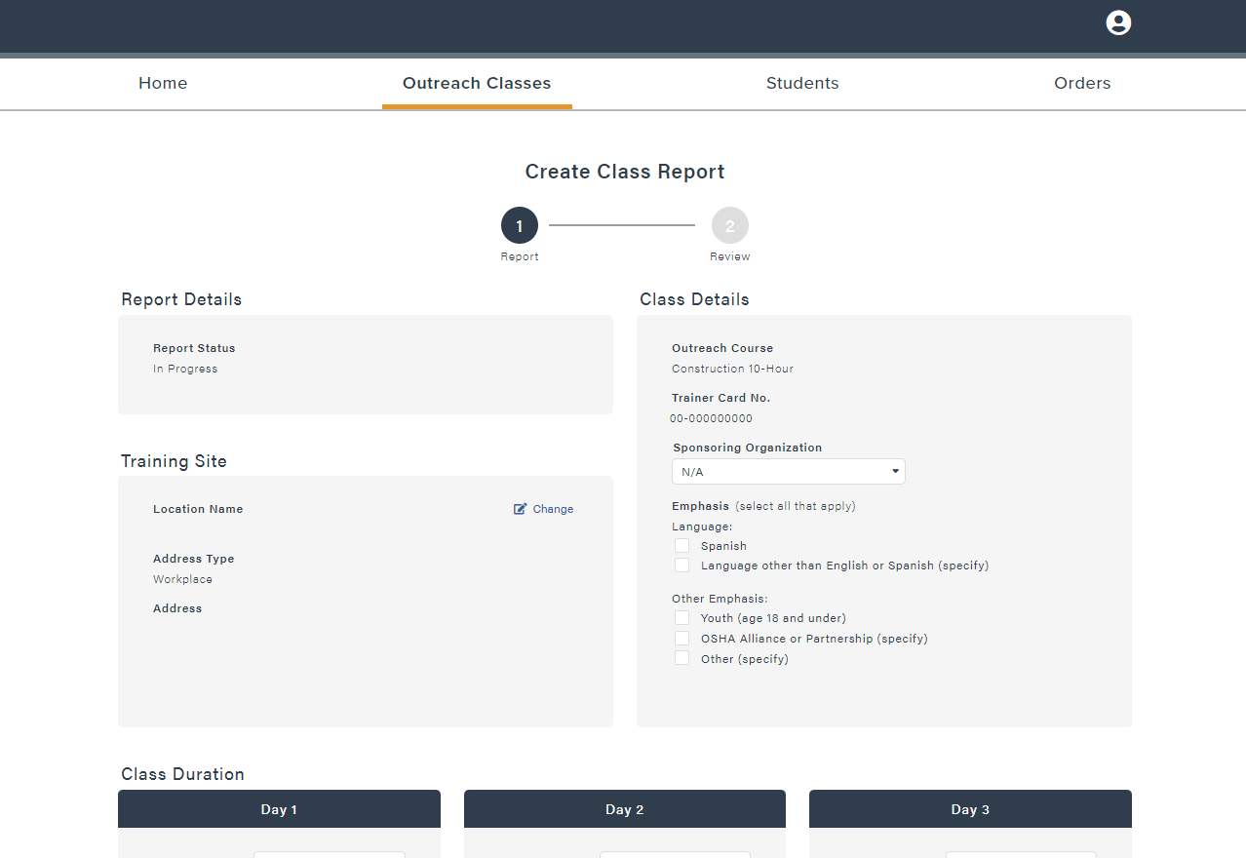
Submitting a class report
Create Class Report:
CSUDH
Hi, Katty
Report Details: Shows the progress of the report
In Progress, Payment Pending, Submitted, Approved, & Rejected
Class Details: Type of Course, Trainer Card Number, Sponsoring Organization, Language Emphasis other than English, and Other Emphasis, such as Youth (age 18 and under)
Training Site: Location Name, Address Type, and Address
To add a new address, or select from a previous address, click the Change button
Main Street
123 Main St
Suite A
City, St
00000

Slide 21
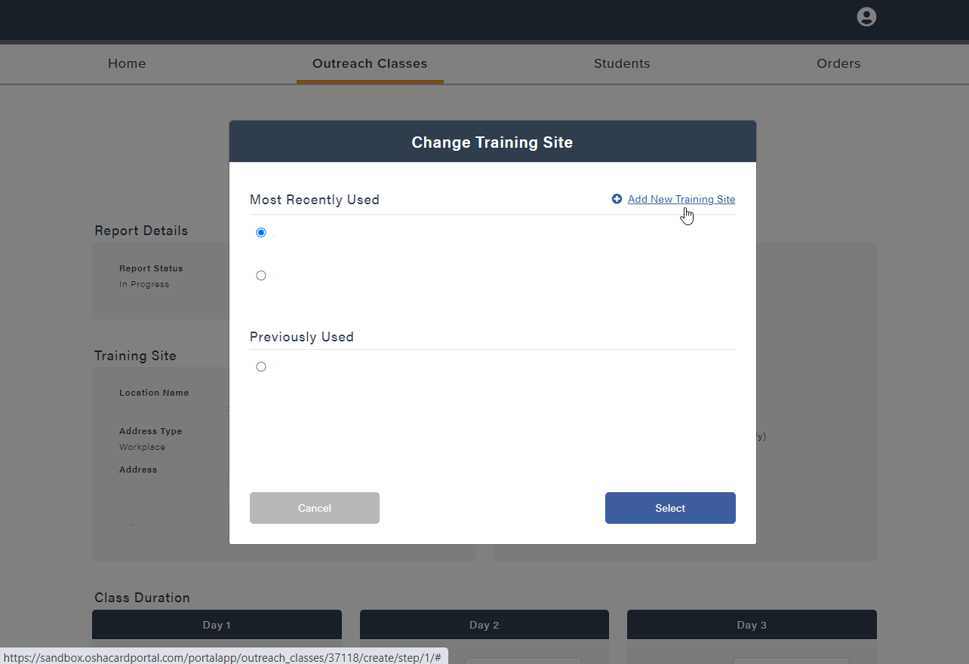
Submitting a class report
Change Training Site:
CSUDH
Hi, Katty
Under Change you can select from the list of Most Recently Used or Previously Used addresses
Click Add New Training Site to add a training site not listed below
Once a site is added, it will be available to select for future class reports
There is no limit to the number of addresses that can be kept on file
Main Street
123 Main St, Suite A, City, St, 00000
2nd Avenue
456 2nd Ave, Suite B, City, St, 00000
Main Street (Video Conferencing)
123 Main St, Suite A, City, St, 00000
CSUDH
123 Main St
Suite A
City, St
00000

Slide 22
Submitting a class report
Create Class Report:
CSUDH
Hi, Katty
Verify that all the information in the Class Details and Training Site are correct
Scroll down to the next section, Class Duration
Main Street
123 Main St
Suite A
City, St
00000

Slide 23
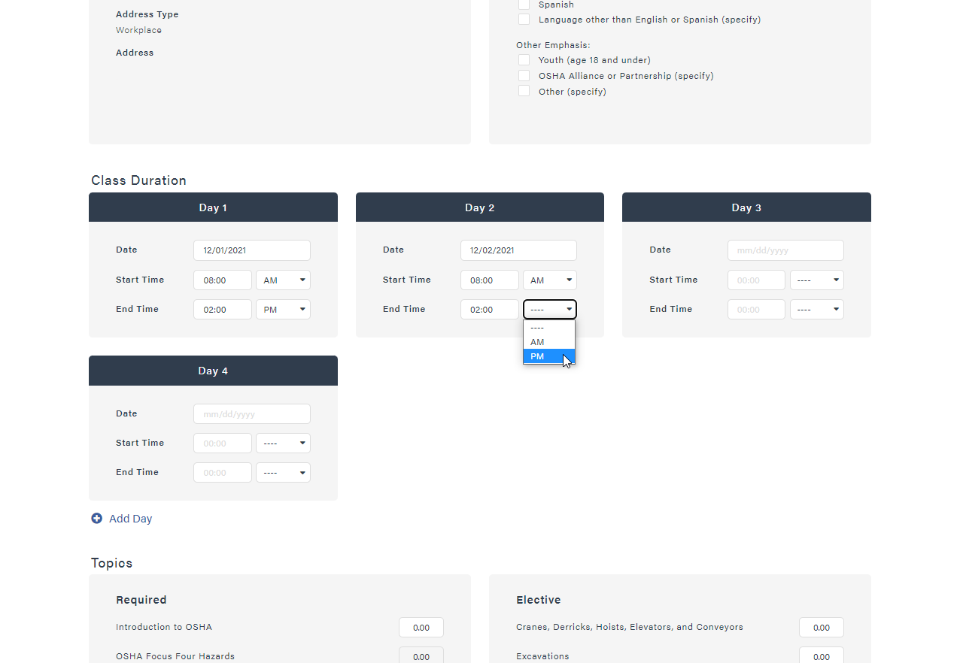
Submitting a class report
Class Duration:
The Class Duration is the total time that the students are in class, including all Topic hours, breaks, and administrative matters
Input the Class Date, Start Time, and End Time for each day
Select AM or PM from the drop-down menu
Click Add Day if you need to report additional class days
If you do not need all the days listed, leave it blank and it will remove them from the report
All classes must be completed within 6 months from start to finish
Scroll down to the next section, Topics
123 Main St
Suite A
City, St
00000

Slide 24
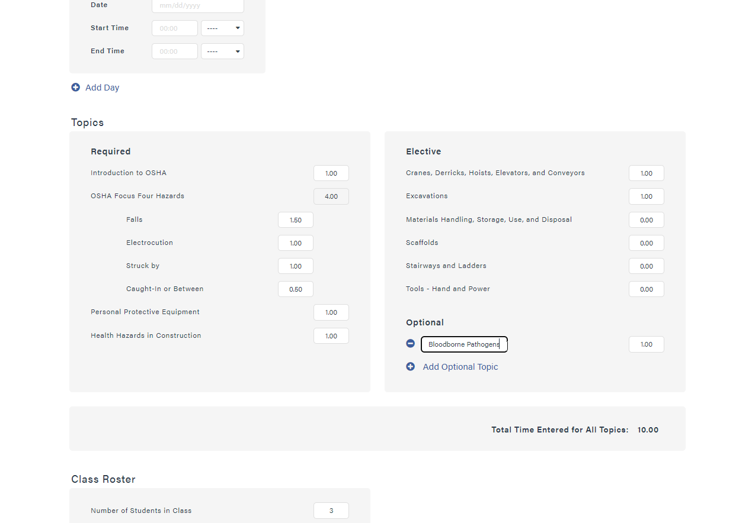
Submitting a class report
Topics:
3 topic categories for every report: Required, Elective and Optional
Topic time must be in decimal format
  30 min = 0.5
  45 min = 0.75
  1 hour = 1.00
  1 hour & 15 min = 1.25
Click Add Optional Topic to add additional topics instructed
Scroll down to the next section, class roster

Slide 25
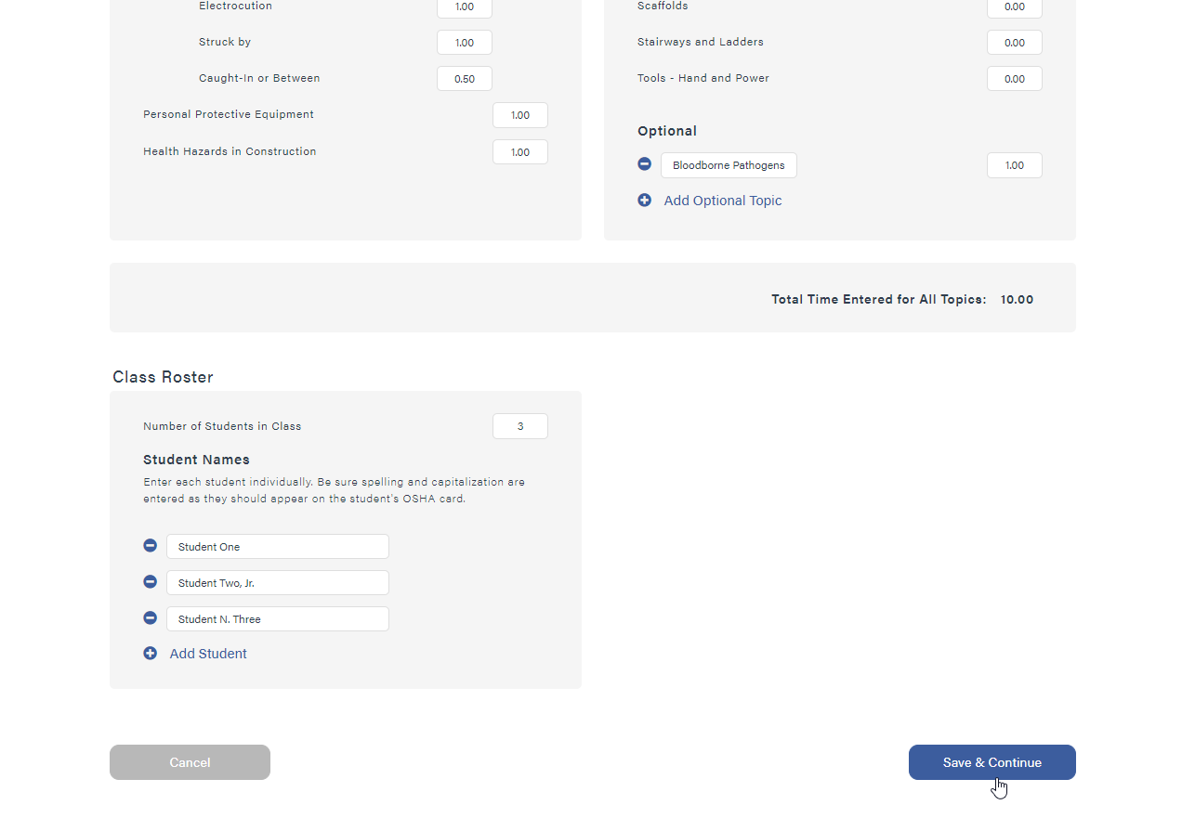
Submitting a class report
Class Roster:
Under Class Roster you can enter the Number of Students in Class, or click the Add Student button to add students one at a time
Outreach training classes must have no less than 3 students and no more than 40 students per class
The student’s name must be their full legal name and should match what appears on a driver’s license or government issued ID
Include any applicable suffix for the student, such as, Jr, Sr, II, or III
Only students who have completed the full training as indicated by the dates/times/topics above should be included on this report. Makeup students are submitted on their own separate report
Once you’re complete, click the Save & Continue button to proceed with reviewing the report

Slide 26
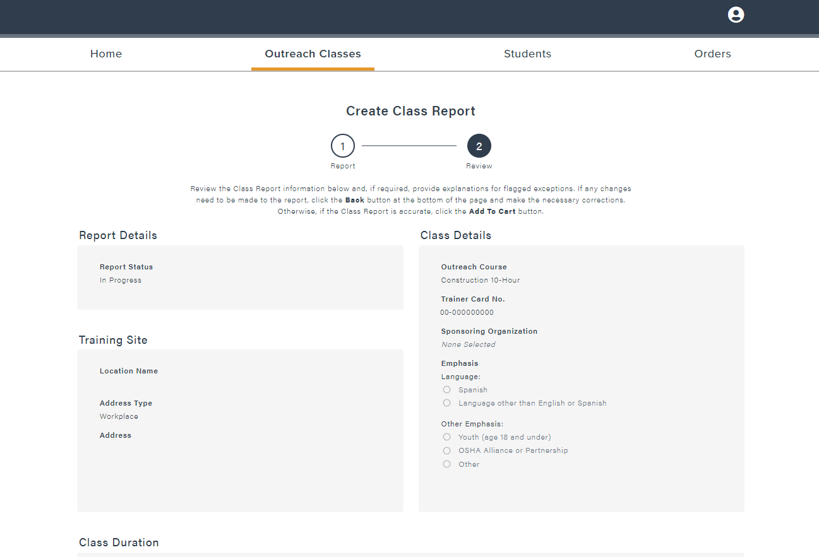
Submitting a class report
Review Class Report:
CSUDH
Hi, Katty
The review page is similar to what the ATO will see while reviewing the report for approval
Review each section to ensure that all information is accurate and follows the Outreach Training Program Requirements and Procedures
Scroll down to review the next section, class duration
Main Street
123 Main St
Suite A
City, St
00000

Slide 27
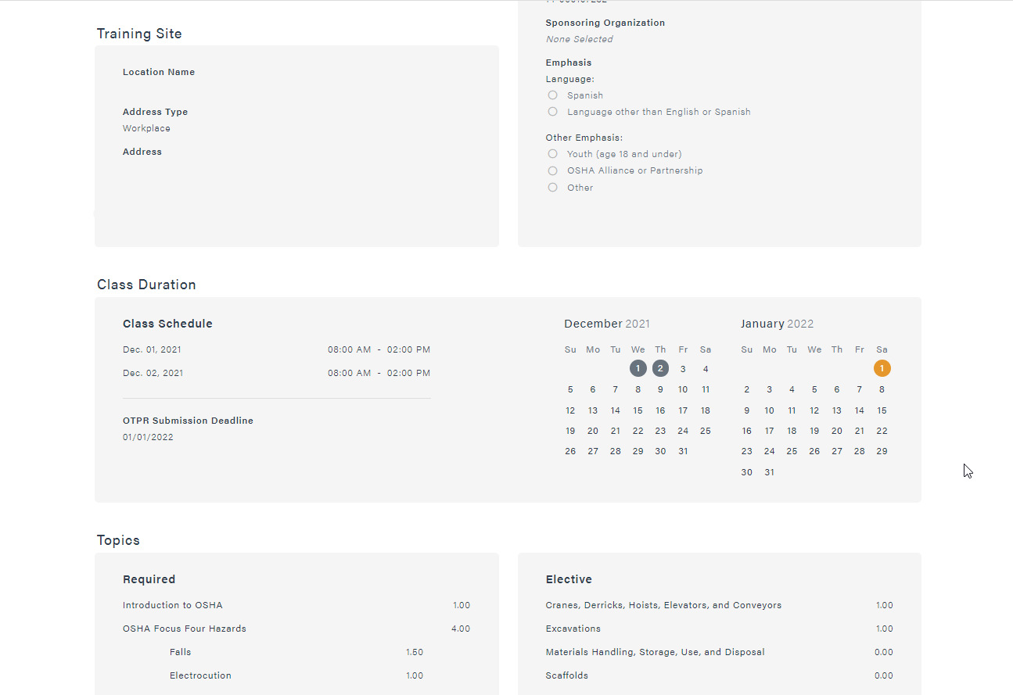
Submitting a class report
Review Class Report:
Class Duration will list the dates and times provided on the previous page and will now include the OTPR Submission Deadline date
OTPR stands for Outreach Training Program Report and is one of the required recordkeeping documents. The OSHA Card Portal will generate the OTPR for you from the report that is being submitted
All OTP reports must be submitted within 30 calendar days of class completion
Scroll down to review the next section, topics
Main Street
123 Main St
Suite A
City, St
00000

Slide 28
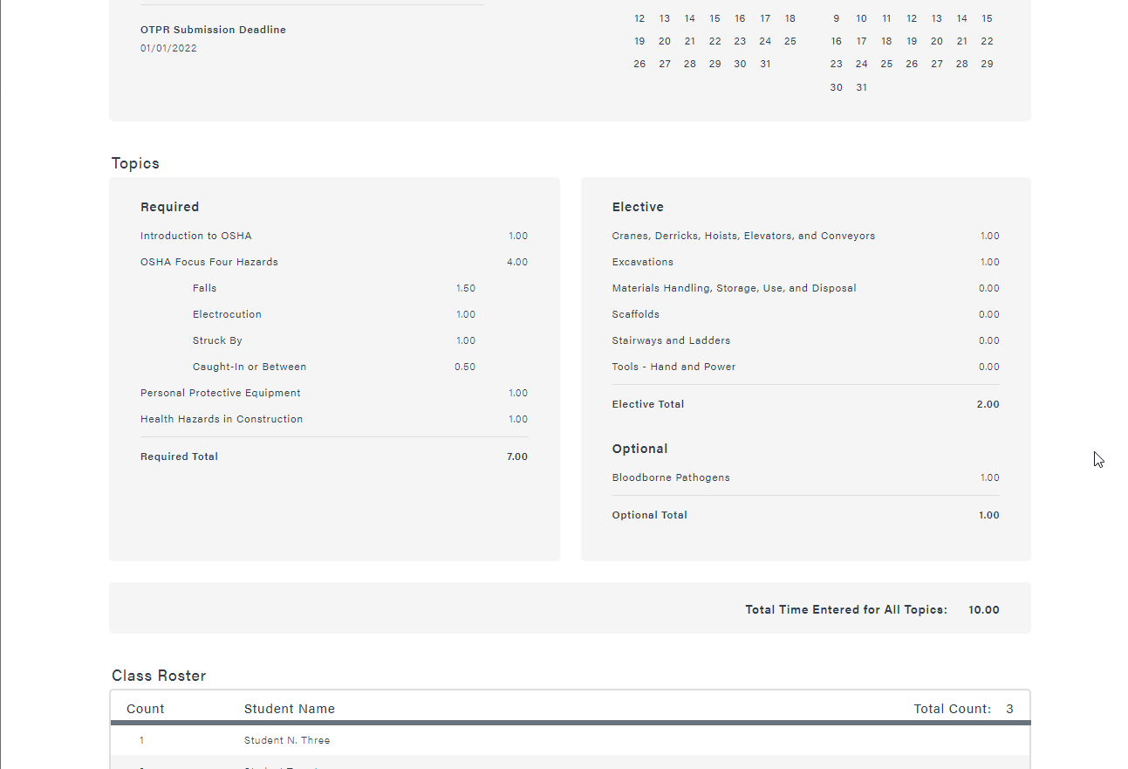
Submitting a class report
Review Class Report:
Double check that the topics submitted match the topics provided on the detailed topic outline for the class
Scroll down to review the next section, class roster

Slide 29
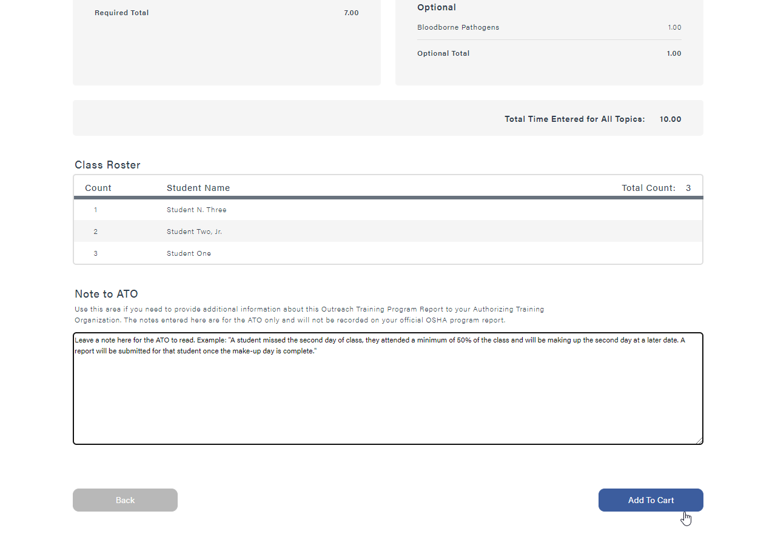
Submitting a class report
Review Class Report:
Review the names submitted on the Class Roster for accuracy
If you’ve found errors that will need to be adjusted, click the Back button and make the necessary adjustments
Once payment has been made, you cannot add or remove any students
Note to ATO: Leave a note about the class that the ATO may need to know. Do not provide information about payment or shipping
  Shipping is an automated process and cannot be adjusted by the ATO
  The report cannot be viewed until payment has been made.
  If you have updates about payment, please email the ATO
Click Add to Cart to proceed

Slide 30
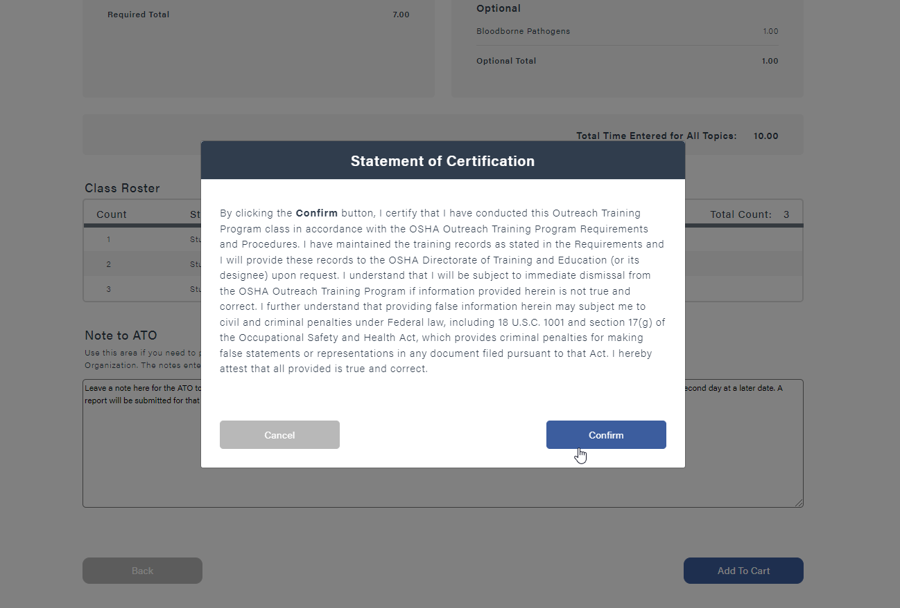
Submitting a class report
Statement of Certification:
All reports must have a Statement of Certification on File
By clicking Confirm you certify that you conducted the Outreach Training Program Class in accordance with the OSHA Outreach Training Program Requirements and Procedures
Click Confirm to proceed with payment

Slide 31
Completing the checkout process

Slide 32
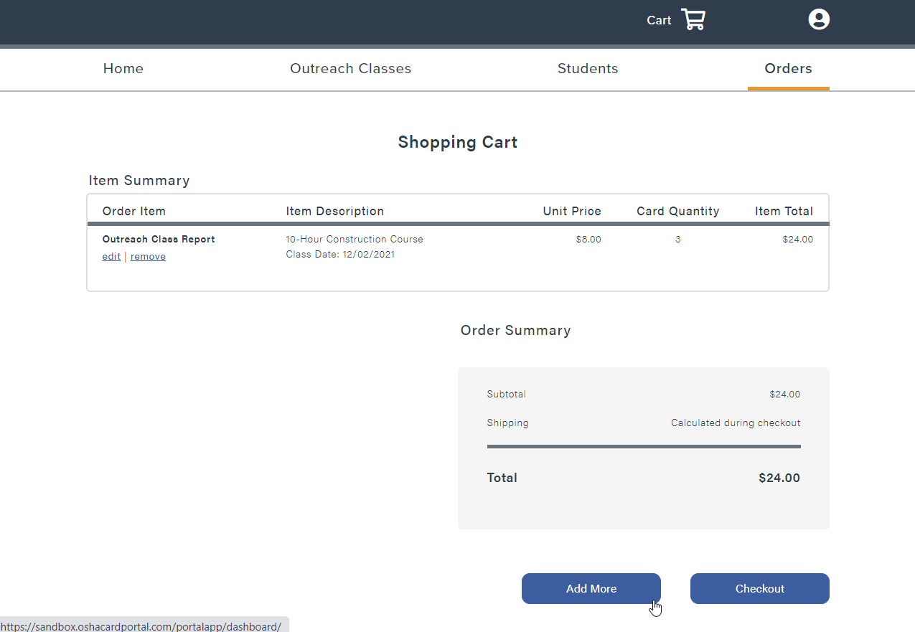
Completing Checkout Process
Shopping Cart:
CSUDH
Hi, Katty
Once the Statement of Certification is confirmed, the report will move into the Shopping Cart
Item Summary: A breakdown of the different items in the cart
Order Summary: The total cost of all items in the shopping cart, minus shipping
If you have more than one report, or a replacement card request to submit on the same invoice, click Add More to add to the order
  Please note, invoices must be paid in full and cannot be split between multiple payment methods
Once all items have been added, click the Checkout button to proceed with payment

Slide 33
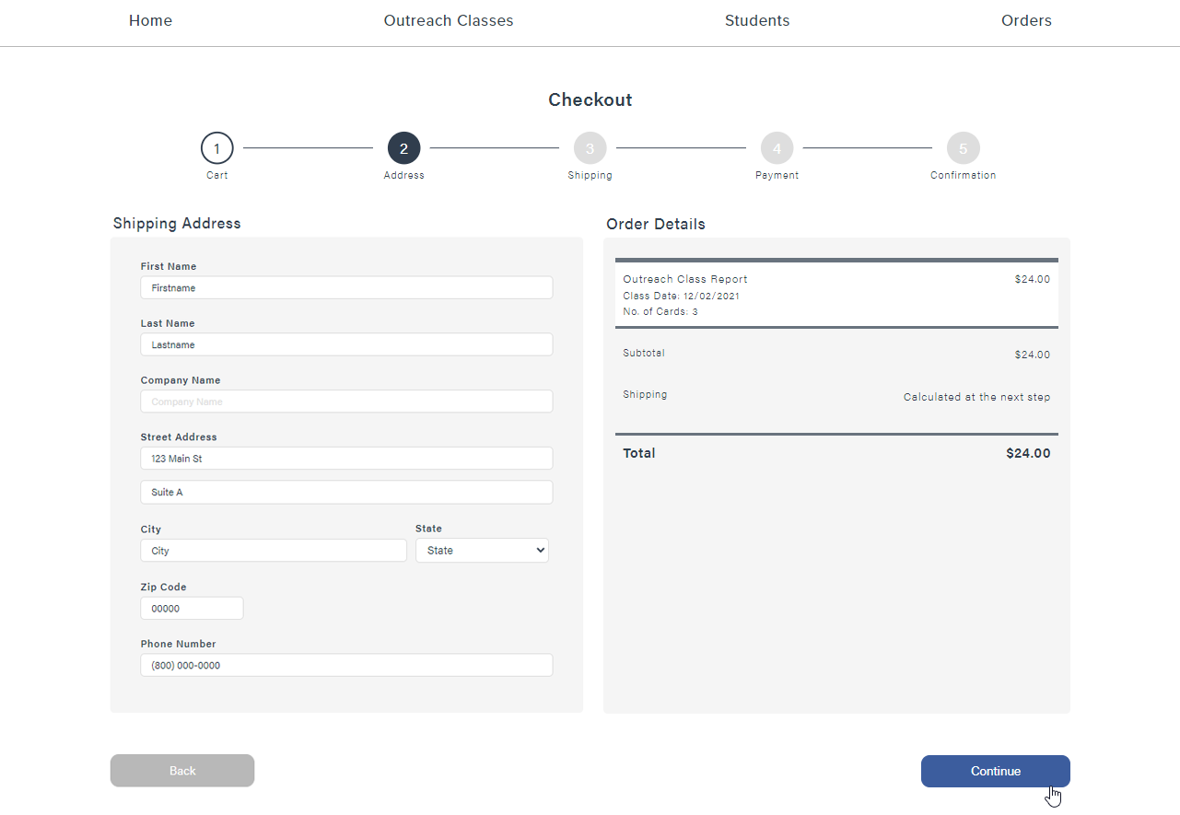
Completing Checkout Process
Shipping Address:
The Shipping Address will be pre-filled in with the address provided in your account settings
The shipping address should be the home or business address of the primary Outreach trainer
Click Continue to select a shipping method

Slide 34
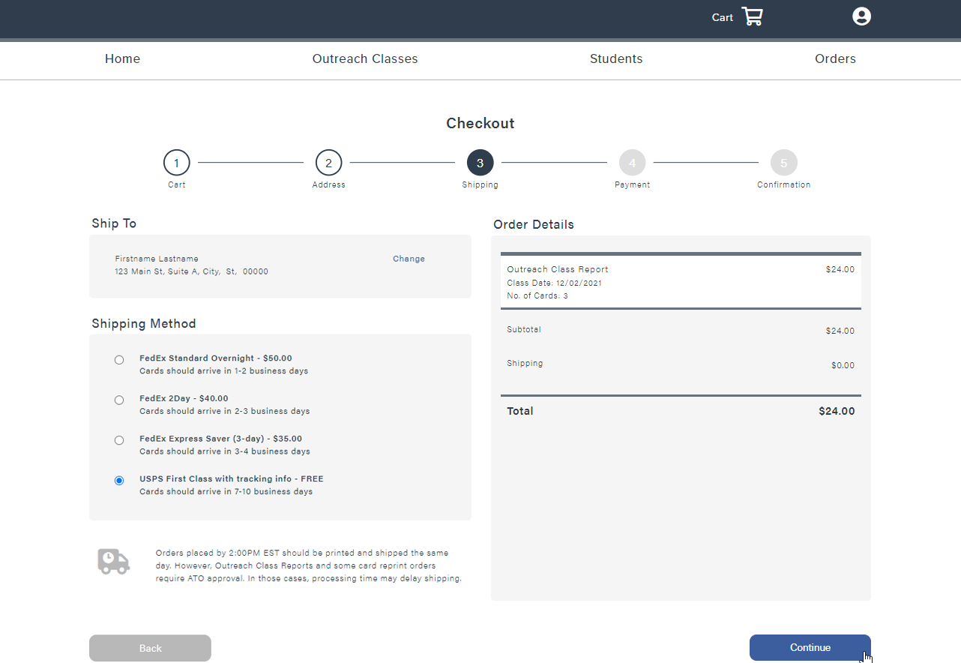
Completing Checkout Process
Shipping Method:
CSUDH
Hi, Katty
USPS First Class with Tracking Info: Provided at no additional cost. Arrives in 7-10 business days
FedEx Express Saver (3-day): Additional cost varies by location and quantity of cards. Arrives in 3-4 business days
FedEx 2Day: Additional cost varies by location and quantity of cards. Arrives in 2-3 business days
FedEx Standard Overnight: Additional cost varies by location and quantity of cards. Arrives in 1-2 business days
Expedited (FedEx) orders approved by the ATO by 2:00pm EST are shipped the same day
Choose shipping method and click Continue to proceed with payment

Slide 35
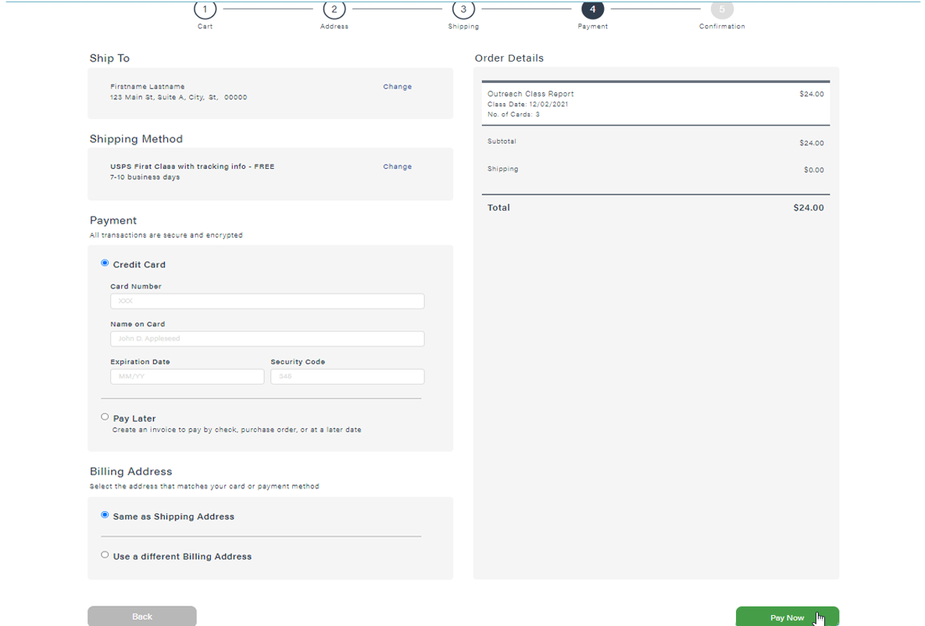
Completing Checkout Process
Payment Method -
Pay Now:
If making a payment by credit, enter in the credit card information in the Payment section
The Shipping Address is selected as the default Billing Address; however, this can be changed by selecting Use a different Billing Address and filling in the alternate Billing Address information
Click Pay Now and the report will be instantly submitted to the ATO for review

Slide 36
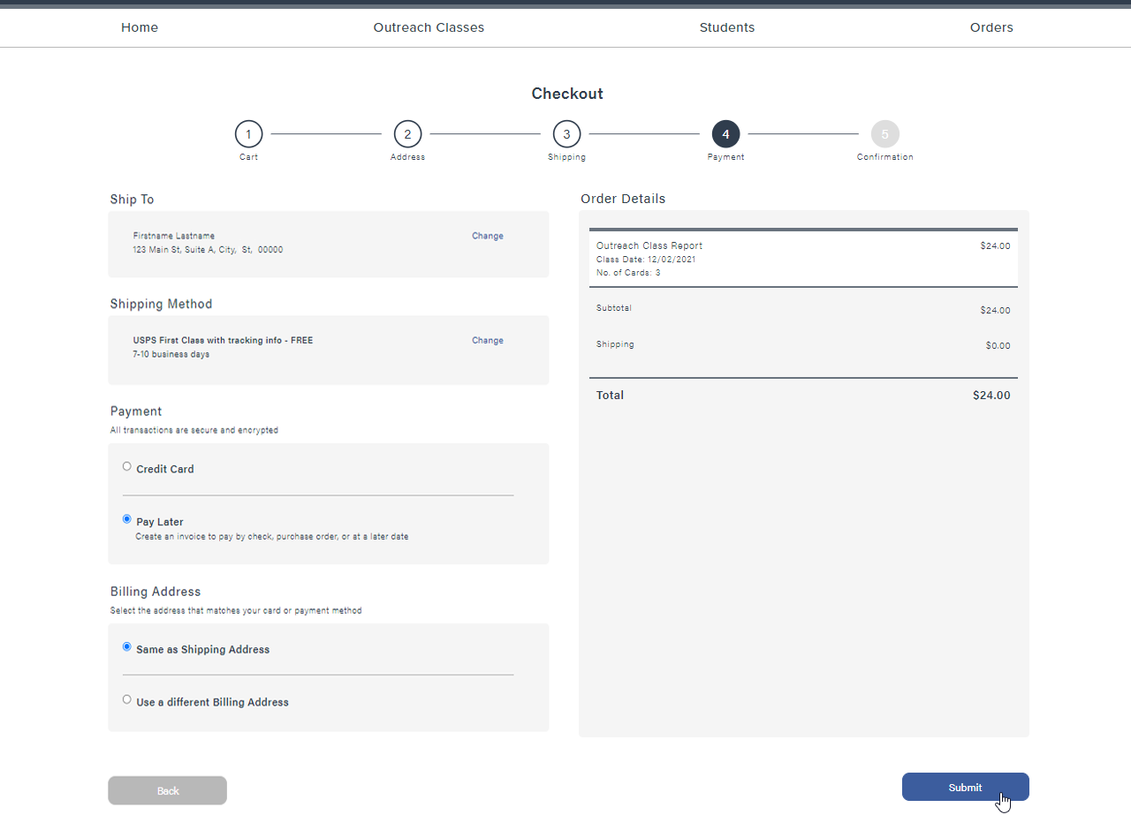
Completing Checkout Process
Payment Method -
Pay Later:
If you would like to request an invoice, select Pay Later in the Payment section
The Shipping Address is selected as the default Billing Address; however, this can be changed by selecting Use a different Billing Address and filling in the alternate Billing Address information
The Billing Address can be adjusted by the person who is submitting payment
The Ship To address and Shipping Method can only be adjusted by the Outreach trainer and not a 3rd party submitting payment
Click Submit to generate an invoice

Slide 37
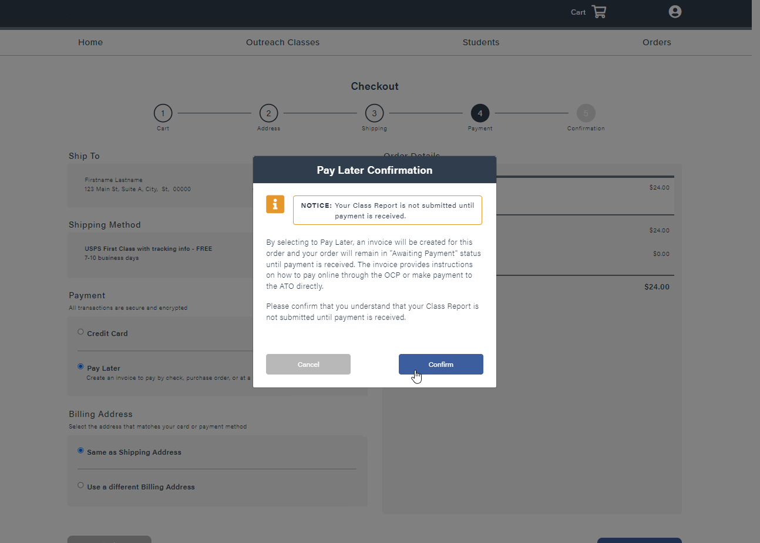
Completing Checkout Process
Pay Later Confirmation:
CSUDH
Hi, Katty
By selecting to Pay Later, an invoice will be created for this order and your order will remain in Awaiting Payment status until payment is received
Orders Awaiting Payment are not considered submitted, payment must be completed within 30 days from the last day of class to remain in compliance with the program requirements
Orders Awaiting Payment cannot be reviewed by the ATO, and will not be visible until payment has been received
Click Confirm to generate the invoice

Slide 38
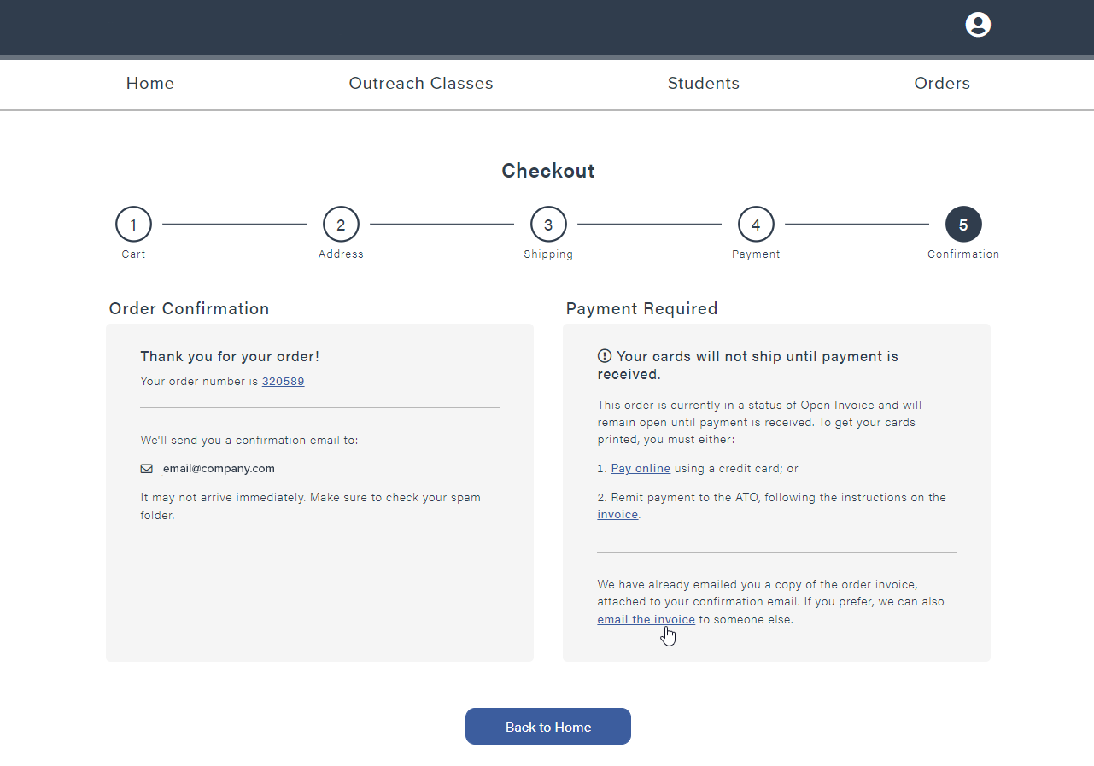
Completing Checkout Process
Invoice Confirmation:
CSUDH
Hi, Katty
A copy of the Invoice will be emailed to you
Click Pay Online to submit a payment with your credit card
Click Email the Invoice to send an email directly from noreply@oshacardportal.com to someone else
Click Invoice to download a PDF copy of the invoice

Slide 39
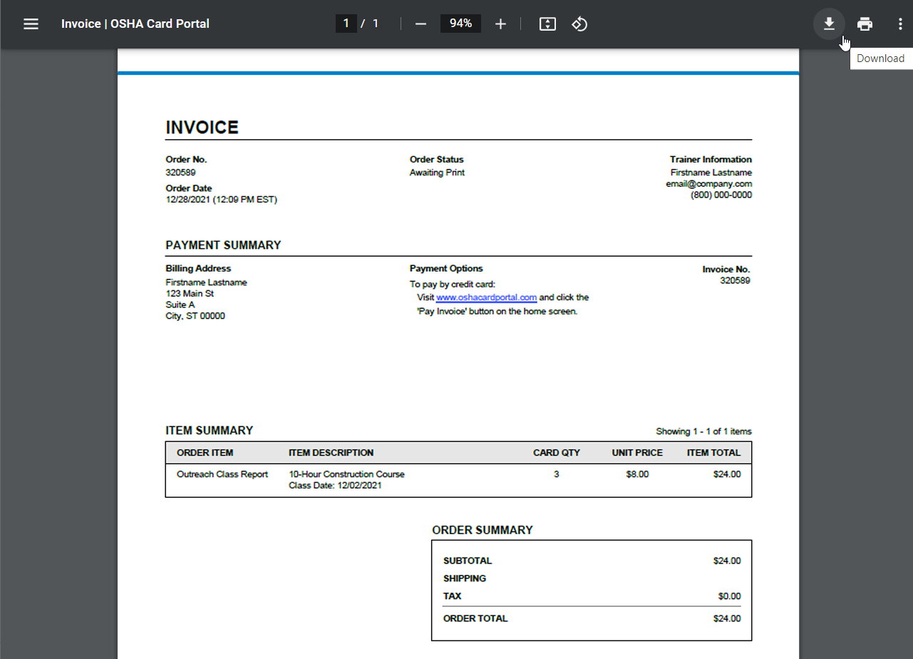
Completing Checkout Process
PDF Invoice:
From Google Chrome, clicking Invoice will open a new window
Click Download to download a copy of the invoice to your computer
Click Print to print a copy of the invoice to your printer

Slide 40
Editing your Account

Slide 41
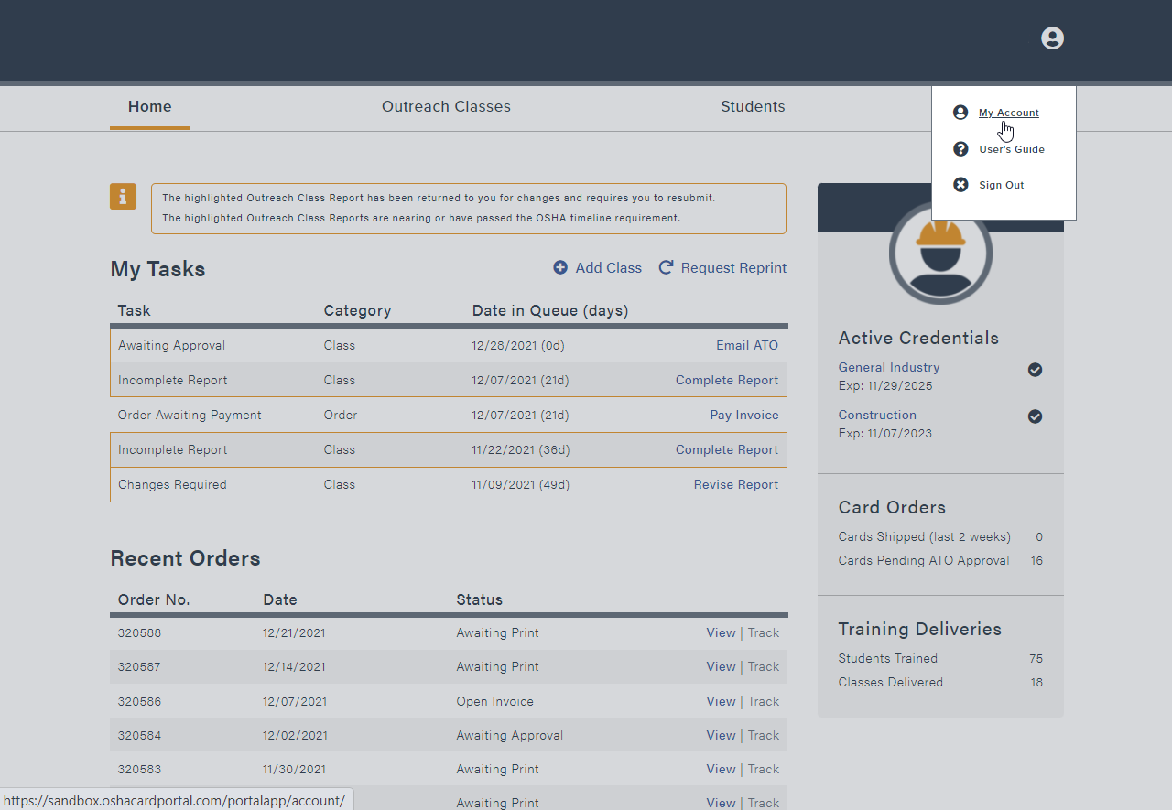
Editing your Account
My Account
CSUDH
In the top right corner, click on the greeting that says Hi, Xxxx
This will bring up a dropdown menu, select My Account to view and edit your account information
Hi, Katty

Slide 42
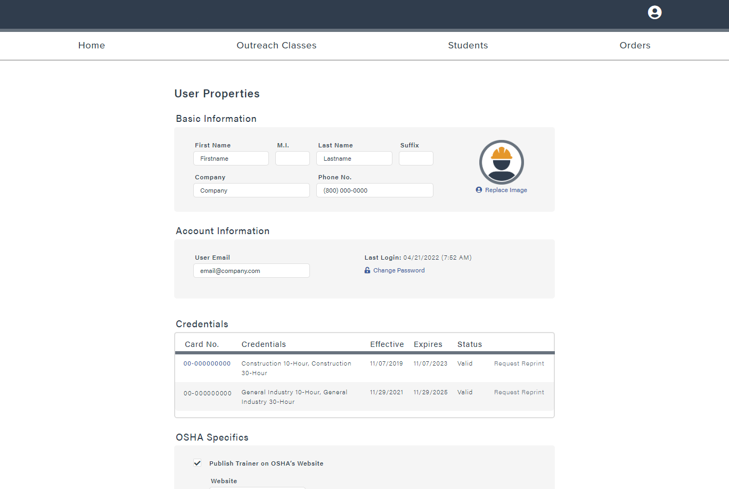
Editing your Account
User Properties:
CSUDH
Hi, Katty
Information under My Account is must remain up to date
Basic Information: Your full legal name, company, and a phone number where the ATO can reach you directly
Account Information: The email address you will utilize to log into your account. This can be updated at any time
Credentials: A list of current and past credentials. A replacement Outreach trainer card can be requested if the credential is Valid
Scroll down to view the next section, OSHA Specifics

Slide 43
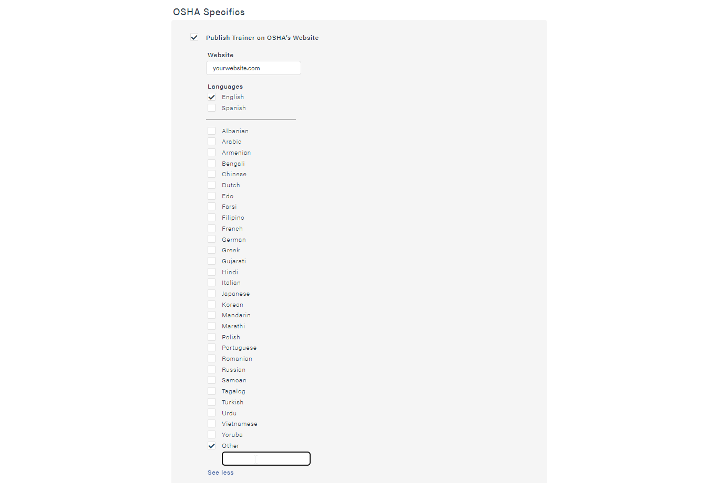
Editing your Account
OSHA Specifics:
This section is utilized to publish yourself to OSHA.gov list of Outreach Trainers
Click the check box to activate
Add any websites or languages
OSHA.gov will also publish the email address and phone number listed on your account
The Opt-In trainer list is submitted to OSHA at the end of each month and should be uploaded by the 15th of the following month. If you do not see your information after the 15th of the following month, please reach out to your ATO
Scroll down to view the next section, Shipping Address and Billing Address

Slide 44
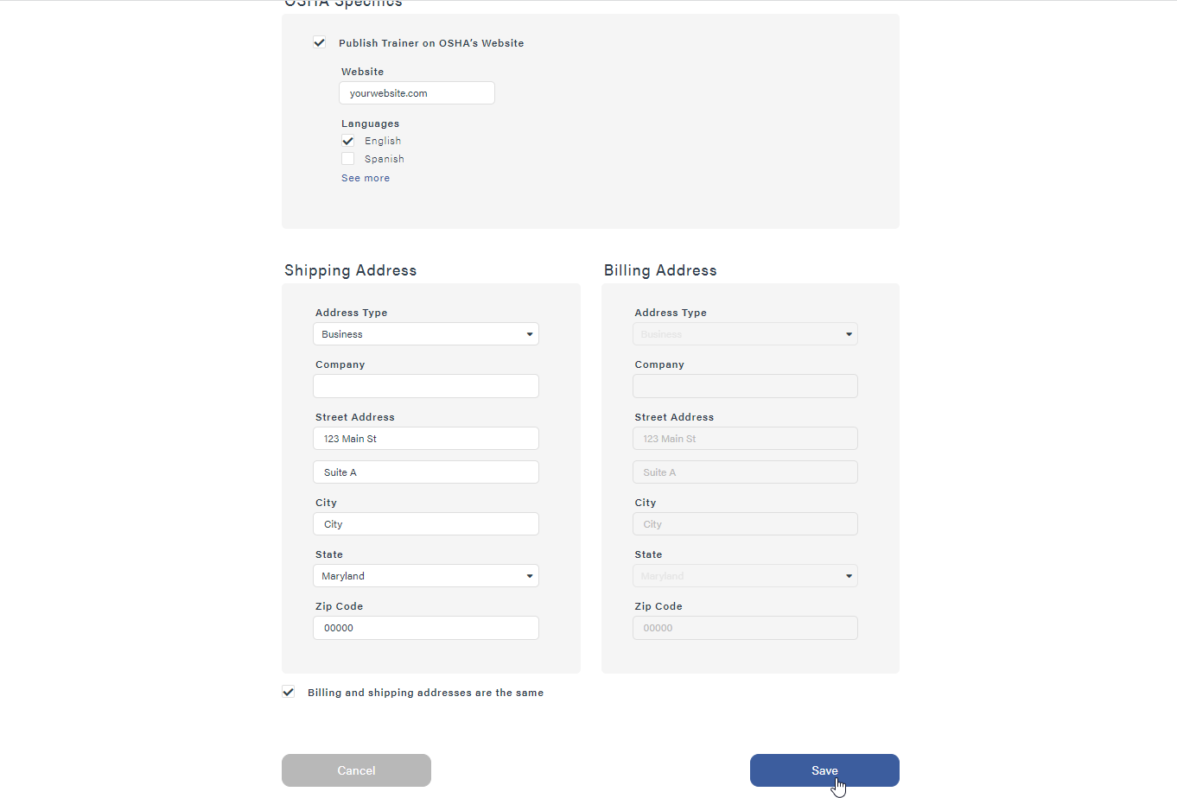
Editing your Account
Account Addresses:
Shipping Address: This is the address that will default for all OSHA Card Portal orders. This will also be the address that any communication from the ATO will be sent to
Billing Address: This can be the same as the Shipping Address by clicking the check mark at the bottom or can be a separate address
Once any adjustments have been made, click the Save button at the bottom of the page. If you do not click Save, the adjustments will revert back

Slide 45
Exploring the four main tabs
Home | Outreach classes | Students | orders

Slide 46
Exploring the four main tabs
Home:
CSUDH
Hi, Katty

Slide 47
Exploring the four main tabs
Home | Outreach classes | Students | orders

Slide 48
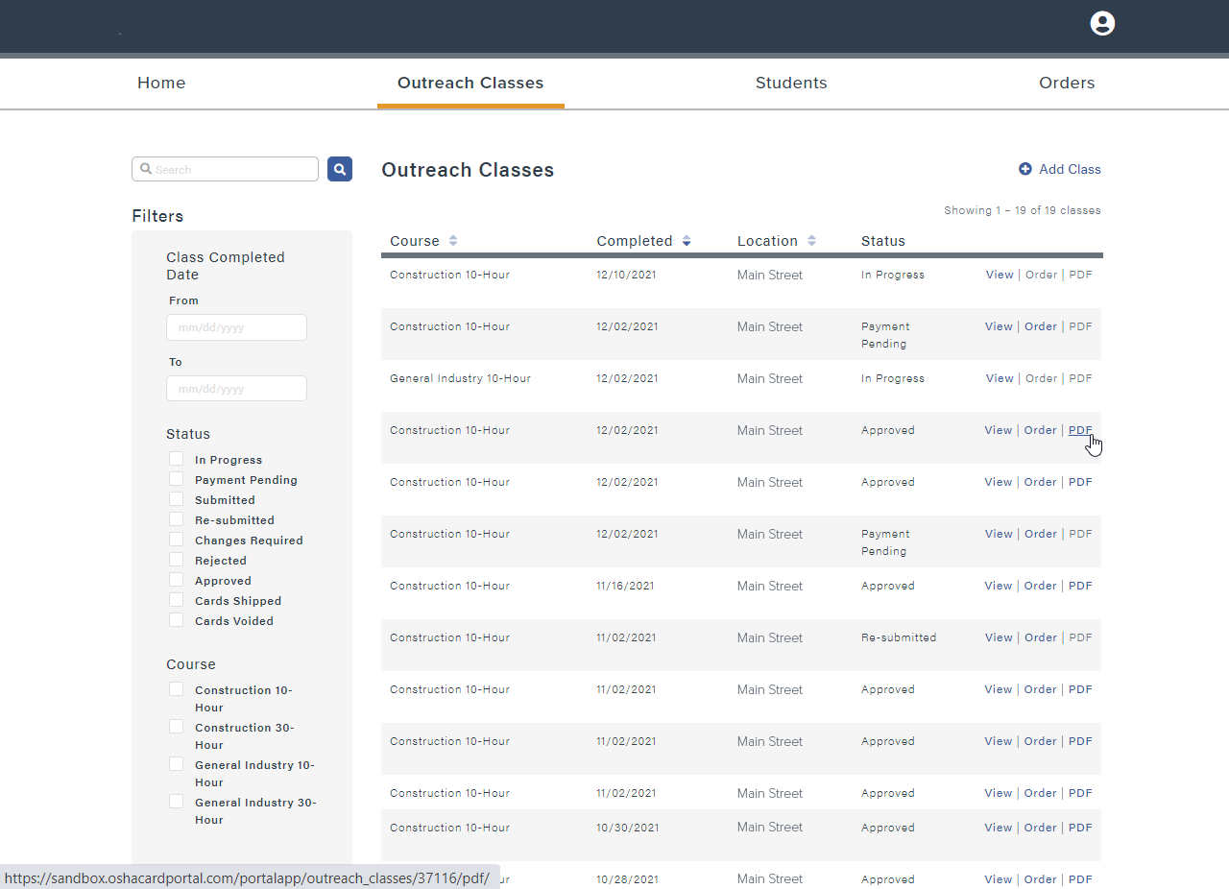
Exploring the four main tabs
Outreach Classes:
CSUDH
Hi, Katty
Use the Search Box to search for a specific student’s name
Classes can be Filtered by:
  Class Completed Date
  Status of Outreach Classes
  Course Type
Columns with the light blue arrow can be sorted by ascending or descending order
View: This will take you to the Outreach Class review page
Order: This will take you Order information associated with the class; such as, payment and shipping information
PDF: This will download the PDF copy of the OTPR, one of the required recordkeeping documents

Slide 49
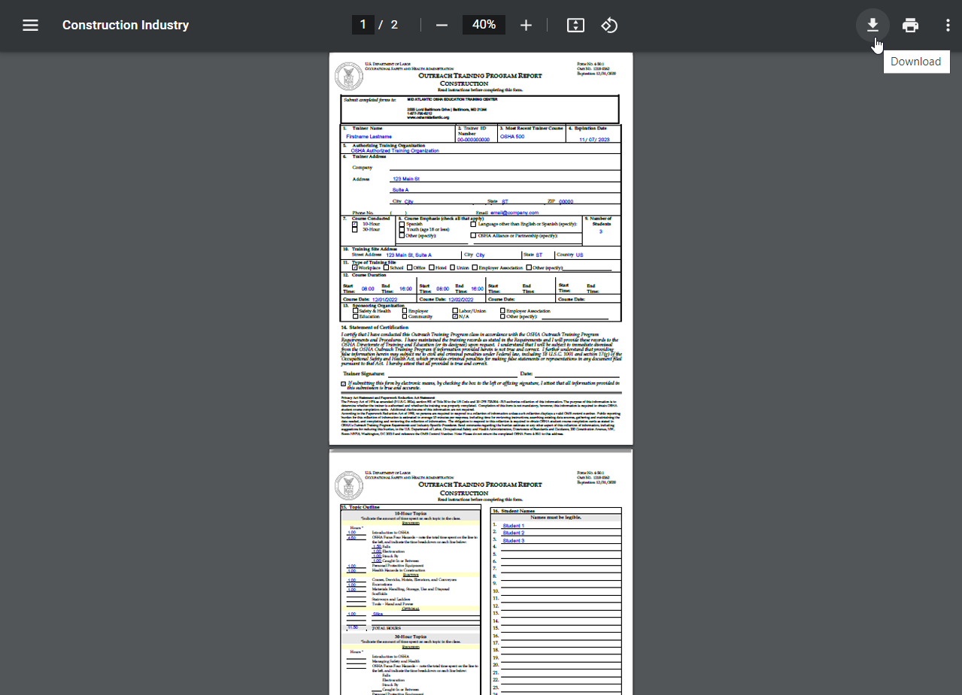
Exploring the four main tabs
Outreach Training Program Report (OTPR):
The Outreach Training Program Report (OTPR) is one of the required recordkeeping documents and should be downloaded and kept with the class recordkeeping documents
Click Download to download the PDF copy of the OTPR to your computer
Click Print to print a copy of the OTPR

Slide 50
Exploring the four main tabs
Home | Outreach classes | Students | orders

Slide 51
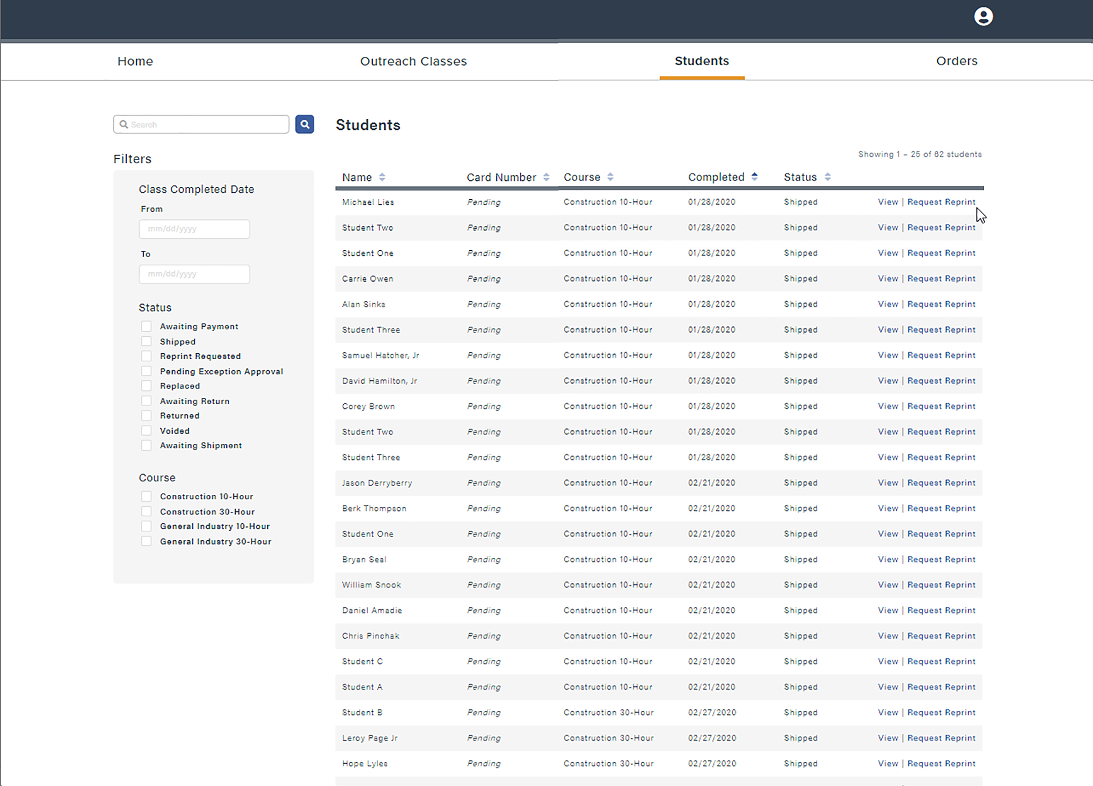
Exploring the four main tabs
Students:
CSUDH
Hi, Katty
Use the Search Box to search for a specific student’s name
Classes can be Filtered by:
  Class Completed Date
  Status of Outreach Class
  Course Type
Columns with the light blue arrow can be sorted by ascending or descending order
View: This will take you to the Student Completion card information page
Request Reprint: This will take you to the order page to request a replacement card for that student

Slide 52
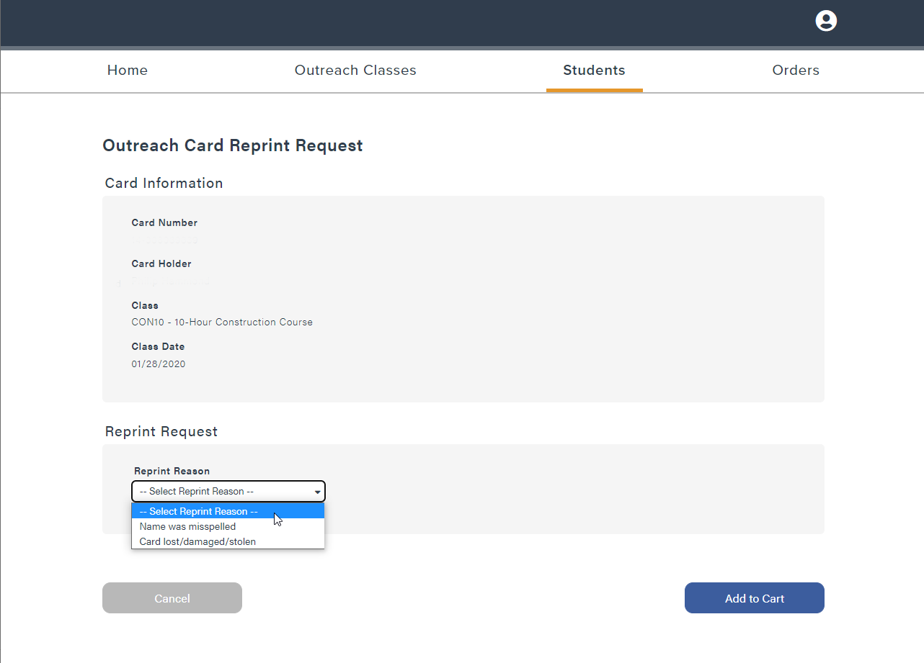
Exploring the four main tabs
Request Student
Replacement Card:
CSUDH
Hi, Katty
Verify that the student information at the top is the card you wish to replace (Name & Card Number)
Select the Reason for the Request, misspelled or lost/damaged/stolen
Student completion cards are only eligible for reprint if the class was completed within the last 5 years
Only one replacement card for lost/damaged/stolen
  If the student completion card is lost more than once, the student will be required to take the course again

Slide 53
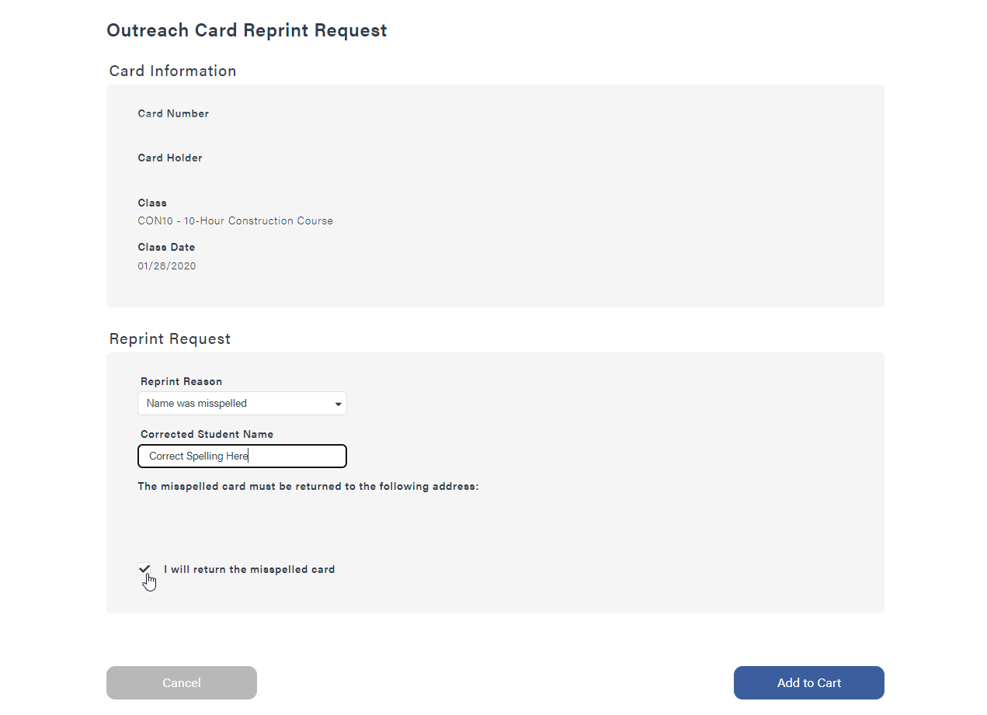
Exploring the four main tabs
Replacing a
Misspelled Card:
If requesting for a misspelled card, enter in the correct spelling in the box provided
The misspelled card must be returned to the ATO at the address provided. The Outreach trainer must check the box that states,
I will return the misspelled card
CSUDH
123 Main St
Suite A
City, ST, 00000

Slide 54
Exploring the four main tabs
Home | Outreach classes | Students | orders

Slide 55
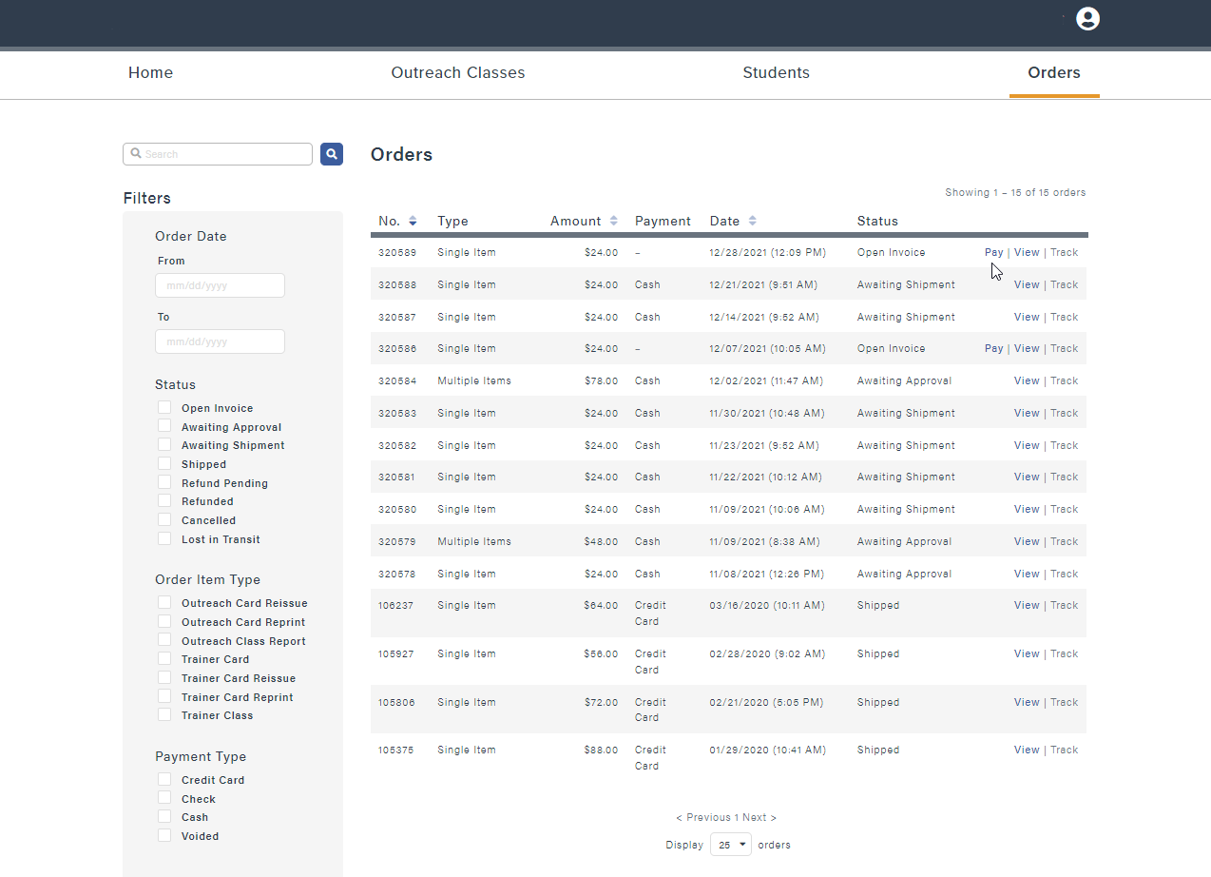
Exploring the FOUR main tabs
Orders:
CSUDH
Hi, Katty
Use the Search Box to search for a specific student’s name
Classes can be Filtered by:
  Class Completed Date
  Status of Outreach Classes
  Order Item Type
  Payment Type
Columns with the light blue arrow can be sorted by ascending or descending order
Pay: This will take you to the checkout page to make payment for the order
View: This will take you Order information associated with the class; such as, payment and shipping information
Track: If the order has shipped, this will take you to USPS or FedEx tracking page. USPS does not track beyond 120 days

Slide 56
Questions?

