Slide 1



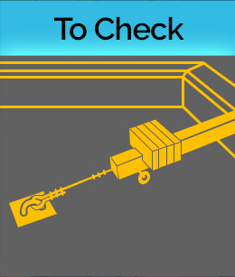




Foundations for Safety Leadership
Notes:
Welcome!
Introductions:
Name
Trade
Position
Years in construction
Most of the slides we’ll be going over are in your student handout starting on page 4. You can follow along and take notes.

Slide 2
Goal
Introduce you to 5 critical safety leadership skills you can use to improve safety climate and safety outcomes on the job site.
Notes:
The overall goal of this training is to give you the opportunity to learn/enhance some critical safety leadership skills that you can use to improve the safety climate and safety outcomes on jobsites.
ASK CLASS:
HOW MANY OF YOU HAVE HEARD THE TERM SAFETY CLIMATE? DO YOU HAVE SOME THOUGHTS ABOUT WHAT IT MEANS?
(AFTER SOME DISCUSSION, LET THEM KNOW YOU’LL BE PRESENTING THE DEFINITION IN A FEW MINUTES)

Slide 3
Learning Objectives
By the end of this module students will be able to:
Explain why safety leadership is important
Describe 5 skills of safety leaders
Discuss how to apply safety leadership skills on the job site
Notes:
We expect that by the end of today’s training each of you will be able to:
Explain why safety leadership is important
Describe 5 critical safety leadership skills and
Discuss how an effective leader can apply them on the jobsite.

Slide 4
What types of things do ineffective leaders do?
Notes:
To get us started let’s brainstorm about the types of actions that effective and ineffective leaders display. It can be someone you work or have worked with, or maybe he or she was a coach, a teacher, or a parent, or even a friend. Ok, now tell me some behaviors that make or made them ineffective leaders.
< ON A WHITE BOARD OR FLIPCHART MAKE 2 COLUMNS, ONE WITH HEADING ‘INEFFECTIVE’ AND THE OTHER HEADING ‘EFFECTIVE >
ADDITIONAL INSTRUCTOR NOTES FOR INEFFECTIVE LEADERS
If students provide only a few (or no ideas) you can ask a few of these questions.
What are some of the basic behaviors ineffective leaders display? (e.g. lies to protect themselves, withholds information, blames worker, blames superiors, reacts angrily to a problem without addressing the problem and seeking solutions)
In what ways might ineffective leaders communicate with their team members? (e.g., yell, say “just do it and don’t ask questions”, threaten them with retaliation)
How might an ineffective leader fail to create a sense of teamwork? (e.g. say things like, “I’m in charge here and you’ll do as I say.” “You don’t need to ask X for their opinion.” “I’ll tell you when something is risky.”)
How might an ineffective leader fail to lead by example? (e.g. is a poor role model by having team members wear PPE and demands safety from them, but doesn’t ‘walk the talk,’ ignores worker safety concerns, thinks that conducting a weekly toolbox talk that may or may not be relevant to the work being done is enough to comply with OSHA regulations and doesn’t need to do anything else, etc.)

Slide 5
What types of things do effective leaders do?
Notes:
Now, think of someone who you believe is or was a very effective leader, or may have even been a really great leader, and tell me some behaviors that type of person displayed.
< WRITE EFFECTIVE LIST ON THE BOARD OR FLIPCHART >
ADDITIONAL INSTRUCTOR NOTES FOR EFFECTIVE LEADERS
If students provide only a few (or no) ideas, you can ask a few of these questions.
What are some behaviors effective leaders demonstrate? (e.g. never goes back on their word, tells the truth, works hard)
How do effective leader communicate with other people? (e.g. listens to hear vs. listens to speak)
How might an effective leader create a sense of teamwork? (e.g. s/he might ask about a team member’s family or the weekend, make sure team members know each other, highlight the importance of working together as a team to improve safety and ensure no one is working on their own, etc.)
How might an effective leader lead by example? (e.g. always wears PPE, never takes or encourages workers to take shortcuts, gets the resources necessary to work safely, conducts productive daily safety huddles and pre-task planning meetings during which s/he asks workers for input on how to best carry out their tasks safely, makes sure team members are working safely, is fair, holds everyone accountable for being safe and reporting hazards, etc.)

Slide 6
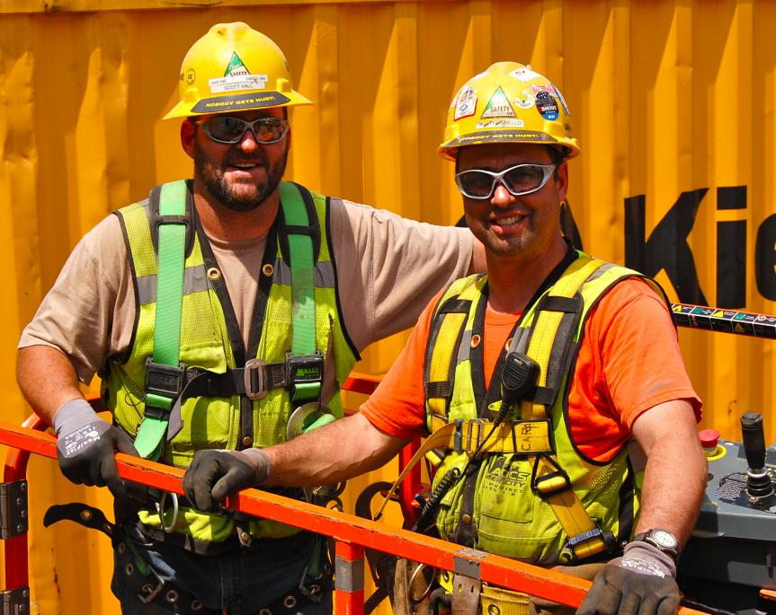
Who are Safety Leaders?
Foremen
Experienced workers
Trainees/apprentices
Superintendents
Owners
Anyone….Everyone
Notes:
ASK CLASS:
WHO ARE THE SAFETY LEADERS ON A JOBSITE?
Anyone, regardless of their title or role, who values their safety and well-being and that of their fellow workers, is responsible for being an effective safety leader. This means that everyone needs to develop and use safety leadership skills.

Slide 7
Safety Leaders
Safety Programs &
Policies
Safety Leaders
Safety Climate
Safety Incidents
Notes:
Safety leaders work at all levels of a company:
Leaders at the highest level develop the safety programs and policies
Everyone on the jobsite is a leader when it comes to reducing safety incidences
But it is the
Frontline supervisors and foremen who make sure programs and policies are implemented and enforced which creates a strong jobsite safety climate

Slide 8
Safety Leaders Strengthen
Jobsite Safety Climate
How well a company’s policies, procedures, and practices are actually implemented on the job site.
Notes:
When we use the term safety climate, we are talking about how well a company’s safety policies, procedures, and practices are actually implemented on the jobsite.
When team members practice safety leadership skills they are helping to create a strong safety climate to ensure that everyone works productively, efficiently, and safely.
ASK CLASS:
CAN WORKERS TELL WHEN THERE’S A MISMATCH BETWEEN WHAT MANAGEMENT OR SUPERVISORS SAY ABOUT SAFETY AND WHAT IS ACTUALLY DONE ON THE JOBSITE? HOW MIGHT THAT AFFECT THEIR THOUGHTS ABOUT SAFETY AND THE JOBSITE SAFETY CLIMATE?
IS THERE A DIFFERENCE BETWEEN A PRIORITY AND A VALUE?
HOW MIGHT SAFETY CLIMATE BE AFFECTED IF SAFETY IS JUST A PRIORITY AND NOT A VALUE?

Slide 9

Direct Costs
Medical treatment
Lost wages
Sick pay
Damage to product or equipment
Higher insurance premiums
Notes:
It’s been shown that over the course of their career, a construction worker has a 78% chance of getting injured at work.
The total cost of these injuries to workers, contractors, and the construction industry as a whole is over $11 billion per year or about $27,000 per injured construction worker.
There are costs which are easier to see called Direct Costs, and others which may not be so obvious, called Indirect Costs. Leadership can play a part in whether or not a company experiences these costs.
ASK CLASS:
WHAT DO YOU THINK ARE EXAMPLES OF DIRECT COSTS OF JOBSITE INJURIES?
Direct costs include medical treatment, lost wages, sick pay, damage to work product or equipment, and increased insurance premiums.

Slide 10
Indirect Costs
Disability
Shorter life expectancy
Family and co-worker suffering
Lost productivity
Hiring costs
Diminished company reputation
Death
Notes:
ASK CLASS:
WHAT ARE SOME EXAMPLES OF INDIRECT COSTS?
Indirect costs include things like family and co-worker suffering, lost productivity related to incident investigations and work stoppage, hiring costs to replace an injured worker, and the company’s diminished public reputation, especially if the incident is covered by local media. This can reduce the company’s ability to win bids.
ASK CLASS:
ARE SOME OF THESE COSTS MORE IMPORTANT THAN OTHERS?

Slide 11
Benefits of Effective Safety Leadership
Increased morale
Increased teamwork
Positive safety climate
Reduced hazards
Safer work practices
Fewer injuries and fatalities
Better business reputation
More productive and better quality
Others?
Notes:
ASK CLASS:
SO, TO SUMMARIZE, TELL ME WHAT YOU THINK SOME OF THE BENEFITS ARE OF BEING AN EFFECTIVE SAFETY LEADER ON A JOBSITE?
(After you make a list on the board, present the slide list and if there’s time, tie this back to costs from slide 9 and 10)
-----------------------
We’ve gone over the costs of ineffective safety leadership and benefits of effective leadership and how good leadership can improve safety climate and safety outcomes. But we actually haven’t defined what a safety leader is or what skills she or he can use on the jobsite. That’s what we’re going to cover next before we get into the scenarios.

Slide 12
Safety leader is defined as…
A person who has the courage to demonstrate that s/he values safety by working and communicating with team members to identify and limit hazardous situations even in the presence of other job pressures such as scheduling and costs.
Notes:
ASK CLASS:
HOW WOULD YOU DEFINE A SAFETY LEADER?
In the FSL course, we define a safety leader as... A person who has the courage to demonstrate that s/he values safety by working and communicating with team members to identify and limit hazardous situations even in the presence of other job pressures such as scheduling and costs.
ASK CLASS:
WHAT DO YOU THINK ABOUT THE WORD COURAGE? DOES IT TAKE COURAGE TO BE A LEADER? DOES THE AMOUNT OF COURAGE DEPEND ON YOUR ROLE OR POSITION ON THE JOBSITE? WHEN A COMPANY VALUES SAFETY AND IT’S NOT JUST A PRIORITY, HOW MIGHT THAT AFFECT THE NEED FOR COURAGE?

Slide 13
5 LEADERship Skills
Leads by example
Engages and empowers team members
Actively listens and practices three-way communication
DEvelops team members through teaching, coaching, & feedback
Recognizes team members for a job well done
Notes:
The FSL course focuses on 5 critical skills that you as a safety leader can use to create a strong jobsite safety climate and reduce safety incidents.
Here they are…
DISTRIBUTE WALLET CARD WITH SKILLS AND TELL CLASS:
These wallet cards list the skills.
I’d encourage you to put it in your wallet and look at it every so often to refresh your memory of what you learned today.
Next, we are going to discuss the specific actions you can use to demonstrate each of these on the jobsite.

Slide 14
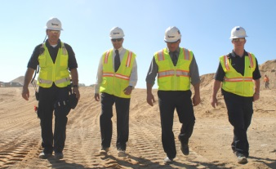
How to
Lead by Example
Have a positive attitude about safety
Establish safety as a core value
Set high expectations for safety
Share safety vision with the team
“Walk the talk”
Reinforce the idea that everyone owns safety
Lead up!
Notes:
Leading by example is probably the most important of the five safety leadership skills in the FSL course.
ASK CLASS: WHAT DO YOU THINK IT MEANS TO LEAD BY EXAMPLE?
Team members learn from their leaders. They notice when they cut corners, don’t follow safety policies or procedures, or give inconsistent safety messages.
ASK CLASS: HOW DOES COURAGE PLAY INTO LEADING BY EXAMPLE?
Let’s go over some ways you can lead by example.
First, you need to personally value and consistently demonstrate a positive attitude about safety. You should also establish safety as the team’s core value by building it into all aspects of the job.
As a safety leader you must set high safety expectations for every team member. Let them know on a regular basis that you expect them to always use safe work practices and ensure that other team members do too, and immediately report hazardous conditions and all injuries or near misses.
These actions send the message that safety is an integral part of working everyday and not just a way to avoid safety violations. The next way to lead by example is to develop and share your safety vision with your team.
ASK CLASS: WHAT DO YOU THINK IT MEANS TO HAVE A SAFETY VISION?
You can talk about the importance of safety for you and for them in terms of the direct and indirect costs we talked about. You can emphasize that safe work goes hand-in-hand with productive and quality work. Another part of creating a vision is to consider the safety implications of all your decisions and share those with your team.
An action you can put into place immediately is to not practice the old way of “Do as I say, but not as I Do,” and instead, “Walk the talk” by always following safe work procedures and practicing safe practices.
As a leader, you need to consistently communicate that everyone owns safety. It’s not just the foreman’s or safety person’s responsibility. It’s up to everyone to keep the jobsite safe for themselves and others. A final way to lead by example …
is to lead up by working to persuade individuals like company owners and others in supervisory positions to improve jobsite safety and health.
ASK CLASS: HOW DOES COURAGE PLAY INTO LEADING UP?
Some ideas for things you can do to lead up include:
• Find out what has (and hasn’t) worked in the past to motivate them to improve safety and health policies
• Try to get them to think about safety in a new way
• Present solutions, rather than only pointing out problems
• Find others (workers, foremen, etc.) to help you convey your message

Slide 15
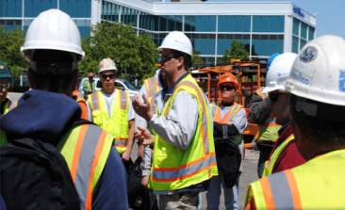
How to
Engage and Empower Team Members
Explain why safety is critical to getting the job done
Engage team members in safety decision-making
Conduct daily morning safety huddles and joint worker-management walk-arounds throughout the workday
Empower team members to
  Report safety concerns, injuries and near misses
  Report or fix hazards or unsafe situations
Notes:
The next leadership skill is to engage and empower team members in the safety process.
ASK CLASS:
WHAT ARE SOME IDEAS FOR DOING THAT?
You can explain why working safely is critical to getting the job done and not just say “be safe”.
You can engage the team in safety-related decisions so they can see how they, too, own safety. These skills can be used with the whole group as well as with individual workers.
Involving workers in daily huddles and joint management walk-arounds lets the team know that safety is valued, it is an essential aspect of how work gets done, and they are a critical part of the overall safety effort.
Finally, as a leader, you need to empower team members to report jobsite hazards, safety concerns, and near misses, and to act upon unsafe situations and make it clear that there will be no negative consequences or retaliation when they do. You can develop an “action list” to show how issues raised are addressed and place the list in a prominent place to help ensure accountability and build trust.

Slide 16
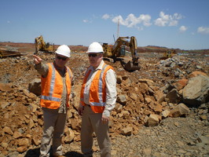
How to
Actively listen and
Practice 3-way Communication
Treat team members with respect when they are speaking
Pay attention to non-verbal cues such as body language and eye contact
Listen to hear what is being said vs. to come up with a response.
Ask clarifying questions
Actively listen
Notes:
Being able to communicate effectively is at the core of all the other leadership skills and is critical to becoming an effective safety leader.
There are 2 aspects to this skill. The first one we’ll discuss is about learning to be an Active rather than Passive listener. The second one outlines a simple strategy you can use to reduce misunderstandings between you and the person you’re speaking with.
ASK CLASS:
HAVE YOU EVER TRIED TELLING SOMEONE SOMETHING IMPORTANT AND YOU CAN TELL THEY AREN’T LISTENING? HOW CAN YOU TELL?
Learning to actively listen first involves treating your team member with respect and giving that person your full attention. Don’t check phones, emails, or read other materials during the conversation. Pay special attention to your and the speaker’s body language because it can sometimes convey more information than words. Maintain eye contact; avoid making negative facial expressions or raising your voice. If you’re feeling resentful or insulted, make an extra effort to maintain professional conduct.
Most importantly, you need to listen to hear what the person is saying rather than listening just to come up with a response. Finally, ask clarifying questions to ensure you understand what speaker is saying or asking.

Slide 17
How to
Actively Listen and
Practice 3-way Communication (cont’d)
Practice 3-way
communication
Make sure you have listener’s attention
Be direct and concise
Ask team member to repeat message
Clarify any misunderstandings
Notes:
ASK CLASS:
HAVE YOU EVER GIVEN SOMEONE INSTRUCTIONS TO DO SOMETHING, THEY SAY SURE THING, AND THEN GO AND DO SOMETHING ELSE? COULD IT BE THAT THEY DIDN’T UNDERSTAND WHAT YOU WERE ASKING THEM TO DO?
Practicing 3-way communication helps ensure everyone understands your message or instructions. This is done by making sure you have the listener’s attention, being direct and concise, and most importantly, having the listener repeat what you said to be sure the message was understood. This also allows you to clarify any misunderstandings.
CLASS ACTIVITY:
PRACTICE 3-WAY COMMUNICATION WITH SOMEONE IN THE CLASS – OR ASK STUDENT TO DO IT
Example: “Hey [student’s name], can you go get me a sandwich?” After the student responds, comment that they did not get you the right kind of sandwich and they didn’t get you a chips or a drink, either!

Slide 18
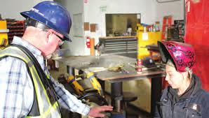
How To
Develop Team Members through
Teaching, Coaching, and Feedback
Observe worker action
Address the issue
Problem solve
Practice action
Teach & coach
Notes:
Effective safety leaders work to develop their team members by teaching and coaching them on how to do things correctly and safely on the jobsite. They also provide feedback to let them know how they are doing and if any changes are needed.
ASK CLASS:
WHAT IS THE DIFFERENCE BETWEEN TEACHING, COACHING, AND FEEDBACK?
Teaching = telling
Coaching = watching
Feedback = evaluating performance
First, we’ll talk about teaching and coaching.
When you want to teach a team member a new or better way to do something, respectfully ask questions to understand why s/he is doing it that way and then problem-solve together (even if you already have a solution) to find a better or safer approach to completing the task.
Show the team member how to perform the activity correctly, then watch him/her to be sure they have learned how to do it. If they need to be corrected, treat the person with respect and be a coach.
Encourage team members to constantly update their knowledge and skills so they can do their jobs better and safer.

Slide 19
How To
Develop Team Members through
Teaching, Coaching, and Feedback (cont’d)
Use the FIST Principle:
Describe the FACTS
Explain the IMPACT
Provide SUGGESTIONS
Be TIMELY
Notes:
Providing constructive feedback is another leadership skill you can use to develop your team members.
When giving constructive feedback, try hard to focus on the situation or behavior rather than the person.
The FIST principle can help you do that.
First, describe the Facts: What is the situation or activity/behavior for which you are providing feedback? When and where did it occur? What were the circumstances?
Next, explain the Impact: What are the potential consequences that may result (good or bad)?
Then, offer Suggestions: Work together to problem-solve and come up with solutions. Think of ways team members might use the same approach in the future.
Finally, be Timely: Don’t wait to provide feedback. It is more effective when you give it close to when the situation/behavior occurred.
CLASS ACTIVITY:
PRACTICE THE FIST PRINCIPLE
FOR EXAMPLE, USE THE FIST PRINCIPLE TO GIVE A TEAM MEMBER CONSTRUCTIVE FEEDBACK ABOUT ALWAYS BEING LATE TO WORK.

Slide 20
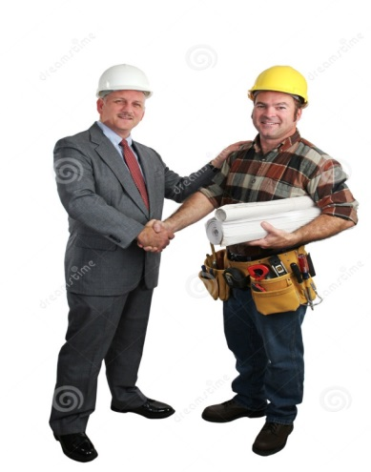
How to
Recognize Team Members for a Job Well Done
Give recognition separately from other types of feedback
Regularly give praise in private
Be specific about why you are praising the person
Give praise publically if the person is comfortable with it
Notes:
The final skill effective safety leaders display is to recognize team members when they go above and beyond to maintain a strong positive jobsite safety climate.
ASK CLASS:
WHY IS IT IMPORTANT TO DO THIS? (e.g. Appreciation motivates and encourages team members to continue working to maintain and improve the jobsite safety climate)
Like other types of feedback, recognition should be given in a timely manner and it must be sincere. It’s also important to separate this type of “way to go” or praise feedback from the type of feedback we just discussed. It may be as simple as saying “good job,” giving a hand shake, or saying “thank you” for going the extra mile for safety or for something really well done.
It’s important to know your team members as individuals so you can use praise and acknowledgement effectively. For those who are comfortable with public praise, it is a great way to show others that safety is valued. However, a person uncomfortable with public praise may be more embarrassed rather than pleased.
ASK CLASS:
WHAT ARE SOME THINGS YOU MIGHT WANT TO CONSIDER WHEN GIVING PRAISE? (Generational differences - millennials – always needing praise; Old days = no news is good news; Personality of individual; Jobsite culture or climate)
IS THERE EVER A DOWNSIDE TO GIVING RECOGNITION? (Coworker reaction, perceived favoritism, preferential treatment)
----------------------------------------
So we’ve covered the costs of ineffective safety leadership, the benefits and importance of effective safety leadership, and presented the five safety leadership skills covered in this course. Next we’re going to work through some real-world construction scenarios to see how the skills are or are not applied on the jobsite.
Before we start that though, as we go through the scenarios I want you to keep in mind that practicing and using these skills is really not very time-consuming. And that they can be easily inserted into daily workflow and are likely to improve productivity.

Slide 21
Foundations for Safety Leadership (FSL)
Notes:
Have students turn to page 14 in handout
Depending on how we are doing on time, we may not go through each scenario, but we will be covering all 5 skills. You can find the scripts for all the videos in your handout, to read after the class.
Additional Instructor Notes
While the primary goal of the scenarios is to demonstrate the 5 safety leadership skills, they also illustrate important safety hazards. Sometimes the hazards include the OSHA’s Focus Four. As you go through the scenario, you might find it useful to mention them, but please do NOT spend time discussing the hazards themselves, because that is covered in much greater detail in other safety training materials. If while watching the scenarios students identify a particular safety issue, use the moment to recognize them for noticing it, but then quickly get back to the leadership skills.

Slide 22
Scenario Activities
Analyze whether characters used the safety leadership skills
Discuss what could have been done better
Notes:
As we work through each scenario together, we will be analyzing if the characters use any or all of the 5 safety leadership skills and then discuss what they could have done better.
FOR INSTRUCTOR ONLY – HERE’S WHEN YOU COULD CREATE THE TABLE ON A WHITEBOARD OR FLIP CHART TO USE FOR THE SCENARIOS

Slide 23
Scenario Structure
  Situation
  Outcome A
  Outcome B
  First letter of character’s name based on job position:
        Stan is a Superintendent
        Frank is a Foreman
        Emilio is an Experienced worker
        Tia is a Trainee/apprentice
Notes:
Each scenario starts with a description of a safety situation on a construction site. This is followed by two possible outcomes where a leader either uses or doesn’t use one or more of the 5 leadership skills.
In each scenario, you’ll be introduced to a number of different characters. The first letter of each character’s name is based on their job position. For example in one of them, Stan is a Superintendent, Frank is a Foreman, Stan is a Emilio is an Experienced worker, and Tia is a Trainee/apprentice.

Slide 24
Skills and Actions Table
Skills | Actions
Leads by Example | Establishes safety expectations as a core value Shares safety vision with team members Demonstrates a positive attitude about safety Walks the Talk Leads up
Engages and Empowers Team Members | Engages, encourages, and empowers team members to identify and act upon unsafe situations by… Reporting hazards and safety concerns Providing solutions Reporting near misses Stopping work if necessary
Actively Listens and Practices 3-way Communication | Actively listens to hear what team members are saying Practices 3-way communication by having person repeat the message they heard
DEvelops Team Members Through Teaching, Coaching, and Feedback | Respectfully teaches and coaches workers Watches the learner fix the hazardous situation or perform the task to make sure it's done correctly Focuses on potential consequences rather than on the team member Uses the FIST principle: Facts, Impact, Suggestions, Timely
Recognizes Team Members for a Job Well Done | Privately and/or publicly acknowledges team members for going above and beyond when it comes to safety
Notes:
On page 17 of your handout, there is a checklist like this one of the leadership skills that you can use as a sort of cheat sheet as we work through the scenarios.
They are also on the back of your wallet card.

Slide 25
Jobs site and General Contractor
Job site
Six-story mixed use building (1st floor commercial)
North Carolina
12-14 month project
Began in January, scenarios start in July
General Contractor
American Master Builders (AMB) Inc.
50% AMB employees
50% specialty subs
30-50 workers on site at any one time
Union and non-union
Notes:
Here’s a description of the jobsite setting for all the scenarios. It is a free-standing, six-story building in North Carolina with commercial offices on the first floor and residential housing on the upper five floors. The 12-14 month project began in January. The scenarios start taking place in July.
It is being managed by the large general contractor American Master Builders (AMB) Inc. Fifty percent of the employees work directly for AMB. The other 50% are specialty subcontractors. There are between 30-50 union and non-union workers on the site at any one time.

Slide 26

Scenario Main Menu
1
2
3
4
5
6
7
Notes:
Today we’re going to work through [list the scenarios you’ve picked]. If we have time, we’ll do some others.
CLICK THE ICON OF THE SCENARIO YOU WISH TO USE
Additional Instructor Notes
This is the main menu for all the scenarios. You can click on any of the icons and you will be taken to the introductory slide of that scenario. Also, you’ll find this icon in the bottom right corner of each scenario slide. You can click on it and it will take you back to slide 26 so you can click on the next scenario you want to work through.
When you are ready to discuss the FSL course’s takeaway messages, click the “Takeaways” icon.

Slide 27



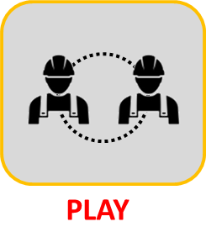
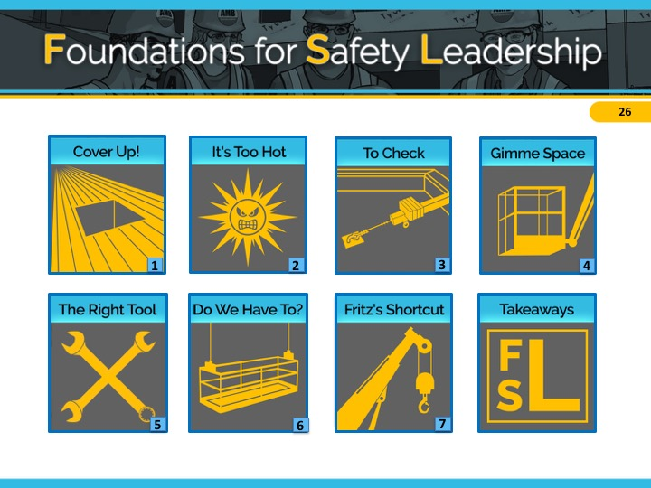
Falls
Who | Role
Stan | Volt Electric Superintendent
Frank | Volt Electric Lead Foreman
Tia | Volt Electric Trainee/apprentice
1
Notes:
The key safety leadership moment illustrated in Cover Up! is how a safety leader can effectively communicate with a team member about how and why to carry out a safety-related task.
The safety hazard in this scenario is falls.
INSTRUCTOR INFORMATION - It is designed to illustrate the following safety leadership skills:
Practicing 3-way communication
Recognizing team members for a job well done
CLICK ON DESIRED TEACHING MODE…

Slide 28

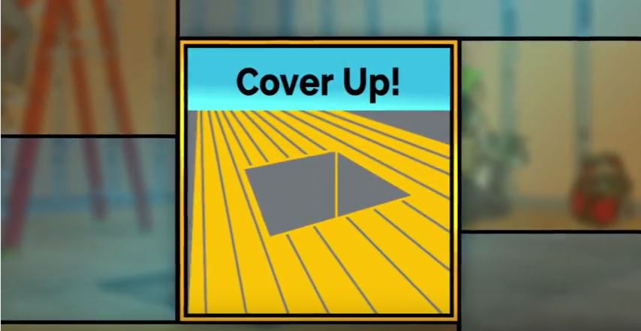
Cover Up! Situation
Situation
Notes:
VIDEO WILL START AUTOMATICALLY
ADVANCE SLIDE

Slide 29
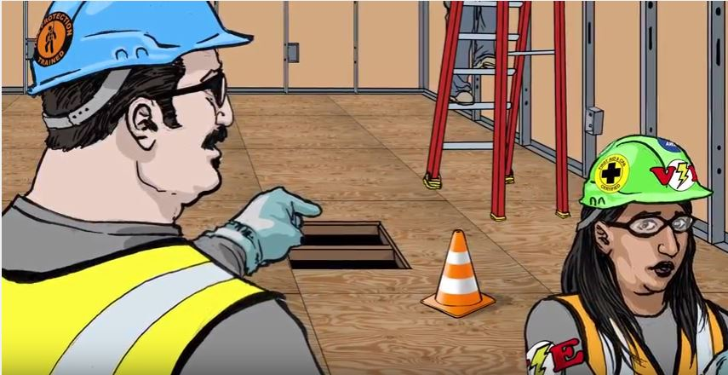
Cover Up! Outcome A
Outcome A
Notes:
VIDEO WILL START AUTOMATICALLY
ADVANCE SLIDE

Slide 30

Cover Up!
Discussion Questions: Outcome A
What went wrong that caused the miscommunication between Frank and Tia?
Which leadership skill(s) could Frank have used to avoid the miscommunication and treat Tia with respect?
Notes:
Reveal the discussion questions and/or use the facilitation table to go through skills.
In outcome A, Frank does not practice 3-way communication when he asks Tia to cover the hole in the plywood floor and, therefore, she didn’t understand exactly what he wanted. She feels humiliated when Frank yells at her, which is likely to have a negative effect on their future communications.
ADVANCE SLIDE

Slide 31
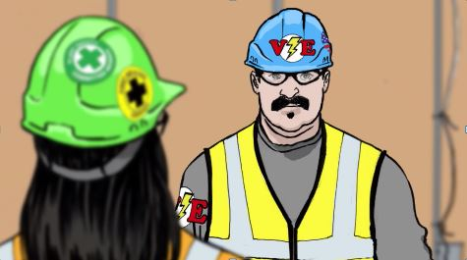
Cover Up! Outcome B
Outcome B
Notes:
VIDEO WILL START AUTOMATICALLY
ADVANCE SLIDE

Slide 32
Cover Up!
Discussion Questions: Outcome B
Which of the 5 leadership skill(s) did Frank display in this ending?
How do you think Tia will respond to Frank in the future when he asks her to do something?
Notes:
Reveal the discussion questions and/or use the facilitation table to go through skills.
In outcome B, Frank does practice 3-way communication. This ensures that Tia understands exactly what Frank wants and by when he wanted it done. The 2 minutes that it took for Frank to do this helped prevent Tia from being humiliated and also from the drywall installers from getting hurt. Frank’s recognizing Tia for doing a good job carrying out his instructions, makes Tia feel valued and she is likely to be even more safety-conscious in the future.
CLICK SCENARIO MENU ICON TO RETURN TO MAIN MENU

Slide 33

Cover Up!
Situation – Key Points
There is a large hole in the plywood floor causing a fall hazard.
Stan, AMB superintendent asks Frank AMB’s foreman to take care of it.
Notes:
Refer students to page 18 in the student guide
Read/have students read the situation in the Cover Up! script (or instructor reads it aloud).
ADVANCE SLIDE

Slide 34
Cover Up!
Outcome A – Key Points
Frank tells Tia, a trainee/apprentice to cover the hole.
Tia decides to take care of it in 15 minutes so she can finish what she’s doing and not delay other workers.
Two drywall installers almost fall into the hole.
Frank yells at Tia for not immediately doing what he’d asked.
Tia feels humiliated. She did not realize he wanted her to drop everything to cover the hole.
Notes:
Read/have students read outcome A in Cover Up! script (or instructor reads it aloud).
ADVANCE SLIDE

Slide 35
Cover Up!
Discussion Questions: Outcome A
What went wrong that caused the miscommunication between Frank and Tia?
Which leadership skill(s) could Frank have used to avoid the miscommunication and treat Tia with respect?
Notes:
Reveal the discussion questions and/or use the facilitation table to go through skills.
In outcome A, Frank does not practice 3-way communication when he asks Tia to cover the hole in the plywood floor and, therefore, she didn’t understand exactly what he wanted. She feels humiliated when Frank yells at her, which is likely to have a negative effect on their future communications.
ADVANCE SLIDE

Slide 36
Cover Up!
Outcome B – Key Points
Frank tells Tia, a trainee/apprentice to cover the hole immediately.
He gives her detailed instructions on how he wants her to do it, including tying off.
Frank asks Tia to repeat his instructions.
Tia follows his exact instructions.
Frank thanks Tia.
Two drywall installers are prevented from falling in the hole.
Notes:
Read/have students read outcome B in Cover Up! script (or instructor reads it aloud).
ADVANCE SLIDE

Slide 37
Cover Up!
Discussion Questions: Outcome B
Which of the 5 leadership skill(s) did Frank display in this ending?
How do you think Tia will respond to Frank in the future when he asks her to do something?
Notes:
Reveal the discussion questions and/or use the facilitation table to go through skills.
In outcome B, Frank does practice 3-way communication. This ensures that Tia understands exactly what Frank wants and by when he wanted it done. The 2 minutes that it took for Frank to do this helped prevent Tia from being humiliated and also from the drywall installers from getting hurt. Frank’s recognizing Tia for doing a good job carrying out his instructions, makes Tia feel valued and she is likely to be even more safety conscious in the future.
CLICK SCENARIO MENU ICON TO RETURN TO MAIN MENU

Slide 38

Cover Up! Situation (Role Play Activity)
Situation
Notes:
For the role play activity, we’ll first watch the scenario situation together. Then, in groups of 2, each person will take the role of one of the scenario characters and for 2 minutes play out the conversation the characters might have either not using or using leadership skills. After 2 minutes is up, we’ll come back together as a group to discuss how it went.
VIDEO WILL START AUTOMATICALLY
ADVANCE SLIDE

Slide 39
Cover Up!
Outcome A
Please role play the conversation where Frank tells Tia (or Tio) to cover the hole. DO NOT use any of the 5 leadership skills.
Discussion Questions for Outcome A
Frank, what did you say to Tia/Tio?
What could go wrong in a situation like this?
From Tia/Tio’s standpoint, what could Frank have done better?
Notes:
Divide students into groups of 2 and ask them to do a role-play as indicated on the slide using none of the leadership skills.
After 2 minutes, reveal the discussion questions or use the facilitation table to go through skills.
In outcome A, Frank does not practice 3-way communication when he asks Tia to cover the hole in the plywood floor and, therefore, she didn’t understand exactly what he wanted. She feels humiliated when Frank yells at her, which is likely to have a negative effect on their future communications.
ADVANCE SLIDE

Slide 40
Cover Up!
Outcome B
This time do the role play with Frank Practicing 3-way Communication and Recognizing Team Members for a Job Well Done.
Discussion Questions for Outcome B
Frank, in what way did the conversation feel different when you used the leadership skills?
Tia/Tio, describe the difference from your perspective. How did you feel when Frank recognized you for a job well done?
Notes:
Now have the students redo conversation between Frank and Tia/Tio using the following safety leadership skills:
Practicing 3-way Communication
Recognizing Team Members for a Job Well Done
After 2 minutes, reveal the discussion questions or use the facilitation table to go through skills
In outcome B, Frank does practice 3-way communication. This ensures that Tia understands exactly what Frank wants and by when he wanted it done. The 2 minutes that it took for Frank to do this helped prevent Tia from being humiliated and also prevented the drywall installers from getting hurt. Frank’s recognizing Tia for doing a good job carrying out his instructions, makes her feel valued and she is likely to be even more safety conscious in the future.
CLICK SCENARIO MENU ICON TO RETURN TO MAIN MENU

Slide 41

Heat Stress
Who | Role
Franco | AMB, Inc. Foreman
Emilio | AMB, Inc. Experienced Worker
2
Notes:
The primary safety leadership moment illustrated in “It’s too hot, too hot, too hot baby” is how a safety leader approaches a team member who may be facing a potentially serious health risk.
The safety hazard in this scenario is heat stress.
INSTRUCTOR INFORMATION - It is designed to illustrate the following safety leadership skills:
Leading by example
Practicing three-way communication
Engaging and empowering workers
CLICK ON DESIRED TEACHING MODE…

Slide 42

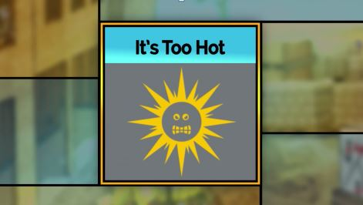
It’s Too Hot Video - Situation
Situation
Notes:
VIDEO WILL START AUTOMATICALLY
ADVANCE SLIDE

Slide 43
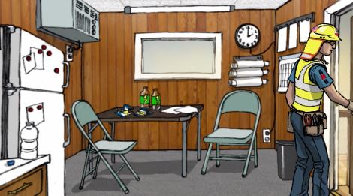
It’s Too Hot Video – Outcome A
Outcome A
Notes:
VIDEO WILL START AUTOMATICALLY
ADVANCE SLIDE

Slide 44
It’s Too Hot!
Discussion Questions: Outcome A
What do you think of the way Franco handled this situation?
Which of the 5 leadership skills did Franco display or not display?
Notes:
Reveal the discussion questions and/or use the facilitation table to go through skills.
Franco led by example by putting safety ahead of productivity when he asked Emilio to go to the trailer and rest. Unfortunately, Franco did not practice three-way communication skills, which resulted in Emilio not understanding that Franco wanted him to not only to rest, but also to stop work for the day.
ADVANCE SLIDE

Slide 45
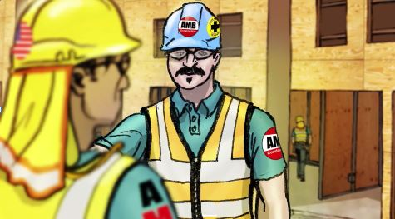
It’s Too Hot Video – Outcome B
Outcome B
Notes:
VIDEO WILL START AUTOMATICALLY
ADVANCE SLIDE

Slide 46
It’s Too Hot!
Discussion Questions: Outcome B
What leadership skills did use Franco this time?
Describe his communication style and how it was different from the first ending.
Notes:
Reveal the discussion questions and/or use the facilitation table to go through skills.
In addition to leading by example as in outcome A, Franco engages in three way communication with Emilio. This allows both of them to understand and agree that Emilio should go to the trailer where it’s cool, drink fluids, eat a snack and not return to work that day. He also leads by example and engages Emilio by offering to get one of the other guys to finish what Emilio had started. This let’s Emilio knows that he is valued and he can focus on getting better.
CLICK SCENARIO MENU ICON TO RETURN TO MAIN MENU

Slide 47

It’s Too Hot!
Situation – Key Points
Franco, a foreman, sees Emilio, an experienced worker, pouring water over his head and sweating profusely and suspects Emilio may have heat exhaustion.
He shouts to Emilio that he’ll come down and walk him to the trailer so he can rest, get something to eat and drink and get out of the sun.
Notes:
Refer students to page 19 in the student guide
Ask students to read the situation for “It’s too hot…” (or instructor reads it aloud).
ADVANCE SLIDE

Slide 48
It’s Too Hot!
Outcome A – Key Points
Emilio goes to the trailer and gets something to eat and drink.
He sees it’s 2:00 and decides to go back to work.
Once outside he is overcome with nausea. His knee buckles and he drops to the ground.
Franco sees this, runs over, and reminds Emilio that he told him to stay in the trailer for the rest of the day and that he should have listened to his instructions.
Notes:
Ask students to read outcome A for “It’s too hot…” (or instructor reads it aloud).
ADVANCE SLIDE

Slide 49
It’s Too Hot!
Discussion Questions: Outcome A
What do you think of the way Franco handled this situation?
Which of the 5 leadership skills did Franco display or not display?
Notes:
Reveal the discussion questions and/or use the facilitation table to go through skills.
Franco led by example by putting safety ahead of productivity when he asked Emilio to go to the trailer and rest. Unfortunately, Franco did not practice three-way communication skills, which resulted in Emilio, not understanding that Franco wanted him to not only to rest, but also to stop work for the day.
ADVANCE SLIDE

Slide 50
It’s Too Hot!
Outcome B – Key Points
After Franco tells Emilio what he expects him to do, he asks him to repeat his instructions.
Emilio repeats them but he leaves out the part about staying in the trailer for the rest of the day, because he wants to finish what he was doing.
Franco corrects him and says that his only job today is to get better for tomorrow and that he’ll have another crew member finish-up.
Notes:
Ask students to read outcome B for “It’s too hot…” (or instructor reads it aloud).
ADVANCE SLIDE

Slide 51
It’s Too Hot!
Discussion Questions: Outcome B
What leadership skills did Franco use this time?
Describe his communication style and how it was different from the first ending.
Notes:
Reveal the discussion questions and/or use the facilitation table to go through skills.
In addition to leading by example as in outcome A, Franco engages in three way communication with Emilio. This allows both of them to understand and agree that Emilio should go to the trailer, drink fluids, eat a snack, and not return to work that day. He also leads by example and engages Emilio by offering to get one of the other guys to finish what Emilio had started. This let’s Emilio knows that he is valued and he can just focus on getting better.
CLICK SCENARIO MENU ICON TO RETURN TO MAIN MENU

Slide 52

It’s Too Hot! Situation (Video)
Situation
Notes:
For the role play activity, we’ll first watch the scenario situation together. Then, in groups of 2, each person will take the role of one of the scenario characters and for 2 minutes play out the conversation the characters might have either not using or using leadership skills. After 2 minutes is up, we’ll come back together as a group to discuss how it went.
VIDEO WILL START AUTOMATICALLY
ADVANCE SLIDE

Slide 53
It’s Too Hot!
Outcome A
Role play the conversation where Franco tells Emilio what he expects him to do next. DO NOT use any of 5 leadership skills.
Discussion Questions for Outcome A
Franco, what did you say to Emilo?
What did or could go wrong by communicating that way?
Emilio, what could Franco have done better?
Notes:
Divide students into groups of 2 and ask them to do a role-play as indicated on the slide using none of the leadership skills.
After 2 minutes, reveal the discussion questions or use the facilitation table to go through skills.
In outcome A in the scenario Franco leads by example by putting safety ahead of productivity when he asked Emilio to go to the trailer and rest. However, he did not practice three-way communication skills, which resulted in Emilio, not understanding that Franco wanted him not only to rest but also to stop work for the day.
ADVANCE SLIDE

Slide 54
It’s Too Hot!
Outcome B
This time have Franco using 3-way communication and leading by example when speaking with Emilio
Discussion Questions for Outcome B
Franco, how did you use the leadership skills?
Emilio, describe the difference between the first and second ending from your perspective and how it may affect what you do.
Notes:
Now, have the students redo the conversation between Franco and Emilio using the following safety leadership skills:
Leading by example
Actively listening and practicing 3-way communication
After 2 minutes, reveal the discussion questions or use the facilitation table to go through skills.
In addition to leading by example as in outcome A, Franco engages in three way communication with Emilio. This allows both of them to understand and agree that Emilio should go to the trailer where it’s cool, drink fluids, eat a snack, and not return to work that day. He also leads by example and engages Emilio by offering to get one of the other guys to finish what Emilio had started. This let’s Emilio knows that he is valued and he can focus on getting better.
CLICK SCENARIO MENU ICON TO RETURN TO MAIN MENU

Slide 55




Falls, Struck by, and Caught-in Between
Who | Role
Finn | AMB, Inc. General Foreman
Enzo | AMB, Inc. Experienced Glazier
Erika | AMB, Inc. Experienced Glazier
Scott | TJ’s Roofing Site superintendent
3
Notes:
The key safety leadership moment in ‘To Check or Not to Check’ is how a safety leader responds to team member(s) bringing up safety concerns.
The major safety hazards in this scenario are falls, struck by, and caught-in between.
INSTRUCTOR INFORMATION - It is designed to illustrate the following safety leadership skills:
Leading by example
Active listening
Engaging and empowering team members
Recognizing team members for a job well done
CLICK ON DESIRED TEACHING MODE…

Slide 56

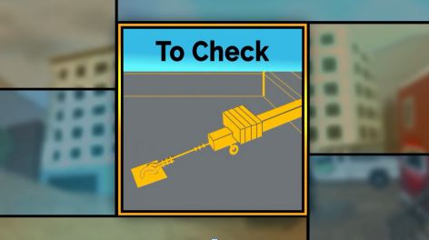
To Check Situation (Video)
Situation
Notes:
VIDEO WILL START AUTOMATICALLY
ADVANCE SLIDE

Slide 57
To Check
Discussion Questions: Situation
What do you think about Erika bringing up her concern about the roofing subcontractor during the safety huddle?
What do you think Finn will do?
Notes:
Reveal the discussion questions and/or use the facilitation table to go through skills.
Try not to spend too much time on the Situation so you have time for the 2 outcomes.
ADVANCE SLIDE

Slide 58
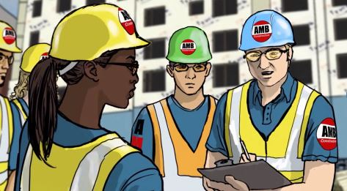
To Check Outcome A (Video)
Outcome A
Notes:
VIDEO WILL START AUTOMATICALLY
ADVANCE SLIDE

Slide 59
To Check
Discussion Questions: Outcome A
What do you think of how Finn handled this situation?
Which of the 5 leadership skills did Finn demonstrate, or not?
What consequences might there be from Finn’s lack of leadership behavior both on the site in terms of safety outcomes and also during subsequent safety huddles?
Notes:
Reveal the discussion questions and/or use the facilitation table to go through skills.
While Finn gives Erika a minimal amount of positive recognition by saying thank you, he basically ignores her concerns demonstrating that he is not actively listening to one of his team members. He is not leading by example and is putting productivity before safety. Finn is also sending a message to the whole crew that he really isn’t interested in engaging or empowering them to identify and bring up hazards.
ADVANCE SLIDE

Slide 60
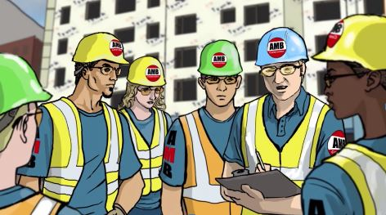
To Check Outcome B (Video)
Outcome B
Notes:
VIDEO WILL START AUTOMATICALLY
ADVANCE SLIDE

Slide 61
To Check
Discussion Questions: Outcome B
What do you think of how Finn handled the situation this time?
In terms of the leadership skills, describe how it was different from the first ending.
Notes:
Reveal the discussion questions and/or use the facilitation table to go through skills.
In this ending, Finn displays quite a few of the 5 safety leadership skills.
He engages and empowers his team members by asking for their opinions, which lets them know he expects them to take responsibility for their own and each other’s safety.
Just by saying “this is great guys”, Finn gives Eric and Enzo positive feedback and recognition which encourages the others to speak-up and sends the message that he trusts them and wants to hear their thoughts.
Finally, Finn is clearly leading by example by immediately speaking with the subcontractor and inviting Erika and Enzo to come along. In both his words and actions he demonstrates that safety comes before productivity. The other team members who see Enzo and Erika going over to the subcontractor with Finn get a stronger sense of the role they play in safety and are, therefore, more likely to take ownership of it on an on-going basis and identify potentially hazardous situations.
CLICK SCENARIO MENU ICON TO RETURN TO MAIN MENU

Slide 62

To Check
Situation - Key Points
Finn and his crew are in their daily safety huddle discussing the day’s tasks
Finn asks if anyone has anything to discuss.
Erika says she's concerned about the tiebacks. She’s heard TJ’s Roofing had been undoing them.
Notes:
Refer students to page 20 in the student guide
Ask students to read the situation for “To Check…” (or instructor reads it aloud).
ADVANCE SLIDE

Slide 63
To Check
Discussion Questions: Situation
What do you think about Erika bringing up her concern about the roofing subcontractor during the safety huddle?
What do you think Finn will do?
Notes:
Reveal the discussion questions and/or use the facilitation table to go through skills.
Try not to spend too much time on the Situation so you have time for the 2 outcomes.
ADVANCE SLIDE

Slide 64
To Check
Outcome A – Key Points
Finn thanks Erika for letting him know and the tells them it’s time to get to work.
Erika inspects the tiebacks and notices one isn’t secure. She fixes it before starting work.
Notes:
Ask students to read outcome A for “To Check…” (or instructor reads it aloud).
ADVANCE SLIDE

Slide 65
To Check
Discussion Questions: Outcome A
What do you think about how Finn handled this situation?
Which of the 5 leadership skills did Finn demonstrate, or not?
What consequences might there be from Finn’s lack of leadership in terms of safety outcomes and also during subsequent safety huddles?
Notes:
Reveal the discussion questions and/or use the facilitation table to go through skills.
While Finn gives Erika a minimal amount of positive recognition by saying thank you, he basically ignores her concerns demonstrating that he is not actively listening to one of his team members. He is not leading by example and is putting productivity before safety. Finn is also sending a message to the whole crew that he really isn’t interested in engaging and empowering them to identify and bring up hazards.
ADVANCE SLIDE

Slide 66
To Check
Outcome B – Key Points
Finn is surprised and asks if others have seen or heard the same thing. Enzo, says yes.
Finn thanks his crew for paying attention to hazards and for speaking up. He then speaks to the subcontractor about his concerns and says he won’t let his crew go onto this site unless tiebacks are secure.
The subcontractor gets defensive but gathers his workers and tells them never to untie any suspended scaffold tiebacks or lifelines and if they ever see any that are unsecured tell him so he can make sure the problem is immediately fixed.
Notes:
Ask students to read outcome B for “To Check…” (or instructor reads it aloud).
ADVANCE SLIDE

Slide 67
To Check
Discussion Questions: Outcome B
What do you think of how Finn handled the situation this time?
Describe how it was different from the first ending specifically focusing on which of the 5 leadership skills Finn displayed.
Notes:
In this ending, Finn displays quite a few of the 5 safety leadership skills.
He engages and empowers his team members by asking for their opinions which lets them know he expects them to take responsibility for their own and each other’s safety.
Just by saying “this is great guys,” Finn gives Eric and Enzo positive feedback and recognition which encourages the others to speak-up and sends the message that he trusts them and wants to hear their thoughts.
Finally, Finn is clearly leading by example by immediately speaking with the subcontractor and inviting Erika and Enzo to come along. In both his words and actions, he demonstrates that safety comes before productivity. The other team members who see Enzo and Erika going over to the subcontractor with Finn get a stronger sense of the role they play in safety and are, therefore, more likely to take ownership of it on an on-going basis and identify potential hazardous situations.
CLICK SCENARIO MENU ICON TO RETURN TO MAIN MENU

Slide 68

To Check Situation
Situation
Notes:
For the role play activity, we’ll first watch the scenario situation together. Then, in groups of 2, each person will take the role of one of the scenario characters and for 2 minutes play out the conversation the characters might have either not using or using leadership skills. After 2 minutes is up, we’ll come back together as a group to discuss how it went.
VIDEO WILL START AUTOMATICALLY
ADVANCE SLIDE

Slide 69
To Check
Outcome A
Without using any of the leadership skills, role play how Finn might respond to Erika’s (or Erik) concerns. DO NOT use any of the 5 leadership skills.
Discussion Questions for Outcome A
What did Finn say to Erika?
How did Erika (Erik) respond?
In what way(s) might Finn’s response affect the rest of the team?
Notes:
Divide students into groups of 2 and ask them to do a role-play as indicated on the slide using none of the leadership skills.
After 2 minutes, reveal the discussion questions or use the facilitation table to go through skills.
In outcome A in the scenario, Finn gives Erika a minimal amount of positive recognition by saying thank you, but he basically ignores her concerns demonstrating that he is not actively listening to one of his team members. He is not leading by example and is putting productivity before safety. Finn is also sending a message to the whole crew that he really isn’t interested in engaging or empowering them to identify and bring up hazards.
ADVANCE SLIDE

Slide 70
To Check
Outcome B
This time have Finn respond to Erika’s (or Erik) concerns by using a number of the leadership skills including leading by example, active listening, recognizing his team members.
Discussion Questions for Outcome B
What did Finn say to Erika this time?
Erika (Erik) how might Finn’s response effect your future behavior? What about the rest of the team?
Notes:
Now have the students redo conversation between Finn and Erick’s (or Erika) using the following safety leadership skills:
Leading by example
Actively listening and practicing 3-way communication
Recognizing them for a job well done
In this ending Finn displays quite a few of the 5 safety leadership skills.
He engages and empowers his team members by asking for their opinions which lets them know he expects them to take responsibility for their own and each other’s safety.
Just by saying “this is great guys,” Finn gives Eric and Enzo positive feedback and recognition which encourages the others to speak-up and sends the message that he trusts them and wants to hear their thoughts.
Finally, Finn is clearly leading by example by immediately speaking with the subcontractor and inviting Erika and Enzo to come along. In both his words and actions he demonstrates that safety comes before productivity. The other team members who see Enzo and Erika going over to the subcontractor with Finn get a stronger sense of the role they play in safety and are therefore more likely to take ownership of it on an on-going basis and identify potential hazardous situations.
CLICK SCENARIO MENU ICON TO RETURN TO MAIN MENU

Slide 71



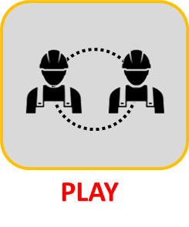
Ergonomics and Electrocution
Who | Role
Simon | AMB, Inc. Site superintendent
Fred | Burnett Insulation Foreman
Eli | Burnett Insulation Experienced Worker
Ted | Burnett Insulation Trainee/apprentice
4
Notes:
The key safety leadership moment in “Gimme some space” is how a site-superintendent may react to a team member telling him about safety risks they may face while completing a work task.
The major safety hazards in this scenario are ergonomics and electrocution.
INSTRUCTOR INFORMATION - It is designed to illustrate the following safety leadership skills:
Active listening
Engaging and empowering team members
Recognizing team members for a job well done
CLICK ON DESIRED TEACHING MODE…

Slide 72

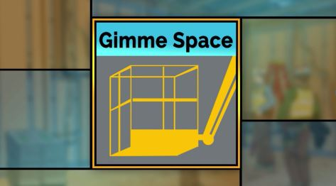
Gimme Space Situation(Video)
Situation
Notes:
VIDEO WILL START AUTOMATICALLY
ADVANCE SLIDE

Slide 73
Gimme Space
Discussion Questions: Situation
Keeping in mind the 5 leadership skills, given his role as a superintendent, what do you think Simon should do?
Notes:
Reveal the discussion questions and/or use the facilitation table to go through skills.
Spend a few minutes getting students’ ideas and then say, Ok, let’s see how your ideas match the two alternative endings we came up with.
ADVANCE SLIDE

Slide 74
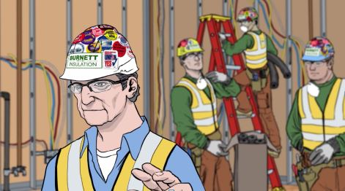
Gimme Space Outcome A
Outcome A
Notes:
VIDEO WILL START AUTOMATICALLY
ADVANCE SLIDE

Slide 75
Gimme Space
Discussion Questions: Outcome A
What are your thoughts about how Simon handled this situation?
Notes:
Reveal the discussion questions and/or use the facilitation table to go through skills.
It is true that Simon at least asks the crew if they need anything. However, because he decides to ignore the crew’s lack of eye contact, he isn’t really actively listening.
ADVANCE SLIDE

Slide 76
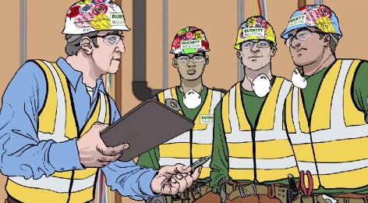
Gimme Space Outcome B
Outcome B
Notes:
VIDEO WILL START AUTOMATICALLY
ADVANCE SLIDE

Slide 77
Gimme Space
Discussion Questions: Outcome B
What leadership skills did Simon demonstrate in this ending compared to the earlier one?
What can be done from a leadership perspective to ensure that workers feel comfortable bringing up safety issues?
Notes:
Reveal the discussion questions and/or use the facilitation table to go through skills.
In this ending, Simon displays at least 3 safety leadership skills. He displays his ability to actively listen by paying attention not just to their words but also their body language which allows him to pick up on cues that something more might be going on.
He engages and empowers his team members by asking them to walk him through what they are going to be doing then when they bring up an issue he asks them to come up with ideas and works with them to resolve their concerns.
Although it sounds simple, by him saying “this is great guys” he’s giving them positive recognition which is likely to embolden them to continue identifying and bringing up, and work to resolve potential safety issues.
CLICK SCENARIO MENU ICON TO RETURN TO MAIN MENU

Slide 78

Gimme Space
Situation – Key Points
Simon checks on his crew and asks them if they need anything to complete their work.
At first no one comments and then Ted says everything is fine.
Simon notices that the other workers aren’t looking at him.
Notes:
Refer students to page 21 in the student guide
Ask students to read the situation for “Gimme some space” (or instructor reads it aloud).
ADVANCE SLIDE

Slide 79
Gimme Space
Discussion Questions: Situation
Keeping in mind the 5 leadership skills, given his role as a superintendent, what do you think Simon should do at this point?
Notes:
Reveal the discussion questions and/or use the facilitation table to go through skills.
Spend a few minutes getting students’ ideas and then say, Ok, let’s see how your ideas match the two alternative endings we came up with.
ADVANCE SLIDE

Slide 80
Gimme Space
Outcome A – Key Points
Simon disregards the lack of eye contact.
He tells them to let him know if they need anything and he leaves.
Notes:
Ask students to read the outcome A for “Gimme some space” (or instructor reads it aloud).
ADVANCE SLIDE

Slide 81
Gimme Space
Reveal the discussion questions
Discussion Questions: Outcome A
What are your thoughts about how Simon handled this situation?
Notes:
Reveal the discussion questions and/or use the facilitation table to go through skills.
It is true that Simon at least asks the crew if they need anything. However, because he decides to ignore the crew’s lack of eye contact, he isn’t really actively listening.
ADVANCE SLIDE

Slide 82
Gimme Space
Outcome B – Key Points
Rather than taking Ted’s word for it, Simon asks his crew to walk him through the tasks and safety issues for the day.
Fred points out that because of the tight space, it will be difficult for them to use a ladder to be able to insulate the copper pipes in the ceiling.
Simon thanks the crew for identifying issues ahead of time. He and the entire crew discuss the situation and together they come up with a good solution.
Notes:
Ask students to read the outcome B for “Gimme some space” (or instructor reads it aloud).
ADVANCE SLIDE

Slide 83
Gimme Space Discussion Questions
Discussion Questions: Outcome B
What leadership skills did Simon demonstrate in this ending compared to the earlier one?
What can be done from a leadership perspective to ensure that workers feel comfortable bringing up safety issues?
Notes:
Reveal the discussion questions and/or use the facilitation table to go through skills.
In this ending Simon displays at least 3 safety leadership skills. He displays his ability to actively listen by paying attention not just to their words but also their body language which allows him to pick up on cues that something more might be going on.
He engages and empowers his team members by asking them to walk him through what they are going to be doing then when they bring up an issue he asks them to come up with ideas and works with them to resolve their concerns.
Although it sounds simple, by him saying “this is great guys” he’s giving them positive recognition which is likely to embolden them to continue identifying and bringing up, and work to resolve potential safety issues.
CLICK SCENARIO MENU ICON TO RETURN TO MAIN MENU

Slide 84

Gimme Space Situation
Situation
Notes:
For the role play activity, we’ll first watch the scenario situation together. Then, in groups of 2, each person will take the role of one of the scenario characters and for 2 minutes play out the conversation the characters might have either not using or using leadership skills. After 2 minutes is up, we’ll come back together as a group to discuss how it went.
VIDEO WILL START AUTOMATICALLY
ADVANCE SLIDE

Slide 85
Gimme Space
Outcome A
Role play the conversation between Simon and Ted in which Simon responds to Ted’s statement that everything is fine. DO NOT use any of the leadership skills.
Discussion Questions for Outcome A
How did Simon respond to Ted saying everything was OK?
What was Ted’s reaction?
Notes:
Divide students into groups of 2 and ask them to do a role-play as indicated on the slide using none of the leadership skills.
After 2 minutes, reveal the discussion questions or use the facilitation table to go through skills.
It is true that Simon at least asks the crew if they need anything. However, because he decides to ignore the crew’s lack of eye contact, he isn’t really actively listening.
ADVANCE SLIDE

Slide 86
Gimme Space
Outcome B
This time have Simon discuss the situation with Fred and the others using the leadership skills such as active listening, engaging and empowering his workers, and recognizing them for identifying a hazardous situation.
Discussion Questions for Outcome B
In what ways was Simon’s response different this time?
What was Ted’s reaction?
Notes:
Now, have the students redo conversation between Simon and the crew using the following safety leadership skills:
Actively listening
Engaging team members
Recognizing team members
After 2 minutes, reveal the discussion questions or use the facilitation table to go through skills.
In this ending Simon displays at least 3 safety leadership skills. He displays his ability to actively listen by paying attention not just to their words but also their body language which allows him to pick up on cues that something more might be going on.
He engages and empowers his team members by asking them to walk him through what they are going to be doing then when they bring up an issue he asks them to come up with ideas and works with them to resolve their concerns.
Although it sounds simple, by him saying “this is great guys” he’s giving them positive recognition which is likely to embolden them to continue identifying and bringing up, and work to resolve potential safety issues.
CLICK SCENARIO MENU ICON TO RETURN TO MAIN MENU

Slide 87

Struck By
Who | Role
Felicia | AMB, Inc. Foreman & Co-owner
Eric | AMB, Inc. Experienced Worker
Tyler | AMB, Inc. Trainee/apprentice
5
Notes:
The key safety leadership moment illustrated in “The Right Tool for the Right Job” is how both a company owner as well as a trainee/apprentice can be a safety leader.
The major safety hazard in this scenario is being struck by a tool.
INSTRUCTOR INFORMATION - It is designed to illustrate the following safety leadership skills:
Leading by example
Recognizing team members for a job well done
CLICK ON DESIRED TEACHING MODE…

Slide 88

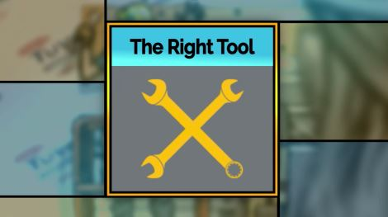
Right Tool Situation (Video)
Situation
Notes:
VIDEO WILL START AUTOMATICALLY
ADVANCE SLIDE

Slide 89
Right Tool
Discussion Questions: Situation
What are your thoughts about how Felicia handled this situation?
Was Eric demonstrating safety leadership? Why or why not?
Notes:
Reveal the discussion questions and/or use the facilitation table to go through skills.
By taking her responsibility as foreman and co-owner of AMB to make sure her workers are as safe as possible, Felicia is leading by example. Eric is not leading by example at all.
ADVANCE SLIDE

Slide 90
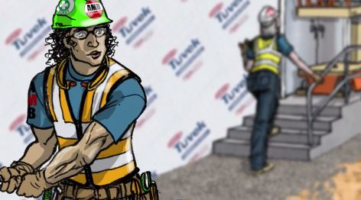
Right Tool Outcome A (Video)
Outcome A
Notes:
VIDEO WILL START AUTOMATICALLY
ADVANCE SLIDE

Slide 91
Right Tool
Discussion Questions: Outcome A
What safety leadership skills might Tyler use to help Eric, his foreman?
How likely is it that a trainee/apprentice would approach his foreman when s/he observes an unsafe situation or practice? What can the foreman do to encourage it?
Notes:
Reveal the discussion questions and/or use the facilitation table to go through skills.
ADVANCE SLIDE

Slide 92
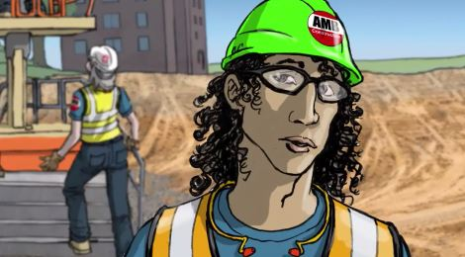
Right Tool Outcome B (Video)
Outcome B
Notes:
VIDEO WILL START AUTOMATICALLY
ADVANCE SLIDE

Slide 93
Right Tool
Discussion Questions: Outcome B
What are your thoughts on how Tyler handled the situation? Was he demonstrating safety leadership?
What about Eric’s response to Tyler?
What leadership skills did Felicia demonstrate in this ending?
Notes:
Reveal the discussion questions and/or use the facilitation table to go through skills.
Tyler is leading by example by taking the initiative and finding a way to have Eric practice a safer behavior without confronting him directly. Eric is not leading by example at all.
Felicia recognizes Tyler by thanking him for going above and beyond by getting the right tool for Eric to use. She also makes sure to ask him whether or not he’s comfortable with public praise, which he isn’t. She is again leading by example by telling Tyler she will speak with Eric later about how he needs to be a safety leader and lead by example.
CLICK SCENARIO MENU ICON TO RETURN TO MAIN MENU

Slide 94

Right Tool
Situation – Key Points
Felicia sees Eric using an open ended wrench rather than a safer tool to tighten bolts on a ledger board.
She tells Eric he needs to find and to use the right tool to finish the job.
Eric looks in the gang box, doesn’t find a ratchet or box wrench, so he decides to continue using the open-ended wrench.
Notes:
Refer students to page 22 in the student guide
Ask students to read the situation for “The Right Tool…” (or instructor reads it aloud).
ADVANCE SLIDE

Slide 95
Right Tool
Discussion Questions: Situation
What are your thoughts about how Felicia handled this situation?
Was Eric demonstrating safety leadership? Why or why not?
Notes:
Reveal the discussion questions and/or use the facilitation table to go through skills.
By taking her responsibility as foreman and co-owner of AMB to make sure her workers are as safe as possible, Felicia is leading by example. Eric is not leading by example at all.
ADVANCE SLIDE

Slide 96
Right Tool
Outcome A – Key Points
Tyler overhears Felicia speaking with Eric about using the right and safety tool for the job he’s doing
Tyler mutters to himself that Eric always talks about working safely but it looks like he doesn’t really mean it
Notes:
Ask students to read the outcome A for “The Right Tool…” (or instructor reads it aloud).
ADVANCE SLIDE

Slide 97
Right Tool
Reveal the Discussion Questions Outcome A
Right Tool
Discussion Questions: Outcome A
What safety leadership skills might Tyler use to help Eric, his foreman?
How likely is it that a trainee/apprentice would approach his foreman when s/he observes an unsafe situation or practice? What can the foreman do to encourage it?
Notes:
Reveal the discussion questions and/or use the facilitation table to go through skills.
ADVANCE SLIDE

Slide 98
Right Tool
Outcome B – Key Points
Tyler finds ratchet for Eric to use.
Felicia notices the interaction and later thanks Tyler for his extra effort, and asks if she can mention it at the next safety huddle.
Tyler doesn’t want to be singled out, but is glad to know she appreciates his actions to make Eric safer.
Felicia tells Tyler she will speak with Eric about the importance of leading by example.
Notes:
Ask students to read the outcome B for “The Right Tool…” (or instructor reads it aloud).
ADVANCE SLIDE

Slide 99
Right Tool
Reveal the Discussion Questions Outcome B
Right Tool
Discussion Questions: Outcome B
What are your thoughts on how Tyler handled the situation? Was he demonstrating safety leadership?
What about Eric’s response to Tyler?
What leadership skills did Felicia demonstrate in this ending?
Notes:
Reveal the discussion questions and/or use the facilitation table to go through skills.
Tyler is leading by example by taking the initiative and finding a way to have Eric practice a safer behavior without confronting him directly. Eric is not leading by example at all.
Felicia recognizes Tyler by thanking him for going above and beyond by getting the right tool for Eric to use. She also makes sure to ask him whether or not he’s comfortable with public praise, which he isn’t.
She is again leading by example by telling Tyler she will speak with Eric later about how he needs to be a safety leader and lead by example.
CLICK SCENARIO MENU ICON TO RETURN TO MAIN MENU

Slide 100

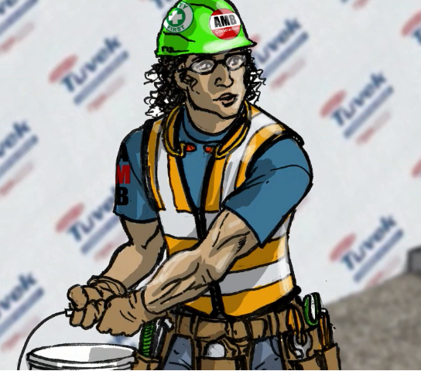
Right Tool Situation
Tyler
Situation
Tyler, a trainee, overhears the conversation between Felicia and Eric and notices that Eric continues to use the wrench.
Notes:
For the role play activity, we’ll first watch the scenario situation together. Then, in groups of 2, each person will take the role of one of the scenario characters and for 2 minutes play out the conversation the characters might have either not using or using leadership skills. After 2 minutes is up, we’ll come back together as a group to discuss how it went.
VIDEO WILL START AUTOMATICALLY
ADVANCE SLIDE

Slide 101
Right Tool
Outcome
Using the leadership skill Leading by Example, role play the situation assuming the roles of Tyler (the trainee who just witnessed the interaction) and Eric.
Discussion Questions
What did Tyler say and what was Eric’s response?
How likely is it that a trainee/apprentice would approach his foreman when s/he observes an unsafe situation or practice? What can the foreman do to encourage it?
Notes:
Divide students into groups of 2 and ask them to do a role-play as indicated on the slide using the leading by example leadership skill.
After 2 minutes reveal the discussion questions or use the facilitation table to go through skills.
Tyler is leading by example by taking the initiative and finding a way to have Eric practice a safer behavior without confronting him directly. Eric says thank you to Tyler, but he really isn’t leading by example.
CLICK SCENARIO MENU ICON TO RETURN TO MAIN MENU

Slide 102




Do We Have To? Falls and Struck by
Who | Role
Floyd | Painting Perfection Foreman
Ed | Painting Perfection Experienced Worker
Tom | Painting Perfection Trainee/apprentice
Tina | Painting Perfection Trainee/apprentice
6
Notes:
The key safety leadership moment in “Do we have to” is how a safety leader needs to pay attention to what team members say and how best to effectively react.
The major safety hazards in this scenario are falls and struck by.
INSTRUCTOR INFORMATION - It is designed to illustrate the following safety leadership skills:
Leading by example
Actively listening and practicing 3 way communication
Developing team members through teaching, coaching, and feedback
Recognizing team members for a job well done
CLICK ON DESIRED TEACHING MODE…

Slide 103

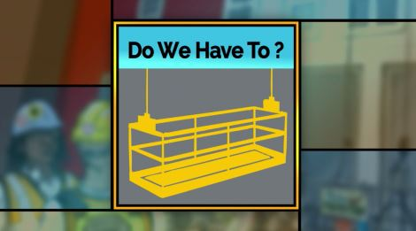
Do We Have To Situation (Video)
Situation
Notes:
VIDEO WILL START AUTOMATICALLY
ADVANCE SLIDE

Slide 104
Do We Have To?
Discussion Questions: Situation
Keeping in mind the five leadership skills, what do you think Floyd should do?
Notes:
Reveal the discussion questions and/or use the facilitation table to go through skills.
ADVANCE SLIDE

Slide 105
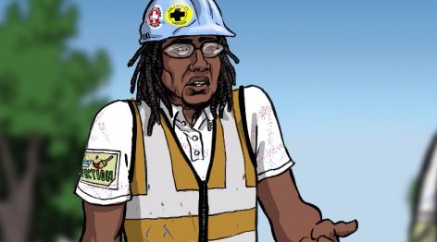
Do We Have to? Outcome A (Video)
Outcome A
Notes:
VIDEO WILL START AUTOMATICALLY
ADVANCE SLIDE

Slide 106
Do We Have To
Discussion Questions: Outcome A
What are your thoughts on how Floyd handled this situation?
Which safety leadership skills did or did he not demonstrate?
What message is Floyd sending to Ed, Tina and Tom about the value of safety?
Notes:
Reveal the discussion questions and/or use the facilitation table to go through skills.
Floyd showed a minimal level of leadership by asking Ed about the rigging. However, rather than actively listening to what he and Tom said about checking the rigging, he simply went along with their plea to not have to go up on the roof and check it.
ADVANCE SLIDE

Slide 107
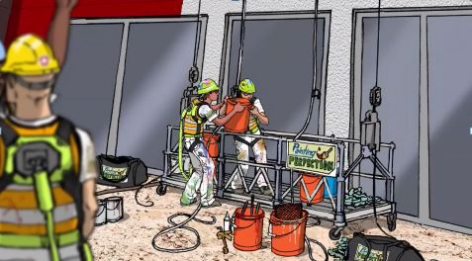
Do We Have To Outcome B (Video)
Outcome B
Notes:
VIDEO WILL START AUTOMATICALLY
ADVANCE SLIDE

Slide 108
Do We Have To?
Discussion Questions: Outcome B
What do you think of the way Floyd handled the situation this time?
Which of the leadership skills did he demonstrate?
Notes:
Reveal the discussion questions and/or use the facilitation table to go through skills.
The first leadership skill Floyd demonstrated was that he actively listened to how Ed and Tom responded and sensed that they might not actually know how to check the rigging. Then, rather than demanding they go up and check it themselves, he led by example by offering to go check it with them. Floyd was able to develop all 3 workers by using his teaching and coaching skills. He asks them to reiterate what he tells them which demonstrates his three-way communication skills. Lastly, he demonstrates his ability to give positive feedback by telling them how glad he is that they admitted not knowing about rigging and recognizes them for being good team members and valued workers.
CLICK SCENARIO MENU ICON TO RETURN TO MAIN MENU

Slide 109

Do We Have To?
Situation – Key Points
Ed and his crew, Tina and Tom who are both trainees are loading materials into a suspended scaffold.
Floyd asks Ed if they’ve inspected the rigging.
Ed snaps back that they checked in the morning and it’s probably 120 degrees on the roof!
Notes:
Refer students to page 23 in the student guide
Read/have the students read the situation (or instructor reads it aloud).
ADVANCE SLIDE

Slide 110
Do We Have To?
Discussion Questions: Situation
Keeping in mind the five leadership skills, what do you think Floyd should do?
Notes:
Reveal the discussion questions and/or use the facilitation table to go through skills.
ADVANCE SLIDE

Slide 111
Do We Have To?
Outcome A – Key Points
Floyd shrugs saying that one check is probably ok.
Ed and his crew hurries to load their materials and finish work to finish early.
At 4 feet off the ground, the rigging gives way and the scaffold tips taking the crew and materials with it.
No one was hurt, but it will cost the company time and money.
Notes:
Ask students to read outcome A for “Do we have to” (or instructor reads it aloud).
ADVANCE SLIDE

Slide 112
Do We Have To?
Reveal Discussion Questions Outcome A
Do We Have To?
Discussion Questions: Outcome A
What are your thoughts on how Floyd handled this situation?
Which safety leadership skills did or did he not demonstrate?
What message is Floyd sending to Ed, Tina and Tom about the value of safety?
Notes:
Reveal the discussion questions and/or use the facilitation table to go through skills.
Floyd showed a minimal level of leadership by asking Ed about the rigging. However, rather than actively listening to what he and Tom said about checking the rigging, he simply went along with their plea to not have to go up on the roof and check it.
ADVANCE SLIDE

Slide 113
Do We Have To?
Outcome B – Key Points
Floyd wonders if Ed and his crew understand safe rigging procedures.
Floyd insists all 3 of them go to the roof to check the rigging. Once there, they tell Floyd that they actually don’t know the correct procedures.
Floyd thanks Ed for being honest and telling him.
He tells them how to do it and has them demonstrate.
Notes:
Ask students to read outcome B for “Do we have to” (or instructor reads it aloud).
ADVANCE SLIDE

Slide 114
Do We Have To?
Reveal Discussion Questions Outcome B
Do We Have To?
Discussion Questions: Outcome B
What do you think of the way Floyd handled the situation this time?
Which of the leadership skills did he demonstrate?
Notes:
Reveal the discussion questions and/or use the facilitation table to go through skills.
The first leadership skill Floyd demonstrated was that he actively listened to how Ed and Tom responded and sensed that they might not actually know how to check the rigging. Then, rather than demanding they go up and check it themselves, he led by example by offering to go check it with them. Floyd was able to develop all 3 workers by using his teaching and coaching skills. He asks them to reiterate what he tells them which demonstrates his three-way communication skills. Lastly, he demonstrates his ability to give positive feedback by telling them how glad he is that they admitted not knowing about rigging and recognizes them for being good team members and valued workers.
CLICK SCENARIO MENU ICON

Slide 115

Do We Have To? Situation
Situation
Notes:
For the role play activity, we’ll first watch the scenario situation together. Then, in groups of 2, each person will take the role of one of the scenario characters and for 2 minutes play out the conversation the characters might have either not using or using leadership skills. After 2 minutes is up, we’ll come back together as a group to discuss how it went.
VIDEO WILL START AUTOMATICALLY
ADVANCE SLIDE

Slide 116
Do We Have To?
Outcome A
Role play the conversation between Floyd and Ed without using any of the leadership skills. DO NOT use any of the 5 leadership skills.
Discussion Questions for Outcome A
Floyd, what did you say to Ed?
2. Ed, what was your response?
Notes:
Divide students into groups of 2 and ask them to do a role-play as indicated on the slide using none of the leadership skills.
After 2 minutes, reveal the discussion questions or use the facilitation table to go through skills.
Floyd showed a minimal level of leadership by asking Ed and Tom about the rigging. However, rather than actively listening to what they said and how they said it he simply went along with their plea to not have to go up on the roof and check the rigging.
ADVANCE SLIDE

Slide 117
Do We Have To?
Outcome B
This time, role play the conversation between Floyd and Ed where Floyd applies his leadership skills including Leading by example, actively listening and practicing 3 way communication, developing his team members through teaching, coaching, and feedback, and recognizing them for a job well done.
Discussion Questions for Outcome B
Which of the leadership skills did Floyd use?
What was Ed’s response to Floyd’s approach?
Notes:
Now have the students redo conversation between Floyd and Ed using the following leadership skills:
Leading by example
Actively listening and practicing 3-way communication
Developing his team members through teaching, coaching and feedback
Recognizing them for a job well done
After 2 minutes, reveal the discussion questions or use the facilitation table to go through skills.
The first leadership skill Floyd demonstrated was that he actively listened to how Ed and Tom responded and sensed that they might not actually know how to check the rigging. Then, rather than demanding they go up and check it themselves, he led by example by offering to go check it with them. Floyd was able to develop all 3 workers by using his teaching and coaching skills. He asks them to reiterate what he tells them which demonstrates his three-way communication skills. Lastly, he demonstrates his ability to give positive feedback by telling them how glad he is that they admitted not knowing about rigging and recognizes them for being good team members and valued workers.
CLICK SCENARIO MENU ICON TO RETURN TO MAIN MENU

Slide 118

Fritz’s Shortcut Struck By and Caught in-Between
Who | Role
Fritz | Mighty Mechanical Foreman
Elliot | Mighty Mechanical Experienced Worker
7
Notes:
The key safety leadership moment in ‘Fritz Takes a Shortcut’ is how a leader handles a near miss incident created because he made a decision to put productivity before safety.
The major safety hazards in this scenario are struck by and caught in-between.
INSTRUCTOR INFORMATION - This scenario is designed to illustrate the following safety leadership skills:
Leading by example
Engaging team members
Actively listening
Recognizing team members for a job well done
CLICK ON DESIRED TEACHING MODE…

Slide 119

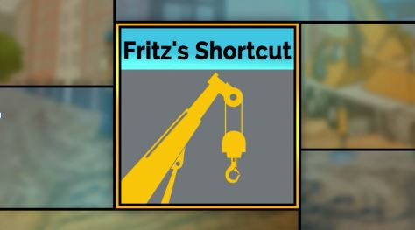
Frit’s Shortcut Situation (Video)
Situation
Notes:
VIDEO WILL START AUTOMATICALLY
ADVANCE SLIDE

Slide 120
Fritz’s Shortcut
Discussion Questions: Situation
How often have you felt pressured to get a job done at the cost of safety? What did you do?
Keeping in mind the 5 leadership skills, what do you think Fritz should do next?
Notes:
Reveal the discussion questions and/or use the facilitation table to go through skills.
ADVANCE SLIDE

Slide 121
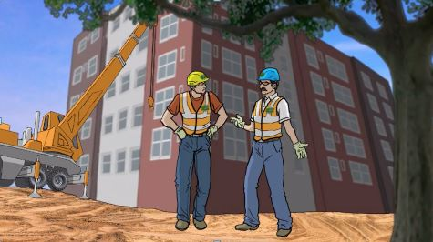
Fritz’s Shortcut Outcome A
Outcome A
Notes:
VIDEO WILL START AUTOMATICALLY
ADVANCE SLIDE

Slide 122
Fritz’s Shortcut
Discussion Questions: Outcome A
What do you think about how Fritz handled this situation? What are some possible safety outcomes?
What do you think Elliot should do?
Notes:
Reveal the discussion questions and/or use the facilitation table to go through skills.
Fritz is displaying very poor leadership skills. He is definitely NOT leading by example. He is NOT actively listening to Elliot, nor is he engaging and empowering him to identify and report hazards and unsafe situations.
ADVANCE SLIDE

Slide 123
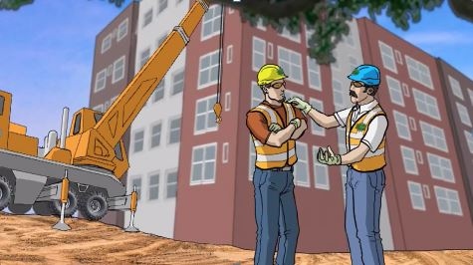
Fritz’s Shortcut Outcome B
Outcome B
Notes:
VIDEO WILL START AUTOMATICALLY
ADVANCE SLIDE

Slide 124
Fritz’s Shortcut
Discussion Questions: Outcome B
How did Fritz do this time?
Describe how the two endings differ in terms of demonstrating the leadership skills.
Notes:
Reveal the discussion questions and/or use the facilitation table to go through skills.
In outcome B, Fritz leads by example by letting his guard down and sharing with his crew that he too can be negatively influenced by pride and ego, which can cause him to make poor safety-related decisions.
ASK CLASS:
THINKING ABOUT THE SAFETY LEADER DEFINITION WHAT IS FRITZ DISPLAYING HERE? (courage)
He recognizes Elliot for identifying and trying to prevent an unsafe situation. He then engages his team by initiating a daily safety huddle and empowers them by creating the expectation that everyone is to report hazardous conditions and near misses. Fritz promises that in the future he will actively listen to their ideas and feedback.
CLICK SCENARIO MENU ICON TO RETURN TO MAIN MENU

Slide 125

Fritz’s Shortcut
Situation – Key Points
Eliot, an experienced worker, sees that the rigging equipment needed to lift the HVAC units to the roof is damaged and tells Fritz, his foreman.
Fritz tells Eliot to go with what they have because they need to keep on-schedule.
Eliot tells Fritz he’s not comfortable with it, but Fritz tells him to do as he says.
The rigging equipment fails, and the HVAC unit falls nearly crushing a worker.
Notes:
Refer students to page 24 in the student guide
Read/Have students read the situation in the “Fritz takes a shortcut” script (or instructor reads out loud).
ADVANCE SLIDE

Slide 126
Fritz’s Shortcut
Discussion Questions: Situation
How often have you felt pressured to get a job done at the cost of safety? What did you do?
Keeping in mind the 5 leadership skills, what do you think Fritz should do next?
Notes:
Reveal the discussion questions and/or use the facilitation table to go through skills.
ADVANCE SLIDE

Slide 127
Fritz’s Shortcut
Outcome A – Key Points
Later, Fritz tells Elliot not to mention to anyone the damaged rigging equipment and his decision to use it.
Elliot is angry about Fritz’s request, but he wants to keep his job.
Notes:
Read/have students read outcome A in “Fritz takes a shortcut” script (or instructor reads out loud).
ADVANCE SLIDE

Slide 128
Fritz’s Shortcut
Reveal the Discussion Questions Outcome A
Fritz’s Shortcut
Discussion Questions: Outcome A
What do you think of the way Fritz handled this situation?
What do you think Elliot should do?
Notes:
Reveal the discussion questions and/or use the facilitation table to go through skills.
Fritz is displaying very poor leadership skills. He is definitely NOT leading by example. He is NOT actively listening to Elliot, nor is he engaging and empowering him to identify and report hazards and unsafe situations.
ADVANCE SLIDE

Slide 129
Fritz’s Shortcut
Outcome B – Key Points
Fritz tells Eliot he was right to question his decision
Fritz calls a safety stand down, and explains …
  They will have daily safety huddles to discuss the day’s tasks.
  From now on he will ask questions and listen to crew members have to say.
  He expects his crew to always report any unsafe situations or hazards.
Notes:
Read/have students read outcome B in “Fritz takes a shortcut” script (or instructor reads out loud).
ADVANCE SLIDE

Slide 130
Fritz’s Shortcut
Reveal Discussion Questions Outcome B
Fritz’s Shortcut
Discussion Questions: Outcome B
How did Fritz do this time?
Describe how the two endings are different in terms of demonstrating specific leadership skills.
Notes:
Reveal the discussion questions and/or use the facilitation table to go through skills.
In outcome B, Fritz leads by example by letting his guard down and sharing with his crew that he too can be negatively influenced by pride and ego, which can cause him to make poor safety-related decisions.
ASK CLASS:
THINKING ABOUT THE SAFETY LEADER DEFINITION WE LEARNED, WHAT IS FRITZ DISPLAYING HERE? (courage)
He recognizes Elliot for identifying and trying to prevent an unsafe situation. He then engages his team by initiating a daily safety huddle and empowers them by creating the expectation that everyone is to report hazardous conditions and near misses. Fritz promises that in the future he will actively listen to their ideas and feedback.
CLICK SCENARIO MENU ICON TO RETURN TO MAIN MENU

Slide 131

Fritz’s Shortcut Situation
Situation
Notes:
For the role play activity, we’ll first watch the scenario situation together. Then, in groups of 2, each person will take the role of one of the scenario characters and for 2 minutes play out the conversation the characters might have either not using or using leadership skills. After 2 minutes is up, we’ll come back together as a group to discuss how it went.
VIDEO WILL START AUTOMATICALLY
ADVANCE SLIDE

Slide 132
Fritz’s Shortcut
Outcome A
Role play a conversation between Fritz and Elliot that might take place after the incident. DO NOT use any of the 5 leadership skills.
Discussion Questions for Outcome A
What did Fritz say to Elliot?
How did Elliot respond?
What, if anything, do you think Elliot should do?
Notes:
Divide students into groups of 2 and ask them to do a role-play as indicated on the slide using none of the leadership skills.
After 2 minutes, reveal the discussion questions or use the facilitation table to go through skills.
Fritz is displaying very poor leadership skills. He is definitely NOT leading by example. He is NOT actively listening to Elliot, nor is he engaging and empowering him to identify and report hazards and unsafe situations.
ADVANCE SLIDE

Slide 133
Fritz’s Shortcut
Outcome B
This time, have one person role play Fritz leading by example and actively listening to Elliot and the other person demonstrating how Elliot would respond.
Discussion Questions for Outcome B
What did Fritz say to Elliot this time?
Did Elliot respond or feel differently about the situation this time ?
Notes:
Now have the students redo conversation between Fritz and Elliot using the following safety leadership skills:
Leading by example
Actively listening
After 2 minutes, reveal the discussion questions or use the facilitation table to go through skills.
In outcome B, Fritz leads by example by letting his guard down and sharing with Eric that he too can be negatively influenced by pride and ego, which can cause him to make poor safety-related decisions.
Fritz promises that in the future he will actively listen to Eric’s ideas and feedback.
ASK CLASS:
THINKING ABOUT THE SAFETY LEADER DEFINITION WE LEARNED, WHAT IS FRITZ DISPLAYING HERE? (courage)
CLICK SCENARIO MENU ICON TO RETURN TO MAIN MENU

Slide 134
Takeaways
It takes COURAGE to be a leader
It takes COURAGE to speak up
These skills can easily be inserted into the daily workflow and productivity will not be effected.
Leaders…
  Lead by example
  Engage and empower team member
  Actively listen and Practice 3-way communication
  Develop team members by teaching, coaching, and knowing how to give constructive feedback
  Recognize team members
Leaders improve SAFETY CLIMATE AND SAFETY OUTCOMES
Notes:
We’ve come to the end of the FSL course and we’ve covered a lot.
Before we uncover the take away messages, tell me one or two things you learned today, or even better, something you’re going to start doing right away (or stop doing) when you get back to the jobsite.
So, here’s are the key points I hope you will take away with you and put into practice on the jobsite:
It takes COURAGE to be a leader.
It takes COURAGE to speak up.
These skills can easily be inserted into the daily workflow and productivity will not be affected.
Leaders…
Lead by Example
Engage and Empower team members
Actively listen and Practice 3-way communication
Develop team members by teaching, coaching, and knowing how to give constructive feedback
Recognize team members for going above and beyond for safety
And finally, if you use these skills on the jobsite and become a true safety leader, you can improve both jobsite SAFETY CLIMATE and SAFETY OUTCOMES.
ADVANCE SLIDE

Slide 135




This module is a collaboration between
(c) 2015, CPWR - The Center for Construction Research and Training. All rights reserved. These materials are made available free of charge by CPWR. No content can be modified without CPWR's approval. CPWR is the research and training arm of North America's Building Trades Unions and serves the construction industry and its workers. (www.cpwr.com).
Production of this training program was supported by NIOSH cooperative agreement OH009762. The contents are solely the responsibility of the authors and do not necessarily represent the official views of NIOSH.
Notes:
This training was developed collaboratively by these organizations.

