Slide 1
ONLINE OUTREACH TRAINER PORTAL
https://outreach.csudhosha.com

Slide 2
Step 1: Register Yourself
Portal via CSUDH Website: https://csudh.edu/osha/trainers
Portal Direct Access: https://outreach.csudhosha.com
Trainer card is required to complete this process

Slide 3
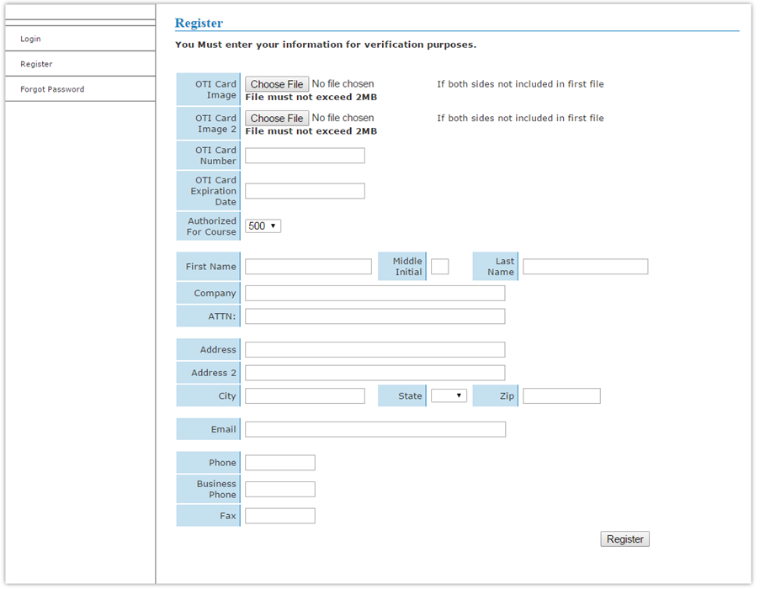
Step 2: Register Yourself
Trainers will need to have a copy of their Trainer card saved to their computer or sharing device to upload and attach a copy to the registration form

Slide 4
Registration Process
Your registration will be reviewed to assure your OTI card number and expiration date are entered correctly.
Once your registration has been approved you will receive an email from noreply@csudhosha.com with your NEW CSUDH Trainer ID # and password.
ALL TRAINERS WILL RECEIVE A NEW TRAINER ID AND PASSWORD

Slide 5
Begin Requesting Cards
Once you receive your Trainer ID & Password email, you can submit a 10 or 30 Hr. card request by logging onto your trainer account.

Slide 6
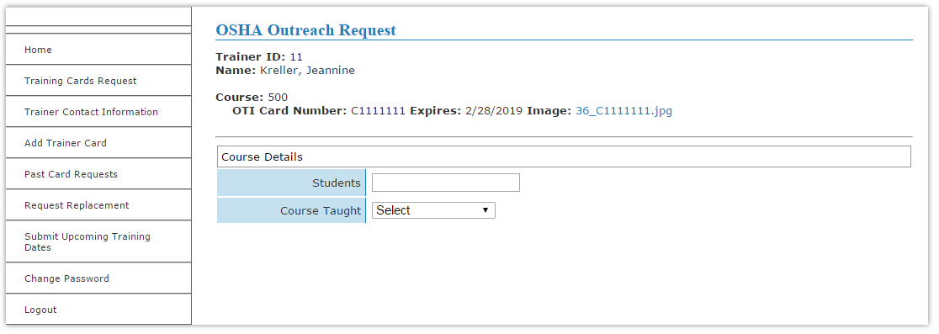
Submitting a Trainer Card Request
From the column on the left side of the screen: Select Training Card Request

Slide 7
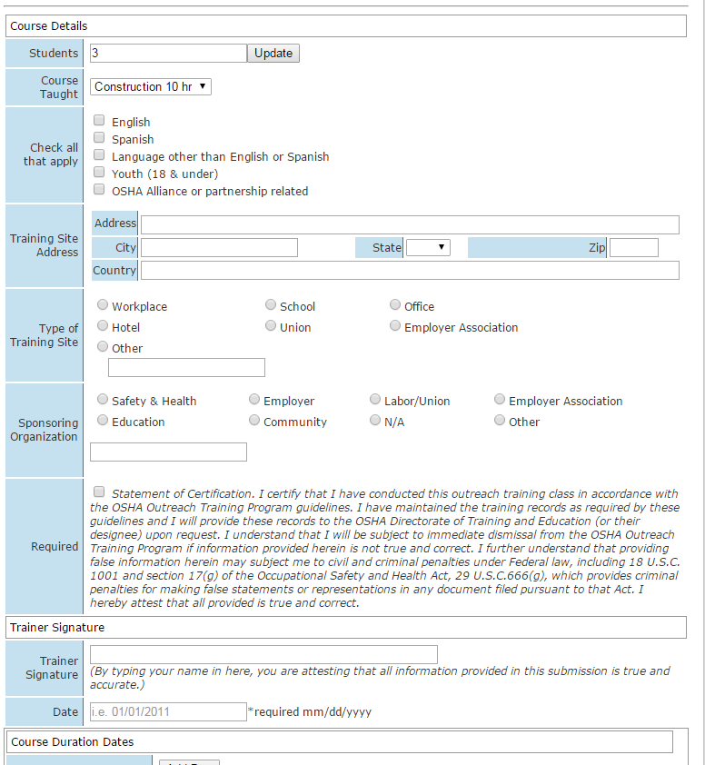
Completing Outreach Training Report
System will make note of errors
Trainer may be locked out if incorrect information is entered
Start time and end time must account for breaks and lunch

Slide 8
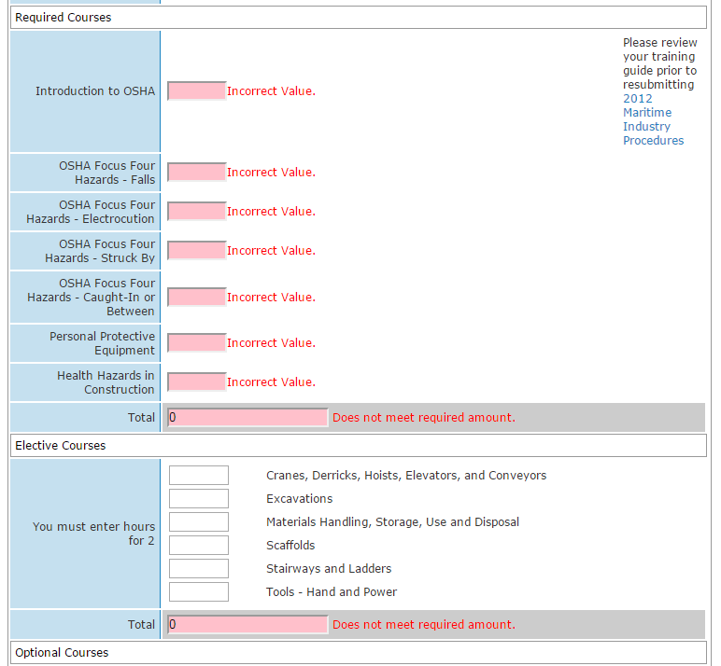
Incomplete OR Incorrect Submission

Slide 9
Incomplete OR Incorrect Submission
If outreach program report form was incomplete or incorrect – the page will prompt you with a:
Scroll down the form to review highlighted areas that are incorrect
Anything submitted incorrectly will be highlighted in RED!!!
Correct the information and resubmit

Slide 10
What causes me to get locked out of the system?
Typical errors made when submitting training:
Not checking the statement of certification box
Not entering Trainer name on signature line
Dates of training in the future
all training must be submitted AFTER training has been completed
Incorrect times on topics
Incomplete topics selected
Did NOT meet minimum requirements for topics and times
Did NOT total 10 or 30 hours as required for training
Exceeded maximum time allowed per topic in a 10 or 30 hours

Slide 11
Things to Consider…
System will automatically lockout after 20 minutes
Entering incorrect information will be noted as a type 2 discrepancy and may generate an audit request
Making multiple errors will prompt the system to lock-out
Lock-out will have to be cleared by calling (310) 243-2425

Slide 12
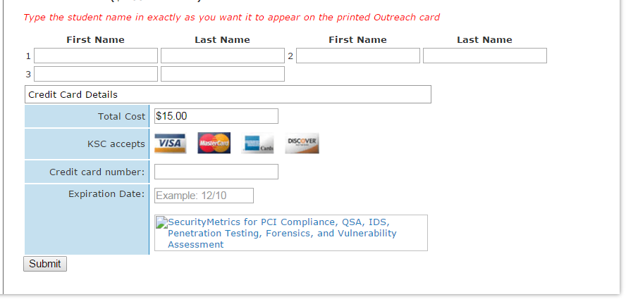
Making Payment: Cost
Each Outreach Card requested costs $8.00

Slide 13
Making Payment: Additional Info
Each Outreach Card requested costs $8.00
At the end of each Outreach Card request, trainers will be required to enter credit card information to pay for their cards
Credit Cards are processed via a secure PayPal portal
Trainers will be emailed a confirmation of submission and receipt
Duplicate card request: $25.00

Slide 14
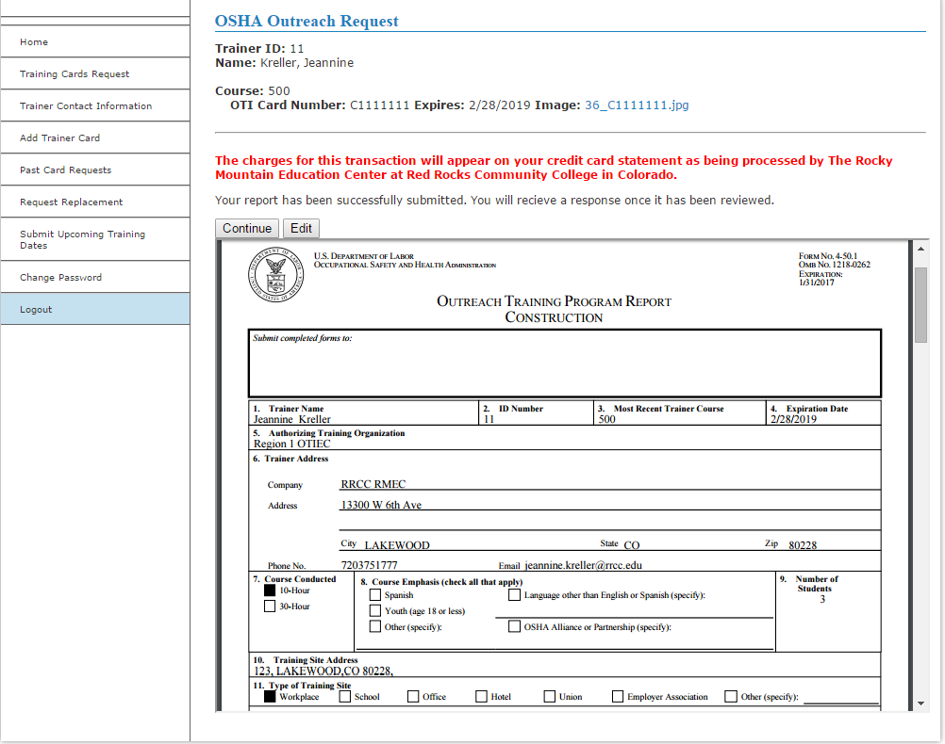
What Happens After Payment (Screen)

Slide 15
What Happens After Payment
If topics and times are complete and correct – an Outreach Program Report Form will be displayed and needs to be approved
Outreach Program Report Forms are required as part of your record keeping requirements. These forms are attached all course submission as a PDF under “past card requests”

Slide 16
How do I know if my card request went through?
Trainers will receive a prompt that says submission was successful and is pending processing
Trainer will receive an email with training information and charges processed
Trainer can also check to see if there is a pending request on their account under
Trainers may have to check their spam or junk mail
ALL correspondence from the Outreach Trainer Portal comes from a auto generated email account starting with noreply@ and should be received immediately

Slide 17
How long does it take to get my cards?
Cards are processed weekly
Trainers will receive an email when cards have been printed with card numbers issued to students
Typically, trainers receive their cards within 7 business days after processing
All Outreach cards are sent by the US Postal Service, first-class mail
Pre-printed cards will be sent to trainer with:
Student name
Trainer name
End date of training

Slide 18
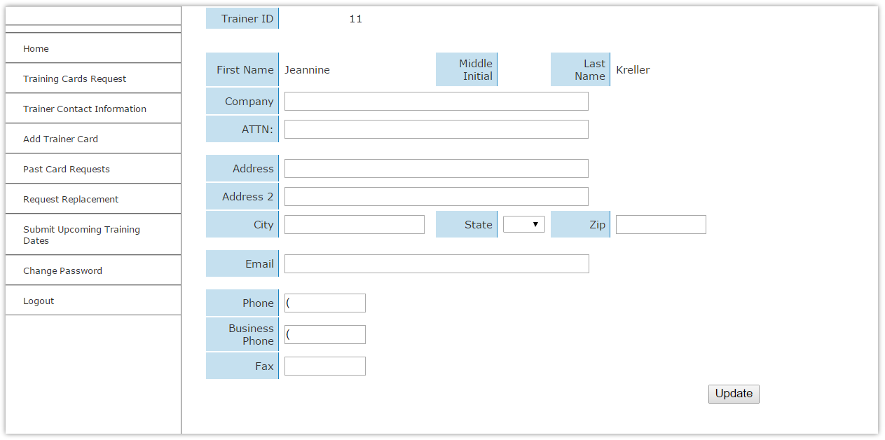
Update Trainer Account Information
Trainer Contact Information:
This is the address where your outreach cards will be mailed and how your OTIEC will contact you. Check to be sure your trainer information is current and make any necessary changes.

Slide 19
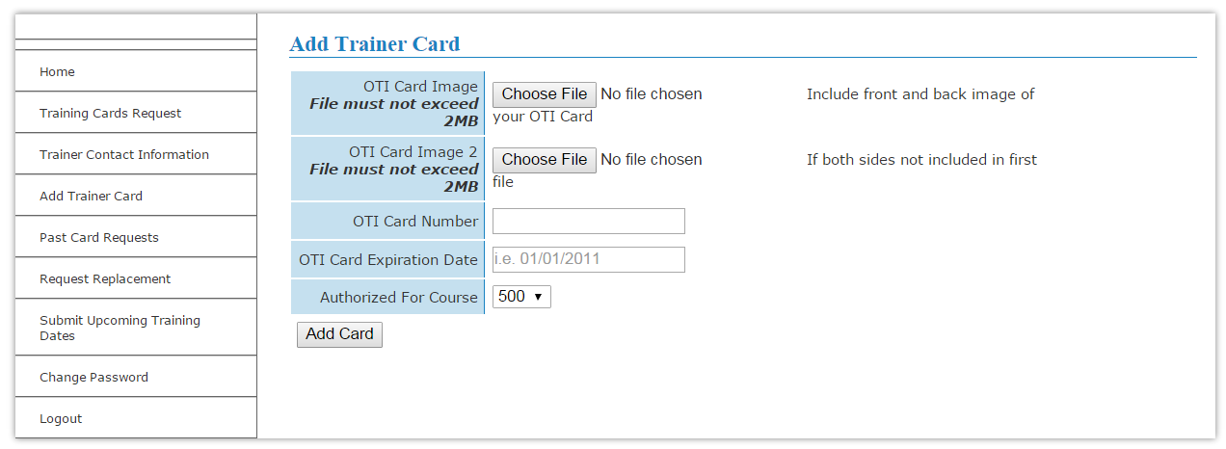
Update Trainer Authorization(s)
Add Multiple Trainer Authorizations or Update NEW Trainer Authorization after completing an update course Construction • General Industry • Maritime • ET&D

Slide 20
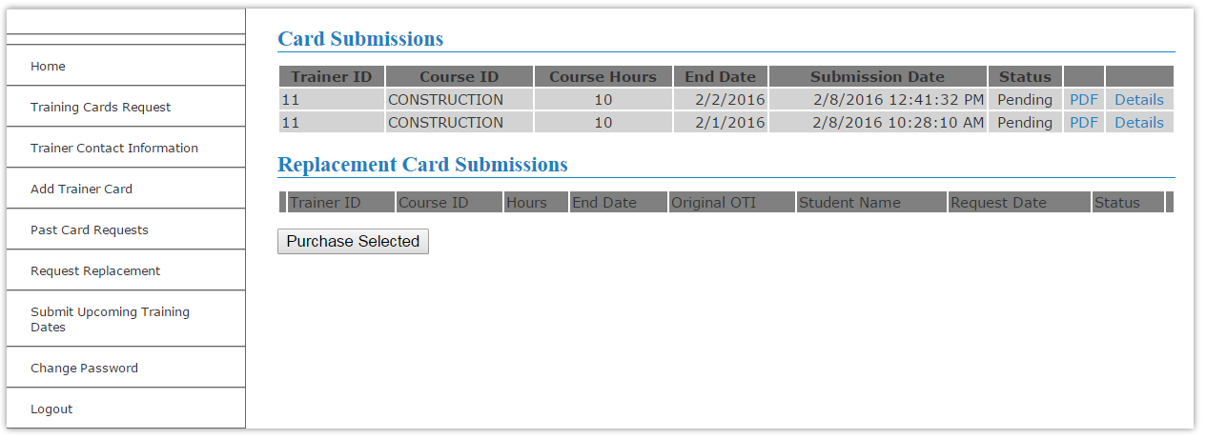
View Card Requests
View all card requests:
Processed
Replacements
Pending

Slide 21
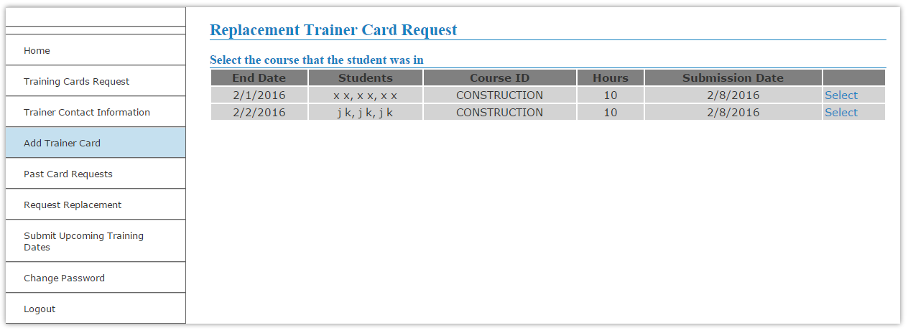
Request Replacement Cards
Replacement cards can be requested for cards issued within the last 3 years.
Replacement fee – $25

Slide 22
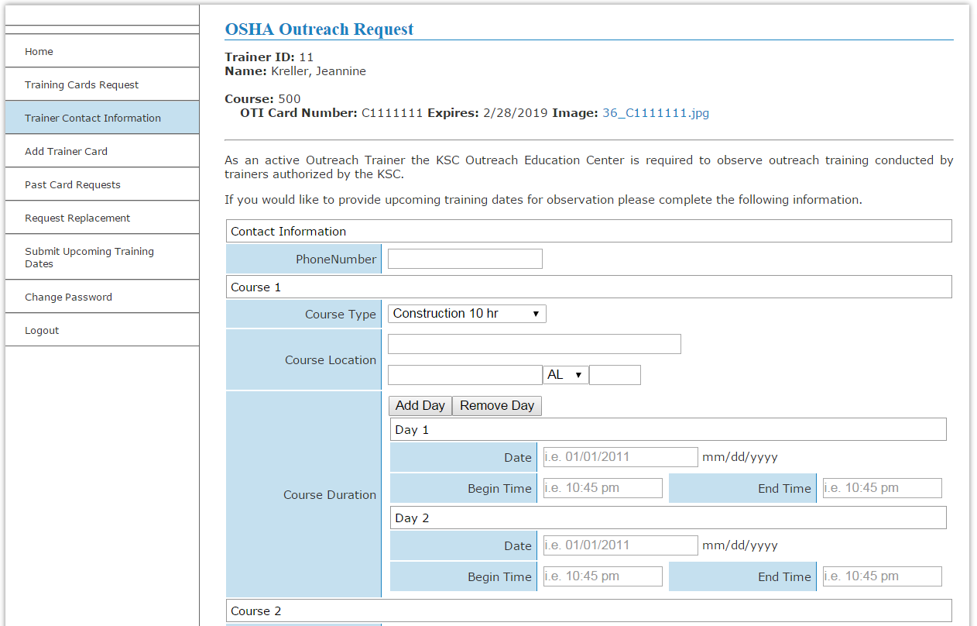
Submit Upcoming Dates of Training for Training Observation

Slide 23
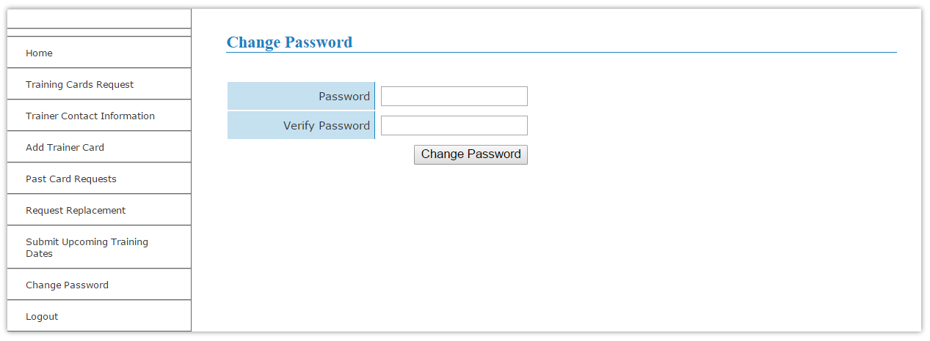
Change Password
The password emailed to trainers is computer generated and will need to be changed to something more familiar.

Slide 24
Have More Questions?
CSUDH OSHA Training Institute Education Center
osha@csudh.edu
📞 310.243.2425
www.csudh.edu/osha

