Slide 1
Academic Requirements Page
TUTORIAL
MyCSUDH

Slide 2
Visit www.csudh.edu and click on MyCSUDH

Slide 3
Enter your username and password when prompt

Slide 4
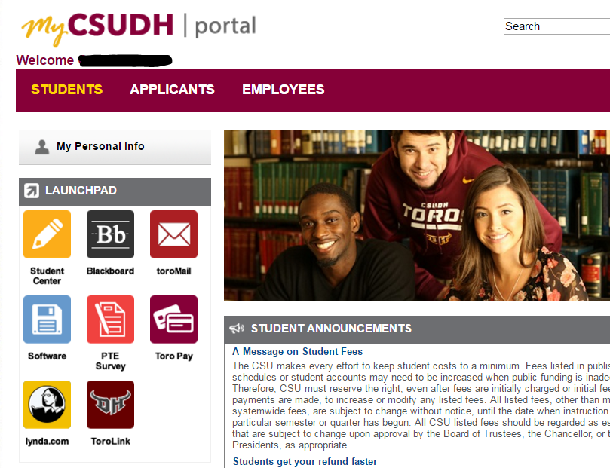
Click on Student Center

Slide 5
On the drop down menu under Other academic…select Academic Requirements.
Select Academic Requirements
Click here once you have selected your option

Slide 6
You will see something like this:

Slide 7
Scroll down to view your degree requirements:
NOTES
BSN students: you will see your General Education courses covering the required GE Area’s from your transfer coursework, such as, Political Science, History, Humanities, etc.
This page will tell you which courses meet certain requirements, such as, the upper division Humanities requirement. It will also list the required courses for BSN or MSN degree.
BSN/MSN: you will see whether your GWAR has been met or not.

